Slide 1
Airspace and Sunlight

Slide 2
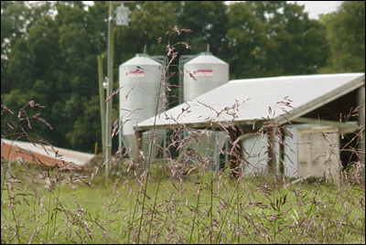
United States v. Causby
Similar Chicken Farm in North Carolina
Notes:
http://www.unc.edu/~acpike/chicken/gallery/g1.html

Slide 3
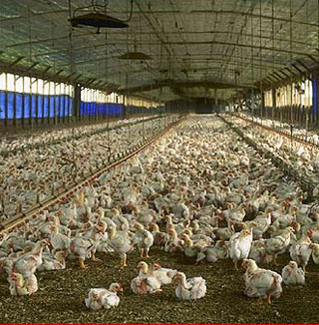
United States v. Causby
Chicken Farm
Notes:
http://www.newsinmotion.com/graphicstv/preview.htm?doc=KRT%2Fkrtnimgfx2%2Fdocs%2F003%2F337

Slide 4
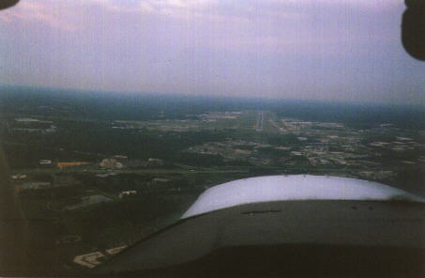
United States v. Causby
Landing at Greensboro, NC Airport
Notes:
http://www.unc.edu/~acpike/chicken/gallery/g1.html
See also http://www.flyfrompti.com/aboutpti_employeenews.asp

Slide 5
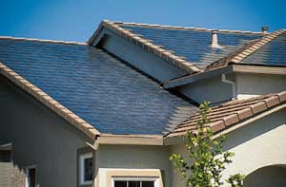
Prah v. Maretti
Similar Solar Panels

Slide 6
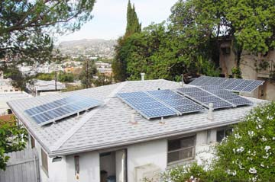
Prah v. Maretti
Similar Solar Panels

Slide 7
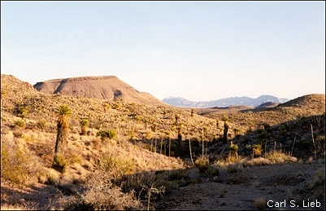
Southwest Weather Research Inc.
Similar Area of West Texas
Notes:
http://www.utep.edu/indio/indio1.jpg

Slide 8
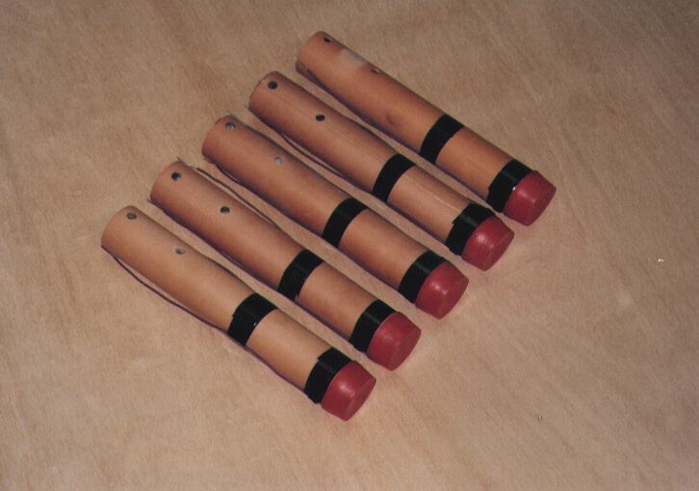
Southwest Weather Research Inc.
50 gram silver iodide cloud seeding flares.
Notes:
http://www.atmos-inc.com/pyroexpl.html

Slide 9
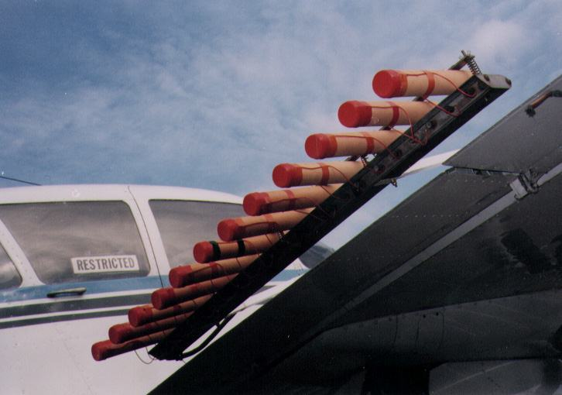
Southwest Weather Research Inc.
Flares mounted on a cloud seeding aircraft.
Notes:
http://www.atmos-inc.com/pyroexpl.html

Slide 10
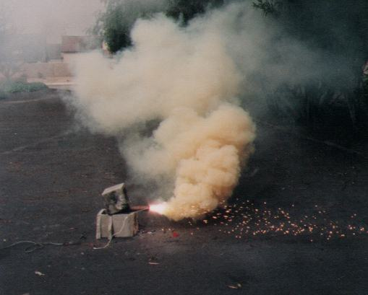
Southwest Weather Research Inc.
Test burning a cloud seeding device.
Notes:
http://www.atmos-inc.com/pyroexpl.html

