Slide 1
Groundwater
Percolating
Underground Stream

Slide 2
Ownership of Percolating Groundwater
1. Common Law Rule
Absolute Ownership Rule
English Rule
Rule of Capture
Can withdraw unlimited amount but cannot be malicious or wasteful.

Slide 3
Ownership of Percolating Groundwater
2. American Rule
Reasonable Use Rule

Slide 4
Ownership of Percolating Groundwater
3. Prior Appropriation

Slide 5
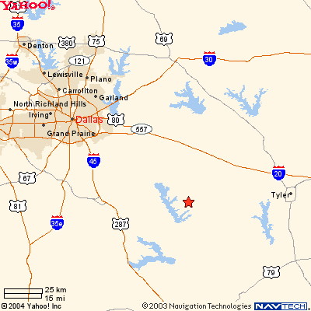
Sipriano v. Great Spring Waters of America

Slide 6
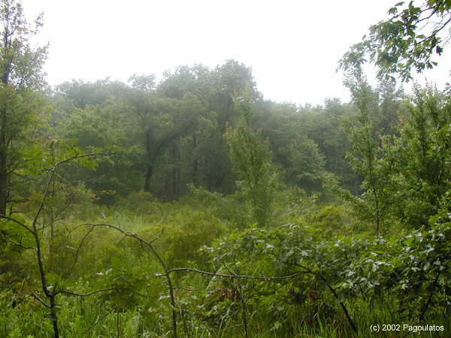
Sipriano v. Great Spring Waters of America
Notes:
http://www.carnivorousplantsoftexas.org/Photos/s21-Henderson/P1010090.jpg

