Slide 1
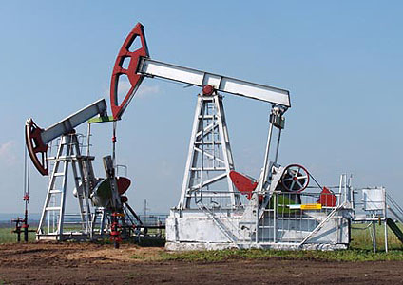
Oil & Gas

Slide 2
Ownership in Place
1. Not owned until extracted.

Slide 3
Ownership in Place
2. Ownership in Place
  Even though oil and gas could be lost if it flows beneath other land.

Slide 4
Ownership in Place
3. Owned by Government

Slide 5
Basic Process
Owner of property lacks financing.
Owner leases property to oil company (or grants easements with a profit).
  Bonus = Owner paid to enter into lease.
  Royalty = Percentage of what produced.
Government regulation to prevent abuses
  Well spacing regulations
  Well production regulations
  Slant drilling often prohibited

