Slide 1
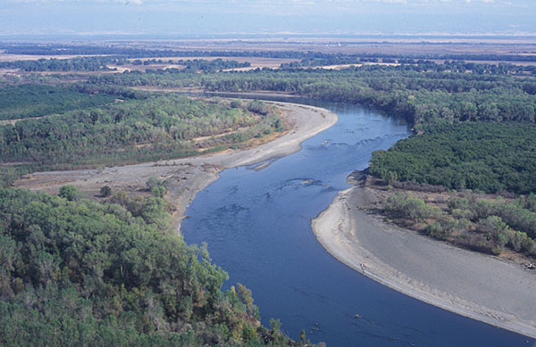
Water in Watercourses

Slide 2
Riparian Rights System
What is riparian land?
Land that is:
    Adjacent to a watercourse, and
    In the same watershed (drains into same watercourse).

Slide 3
Riparian Rights System
Rights of Non-Riparians
None!

Slide 4
Riparian Rights System
Absolute Rights of Riparians
  Unlimited, if no effect on flow
    No restriction on use of water

Slide 5
Riparian Rights System
Absolute Rights of Riparians
  Unlimited, if no effect on flow
  Domestic use, even if effect on flow

Slide 6
Water in Watercourses
[continued]

Slide 7
Riparian Rights System
Correlative Rights (non-domestic use) of Riparians
  Natural Flow – common law approach

Slide 8
Riparian Rights System
Correlative Rights of Riparians
  Natural Flow
  Reasonable Use – modern approach

Slide 9
Prior Appropriation System
Rights to water obtained by:
  Prior Use – traditional approach

Slide 10
Prior Appropriation System
Rights to water obtained by:
  Prior Use
  Permit from Government – modern approach

Slide 11
Prior Appropriation System
How fit with riparian system?
  Colorado Doctrine – abolish riparian rights

Slide 12
Prior Appropriation System
How fit with riparian system?
  Colorado Doctrine
  California Doctrine – riparian rights coexist with prior appropriation rights

Slide 13
Public Rights in Water
Navigable
Tidal
Commerce Clause of U.S. Constitution gives federal government servitude over all navigable waterways which is superior to private rights.

Slide 14
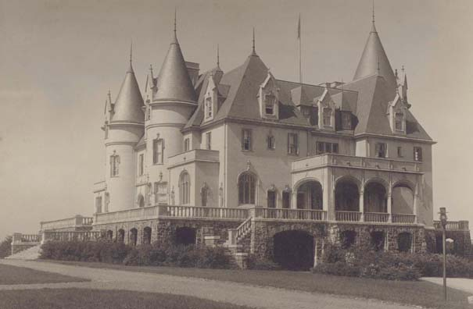
Stratton v. Mt. Herman Boy’s School
Mt. Herman Boy’s School – The Chateau
Notes:
http://www.nmhschool.org/history/archives/index.html

Slide 15
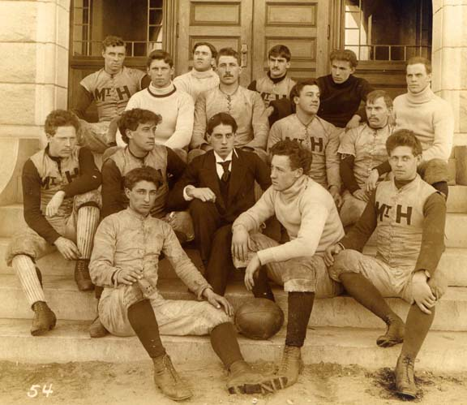
Stratton v. Mt. Herman Boy’s School
1894 Football Team
Notes:
http://www.nmhschool.org/history/archives/index.html

Slide 16
Changing Size of Riparian Land
Approaches:
  Source of Title

Slide 17
Changing Size of Riparian Land
Approaches:
  Source of Title
  Unity of Title

Slide 18
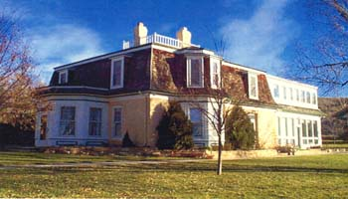
Coffin v. Left Hand Ditch
Coffin House – now a National Landmark
Notes:
http://www.ci.longmont.co.us/about/gallery/pages/Ranch_House.htm

Slide 19
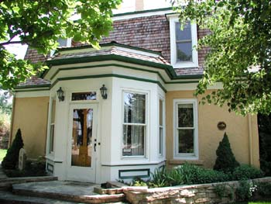
Coffin v. Left Hand Ditch
Coffin House – now a National Landmark
Notes:
http://www.ci.longmont.co.us/planning/ldc/landmarks/pgallery/pages/hwy119_0990.htm

Slide 20
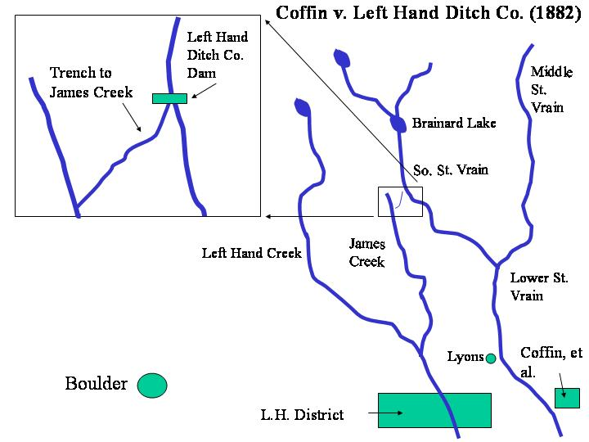
Coffin v. Left Hand Ditch
Defendant
tore down dam
Plaintiff
build dam
Notes:
From Prof. Jack Little of University of Denver

