Slide 1
Drainage of Surface Water

Slide 2
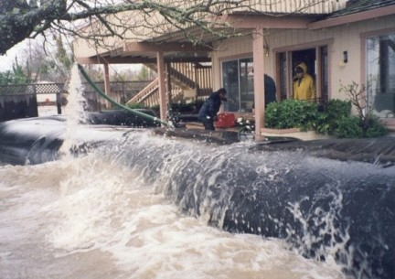
Drainage of Surface Water
Water which does not run in any well-defined channel.
Examples: Run off from rain and melting snow.

Slide 3
Retaining Surface Water
Rule of Capture
Does not matter on whose land water fell.

Slide 4
Getting Rid of Surface Water
1. Natural Servitude (Civil Law Rule) (Natural Flow)
Landowner’s right – water to flow away
Landowner’s duty – permit water to flow over
No alteration of natural contour allowed
But, some courts permit reasonable alterations.

Slide 5
Getting Rid of Surface Water
2. Common Enemy Rule
Landowner can take steps to remove water.
Landowner can take steps to prevent water from coming on to property.
Some courts have reasonable exception for artificial discharge.

Slide 6
Getting Rid of Surface Water
3. Reasonable Use Rule
Case-by-case approach.

Slide 7
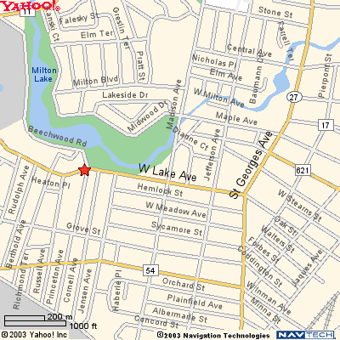
Armstrong v. Francis Corp.
Rahway, NJ
Notes:
ttp://www.njwma7.org/Media/Photo_Tour/Large/Robinsons_Branch.jpg

Slide 8
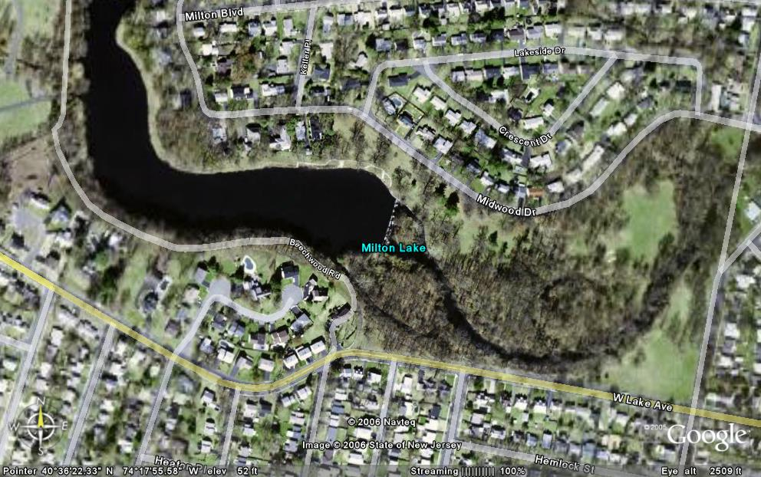
Armstrong v. Francis Corp.

Slide 9
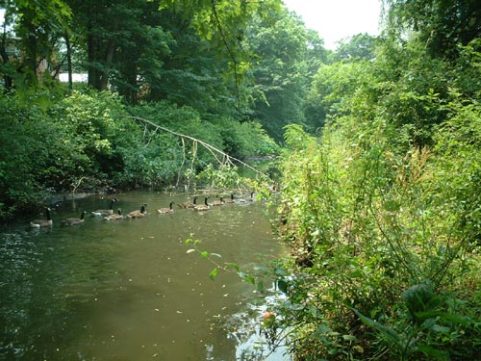
Armstrong v. Francis Corp.
Notes:
http://www.njwma7.org/Media/Photo_Tour/Large/Robinsons_Branch.jpg

Slide 10
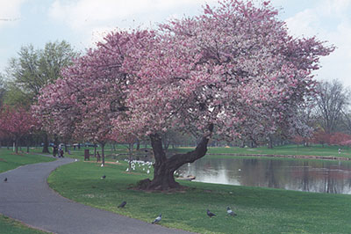
Armstrong v. Francis Corp.
Notes:
http://www.unioncountynj.org/svcsgov/parksrec/index.htm#reservations

