Slide 1
Nuisance

Slide 2
Nuisance -- Defined
Use of property which unreasonably interferes with the use and enjoyment of someone else’s property.

Slide 3
Nuisance compared to Trespass
Trespass
Protects possession
Requires physical intrusion
Does not require harm to land
Nuisance
Protects use and enjoyment
Physical intrusion not needed (but may exist)
Harm to land required

Slide 4
Nuisance – Key Factors Which Courts Balance
Suitability of use to location

Slide 5
Nuisance – Key Factors Which Courts Balance
Suitability of use to location
Compliance with zoning regulations

Slide 6
Nuisance – Key Factors Which Courts Balance
Suitability of use to location
Compliance with zoning regulations
Priority of offending activity

Slide 7
Nuisance – Key Factors Which Courts Balance
Suitability of use to location
Compliance with zoning regulations
Priority of offending activity
Social utility of activity

Slide 8
Nuisance – Key Factors Which Courts Balance
Suitability of use to location
Compliance with zoning regulations
Priority of offending activity
Social utility of activity
Cost of avoiding harm

Slide 9
Possible Remedies
Injunction
Stop the nuisance
Prevents future harm
Money damages
Compensate for past harm.
Pay for ability to harm in the future

Slide 10
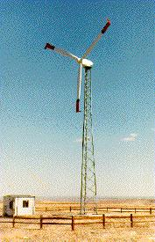

Rose v. Chaikin
Notes:
http://telosnet.com/wind/govprog.html

