Slide 1
Construction of Covenants

Slide 2
Construction of Covenants
Traditional Approach = strict construction
(exactly as written)
Modern Approach = broad construction
(includes similar unstated limits consistent with purpose)

Slide 3
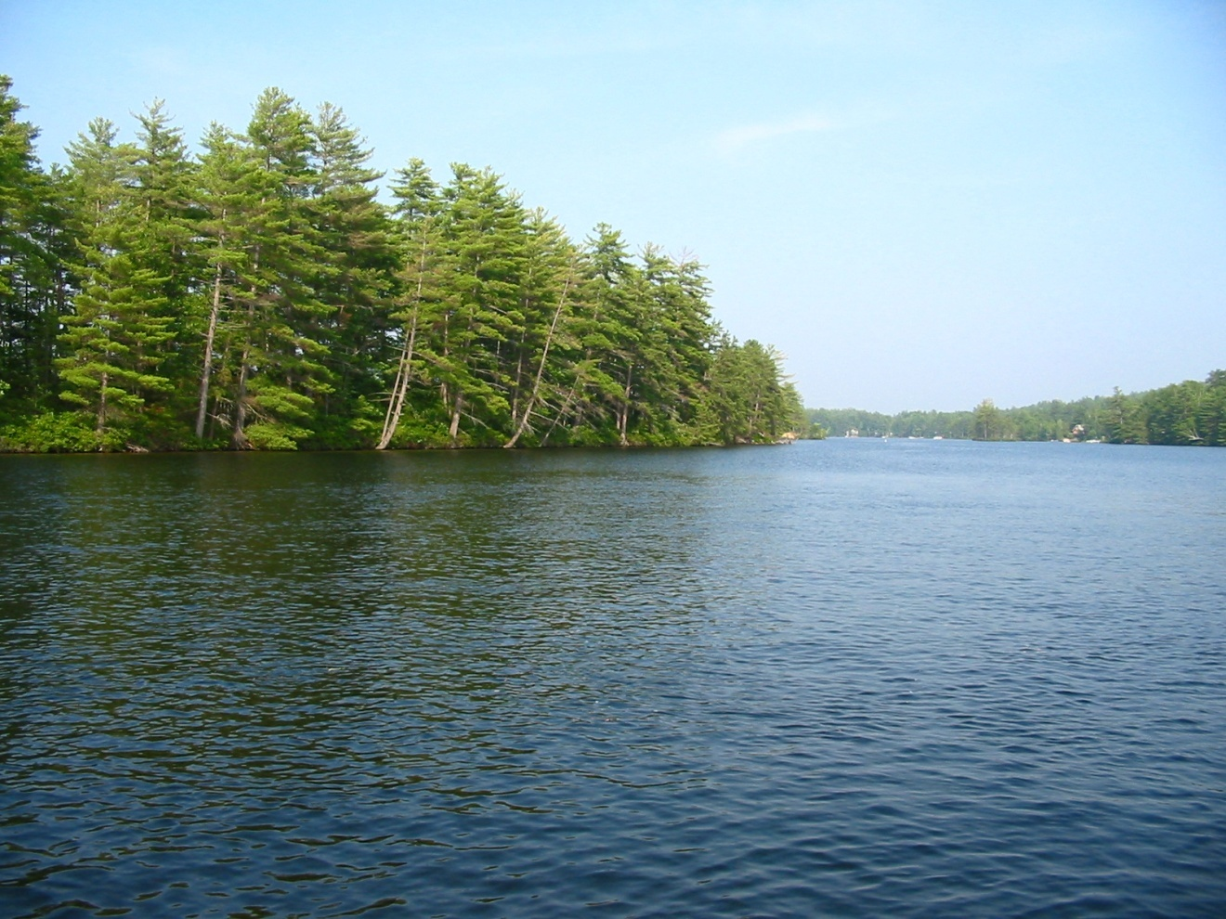
Joslin v. Pine River Development
Pine River Pond

Slide 4
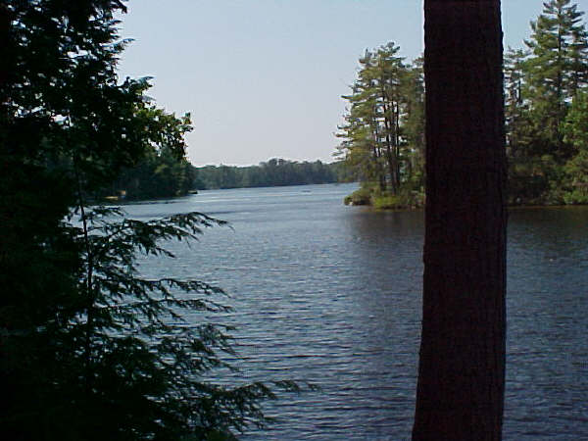
Joslin v. Pine River Development
Pine River Pond
Notes:
http://groups.msn.com/AllAboutCarrollCountyNewHampshireUSA/lakesandponds.msnw?action=ShowPhoto&PhotoID=35

Slide 5
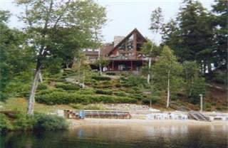
Joslin v. Pine River Development
House overlooking Pine River Pond
Selling price $589,900
Notes:
http://www.beangroup.com/property/listings/Homes/NH/Wakefield/40970

Slide 6
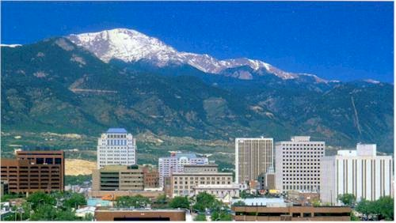
Rhue v. Cheyenne Homes
El Paso County – Colorado Springs Area

Slide 7
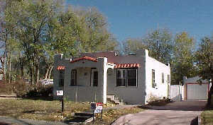
Rhue v. Cheyenne Homes
House similar to the one being moved
Notes:
http://www.realtor.com/FindHome/HomeListing.asp?snum=26&frm=byzip&st=&typ=1%2C+2%2C+3%2C+4%2C+5%2C+6%2C+7&poe=realtor&mnbed=0&mnbath=0&mnprice=0&mxprice=99999999&js=off&pgnum=3&fid=so&mnsqft=&mls=xmls&zp=80903&sid=0241C2384D4DC&snumxlid=1031846809&lnksrc=00003

Slide 8
Termination of Covenants

Slide 9
Termination of Covenants
Express time stated in covenant

Slide 10
Termination of Covenants
Express time stated in covenant
Statutory duration

Slide 11
Termination of Covenants
Express time stated in covenant
Statutory duration
Release

Slide 12
Termination of Covenants
Express time stated in covenant
Statutory duration
Release
Merger

Slide 13
Termination of Covenants
Express time stated in covenant
Statutory duration
Release
Merger
Estoppel, prescription, laches, etc.

Slide 14
Termination of Covenants
Express time stated in covenant
Statutory duration
Release
Merger
Estoppel, prescription, laches, etc.
Unclean hands

Slide 15
Termination of Covenants
Express time stated in covenant
Statutory duration
Release
Merger
Estoppel, prescription, laches, etc.
Unclean hands
Acquiescence

Slide 16
Termination of Covenants
Express time stated in covenant
Statutory duration
Release
Merger
Estoppel, prescription, laches, etc.
Unclean hands
Acquiescence
Changed Conditions

Slide 17
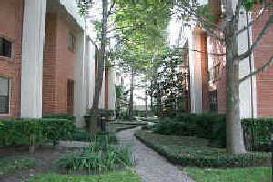
Cowling v. Colligan
Townhome near intersection of
Westheimer & Bering

