Slide 1
Limitations on Covenants and Servitudes

Slide 2
Sources of Limitations
Constitutions
Statutes
Public Policy

Slide 3
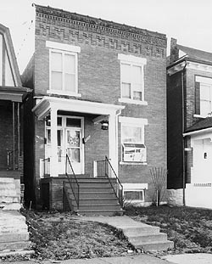
Shelley v. Kraemer

Slide 4
Limitations on Covenants and Servitudes
[continued]

Slide 5
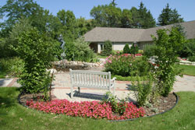
McMillian v. Iserman
Facility in same area; could be actual one.
Notes:
http://www.aaa1b.org/display.php?pageid=110&catid=12

Slide 6
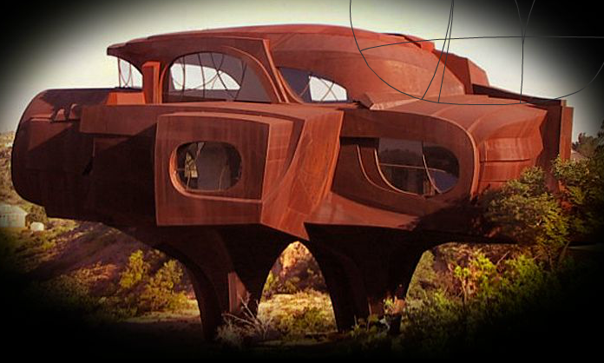
Metal House

Slide 7
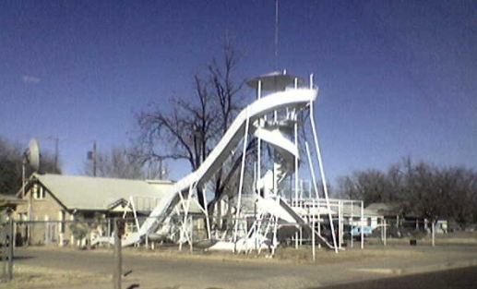
Slide House

Slide 8
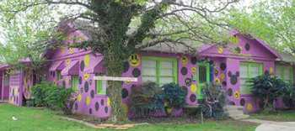
Purple House

