Slide 1
Equitable Servitudes

Slide 2
Equitable Servitudes -- Generally
A covenant enforced as running with the land in a court of equity even though it does not meet all the requirements of a real covenant.
Key issues:
  Which element(s) of a real covenant may be lacking?
  What substitutes for the missing element(s)?

Slide 3
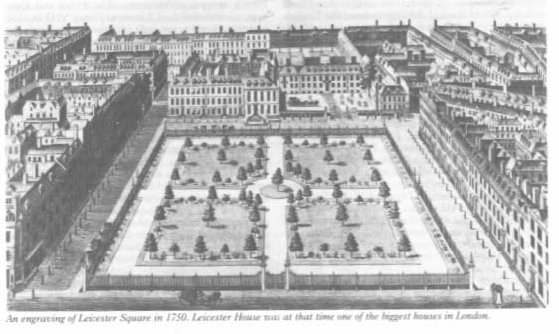
Tulk v. Moxhay
Leicester Square -- 1750
Notes:
http://www.georgianindex.net/London/squares/leicestersq.jpg

Slide 4
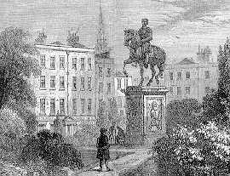
Tulk v. Moxhay
Equestrian Statute -- 1790
Notes:
http://www.speel.demon.co.uk/other/leicestr.htm

Slide 5

Tulk v. Moxhay
Leicester Square -- today
Notes:
http://www.lozoodiverona.it/photos/Londra%20-%20Leicester%20Square.jpg

Slide 6
Tulk v. Moxhay
Court was willing to relax mutual privity requirement in equity because of Moxhay had notice.
Accordingly, he is bound even though elements of real covenant not satisfied.
Notes:
http://www.lozoodiverona.it/photos/Londra%20-%20Leicester%20Square.jpg

Slide 7

London County Council v. Allen

Slide 8
London County Council v. Allen
Court unwilling to relax benefit must touch and concern land requirement.

Slide 9
Equitable Servitudes
Texas Elements

Slide 10
Texas Elements of Equitable Servitudes
Successor to burdened land took with notice of the restriction.

Slide 11
Texas Elements of Equitable Servitudes
Successor to burdened land took with notice of the restriction.
Covenant limits the use of the burdened land.

Slide 12
Texas Elements of Equitable Servitudes
Successor to burdened land took with notice of the restriction.
Covenant limits the use of the burdened land.
Covenant benefits the land of the party seeking to enforce it.

Slide 13
Implied Reciprocal Equitable Servitude

Slide 14
Implied Reciprocal Equitable Servitude
1. Lots in residential subdivision originally owned by common owner/developer.

Slide 15
Implied Reciprocal Equitable Servitude
1. Lots in residential subdivision originally owned by common owner/developer.
2. Owner/Developer imposed restrictions in deeds of most conveyed parcels.

Slide 16
Implied Reciprocal Equitable Servitude
1. Lots in residential subdivision originally owned by common owner/developer.
2. Owner/Developer imposed restrictions in deeds of most conveyed parcels.
3. Developer imposes general plan upon subdivision (uniform restrictions on most deeds, recorded declaration, etc.).

Slide 17
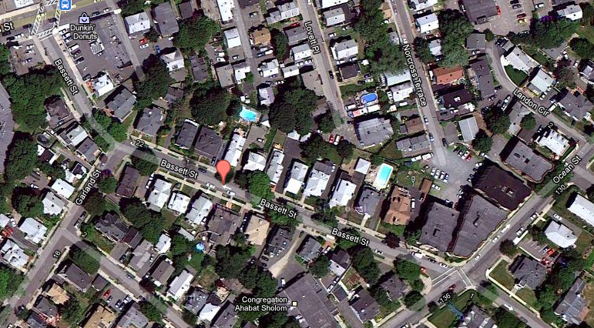
Sprague v. Kimball

Slide 18
Sprague v. Kimball
Kimball (Seller)
Δ
Sprague Grossman
(Purchaser (Purchaser
with restrictions) w/o restrictions)
π Δ

Slide 19
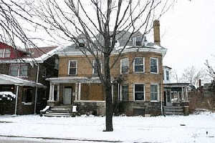
Sanborn v. McLean
House a few blocks away from Collingwood & Second

Slide 20
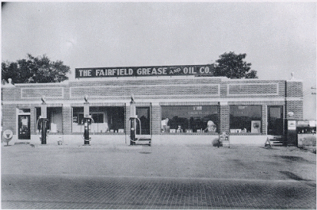
Sanborn v. McLean
Type of gas station McLean wants to build.

