Slide 1
Real Covenants

Slide 2
Definition
Promise which is enforceable not only between the original parties, but also between successors of either party because they are now the new owners of the land.
The future owners are bound even though they did not agree.

Slide 3
Distinguish from:
Assignment of contract rights
Affirmative easements
Negative easements (difficult to do)
Conditions

Slide 4
Elements of Real Covenant
1. Enforceable promises under contract law
  Incorporates entire course in contracts.

Slide 5
Elements of Real Covenant
2. Intent for Promise to Run with the Land
  Common law – “and his/her assigns”
  Modern law – special terminology not needed
  Advice – include reference to “heirs and assigns” and indicate it “runs with and is appurtenant to land.”

Slide 6
Elements of Real Covenant
3. “Touch and Concern” land requirement
  Connection between promise and land
    Burden touches land (impacts land, not landowner personally)
    Benefit touches land (makes land more valuable, not landowner personally)

Slide 7
Elements of Real Covenant
3. “Touch and Concern” land requirement
  How satisfy?
    Both benefit and burden (common law)
    Just burden
    Just benefit

Slide 8
Elements of Real Covenant
4. Privity of estate between original parties
to covenant
  Mutual Privity
    Original parties had mutual interest in same land
    Example = landlord-tenant, co-ownership
    Common law = required
    Modern law = not required

Slide 9
Elements of Real Covenant
4. Privity of estate between original parties
to covenant
  Horizontal Privity
    Land-based relationship between original parties
    Examples = landlord-tenant, buyer-seller, grantor-grantee
    Modern law = sufficient
    Even more modern law = Some states no longer require horizontal privity thus allowing neighbors to enter into real covenants.

Slide 10
Elements of Real Covenant
4. Privity of estate
  Vertical Privity [chain of title]
    New owner of burdened or benefited property must obtain property from prior person who was burdened or benefited.

Slide 11

Real Covenants
Texas Style

Slide 12
Texas Elements of a Real Covenant
1. Enforceable contract
  Normal requirement.

Slide 13
Texas Elements of a Real Covenant
2. Intent of original parties for covenant to run with the land.
  Normal requirement.

Slide 14
Texas Elements of a Real Covenant
3. Proof of intent
  Must either:
    Relate to something in existence at the time of the covenant, or
    Use phrase “assigns” or a functional equivalent.
  Based on common law and stricter than modern approach.

Slide 15
Texas Elements of a Real Covenant
4. Privity of estate between original parties
  Must have either:
    Mutual privity, or
    Horizontal privity.
  Based on common law and stricter than modern approach which sometimes dispenses with this requirement.

Slide 16
Texas Elements of a Real Covenant
5. Promise must touch and concern land
  Both benefit and burden must touch and concern land and thus two (or more) parcels of land are required.
  Based on common law and stricter than modern approach which may allow just benefit or just burden to touch and concern land.

Slide 17
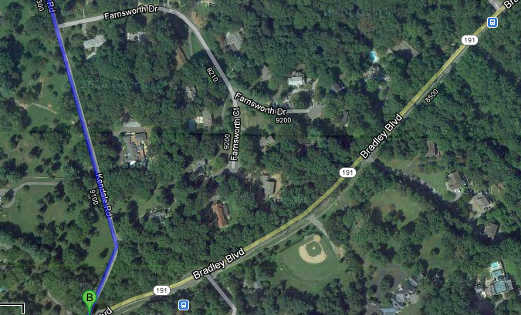
Gallagher v. Bell

Slide 18
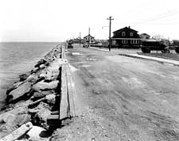
Neponsit v. Emigrant
1936 Photo of Neponsit
Notes:
http://www.queenspix.com/nepindex.html

Slide 19
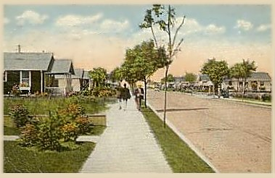
Neponsit v. Emigrant
1924 Colorized Photo of Neponsit

Slide 20

Neponsit v. Emigrant
Neponsit Today
Notes:
http://www.neponsit.org/Location.htm

