Slide 1
Termination of Easements

Slide 2
Termination Methods
Natural Duration
Presumption – fee simple (forever)
May be limited in deed
In gross
Common law = life of dominant tenant
Modern law = fee simple, especially if business related
Licenses end upon revocation
Implied by necessity ends when necessity ends

Slide 3
Termination Methods
Natural Duration
Merger

Slide 4
Termination Methods
Natural Duration
Merger
Release

Slide 5
Termination Methods
Natural Duration
Merger
Release
Abandonment by Dominant Tenant

Slide 6
Termination Methods
Natural Duration
Merger
Release
Abandonment by Dominant Tenant
Estoppel

Slide 7
Termination Methods
Natural Duration
Merger
Release
Abandonment by Dominant Tenant
Estoppel
Forfeiture

Slide 8
Termination Methods
Natural Duration
Merger
Release
Abandonment by Dominant Tenant
Estoppel
Forfeiture
Not Mere Non-use

Slide 9
Termination Methods
Natural Duration
Merger
Release
Abandonment by Dominant Tenant
Estoppel
Forfeiture
Not Mere Non-use
Prescription/Adverse Use

Slide 10
Termination Methods
Natural Duration
Merger
Release
Abandonment by Dominant Tenant
Estoppel
Forfeiture
Not Mere Non-use
Prescription/Adverse Use
Sale of Servient Tenement of a Prescriptive or Implied by Prior Use Easement?
If apparent by inspection – easement likely to continue
If not apparent by inspection – jurisdictions are divided

Slide 11
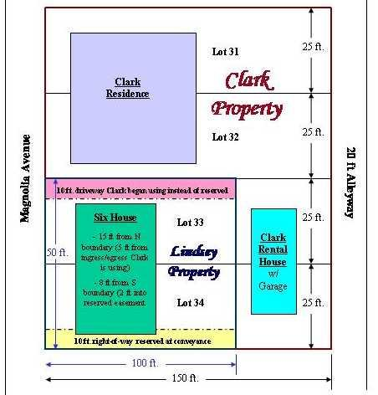
Lindsey v. Clark

