Slide 1
Scope and Transferability

Slide 2
Express Easements
Terms of Easement
Deed provisions control

Slide 3
Scope of Express Easements
Terms of Easement, but if
Easement Silent, then apply Rule of Reason – a balancing test:
benefit to dominant tenant
vs.
burden on servient tenant

Slide 4
Scope of Express Easements
Factors to determine if dominant tenant’s use is reasonable:
Did use occur before the easement?
Did use occur after easement granted without complaint?
What is the purpose of the easement?
How much did dominant tenant pay for the easement?
Should change in circumstances be considered?

Slide 5
Scope and Transferability [continued]

Slide 6
Scope of Implied Easements
Circumstances viewed from a reasonable perspective

Slide 7
Scope of Prescriptive Easements
Original adverse use becomes basis for applying the rule of reason.

Slide 8
S.S. Kresge Co. v. Winkelman Realty
alley
Jefferson
6
5
8
7
2d
Plaintiff
3d
1
2
3
4
Defendant
Washington

Slide 9
Use of Easement by Servient Tenant
May continue to use and enjoy but
May not interfere with dominant tenant’s use.

Slide 10
Use of Easement by Servient Tenant
May grant overlapping easements but
New easements cannot unreasonably interfere with original easement.
Original easement may be made exclusive.

Slide 11
Use of Easement by Servient Tenant
Generally, servient tenant may not move the location of the easement.

Slide 12
Use of Easement by Servient Tenant
If dominant tenant wants easement maintained or repaired, dominant tenant must perform the maintenance.
Covenants to repair, however, may be coupled with an easement.

Slide 13
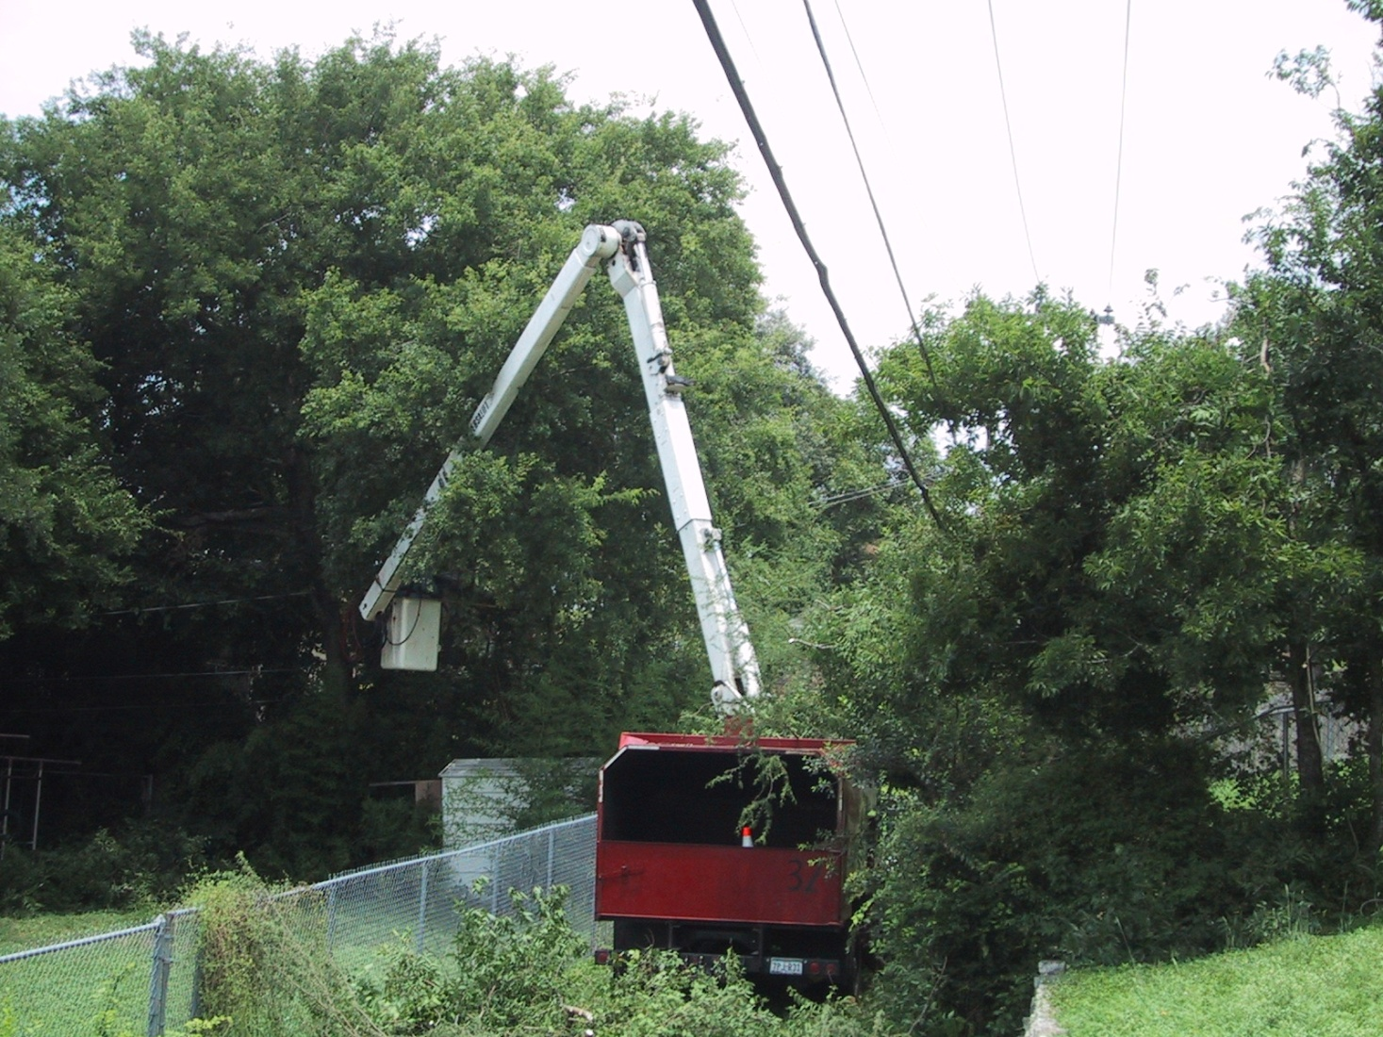
Use of Easement by Servient Tenant

Slide 14
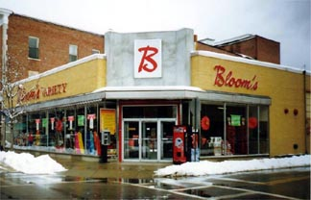
Sakansky v. Wein

Slide 15
Transfer of Easements
Follow express terms of easement, if any.

Slide 16
Transfer of Easements
Burden -- If easement silent:
Burden not severable from servient land.
The easement “runs with” the land and burdens new owners and lessees.

Slide 17
Transfer of Easements
Benefit -- If easement silent:
Appurtenant – Benefit runs with the land and benefits the new owner or lessee.
Cannot transform an appurtenant easement into an in gross easement without consent of servient tenant.

Slide 18
Transfer of Easements
Benefit -- If easement silent:
In gross – different approaches
Common law = no transfer allowed
Modern law = transferred allowed if commercial

