Slide 1
Prescriptive Easements

Slide 2
Basic Concepts
Analogous to adverse possession.
Land need not be in common ownership.
Use not required before severance.
Only affirmative prescriptive easements are possible.

Slide 3
Elements
1. Open & Notorious
Obvious to someone looking at the property.
Use was without permission (if had permission, would be license).

Slide 4
Elements
2. Adverse to Owner’s Claim of Right
Use would impinge on owner’s rights.

Slide 5
Elements
3. Exclusive?
Majority = no
Minority = yes

Slide 6
Elements
4. Uninterrupted Use

Slide 7
Elements
5. Continuous
X number of years (often specified by statute)

Slide 8
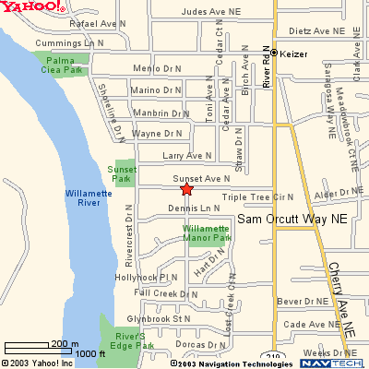
Beebe v. DeMarco

Slide 9
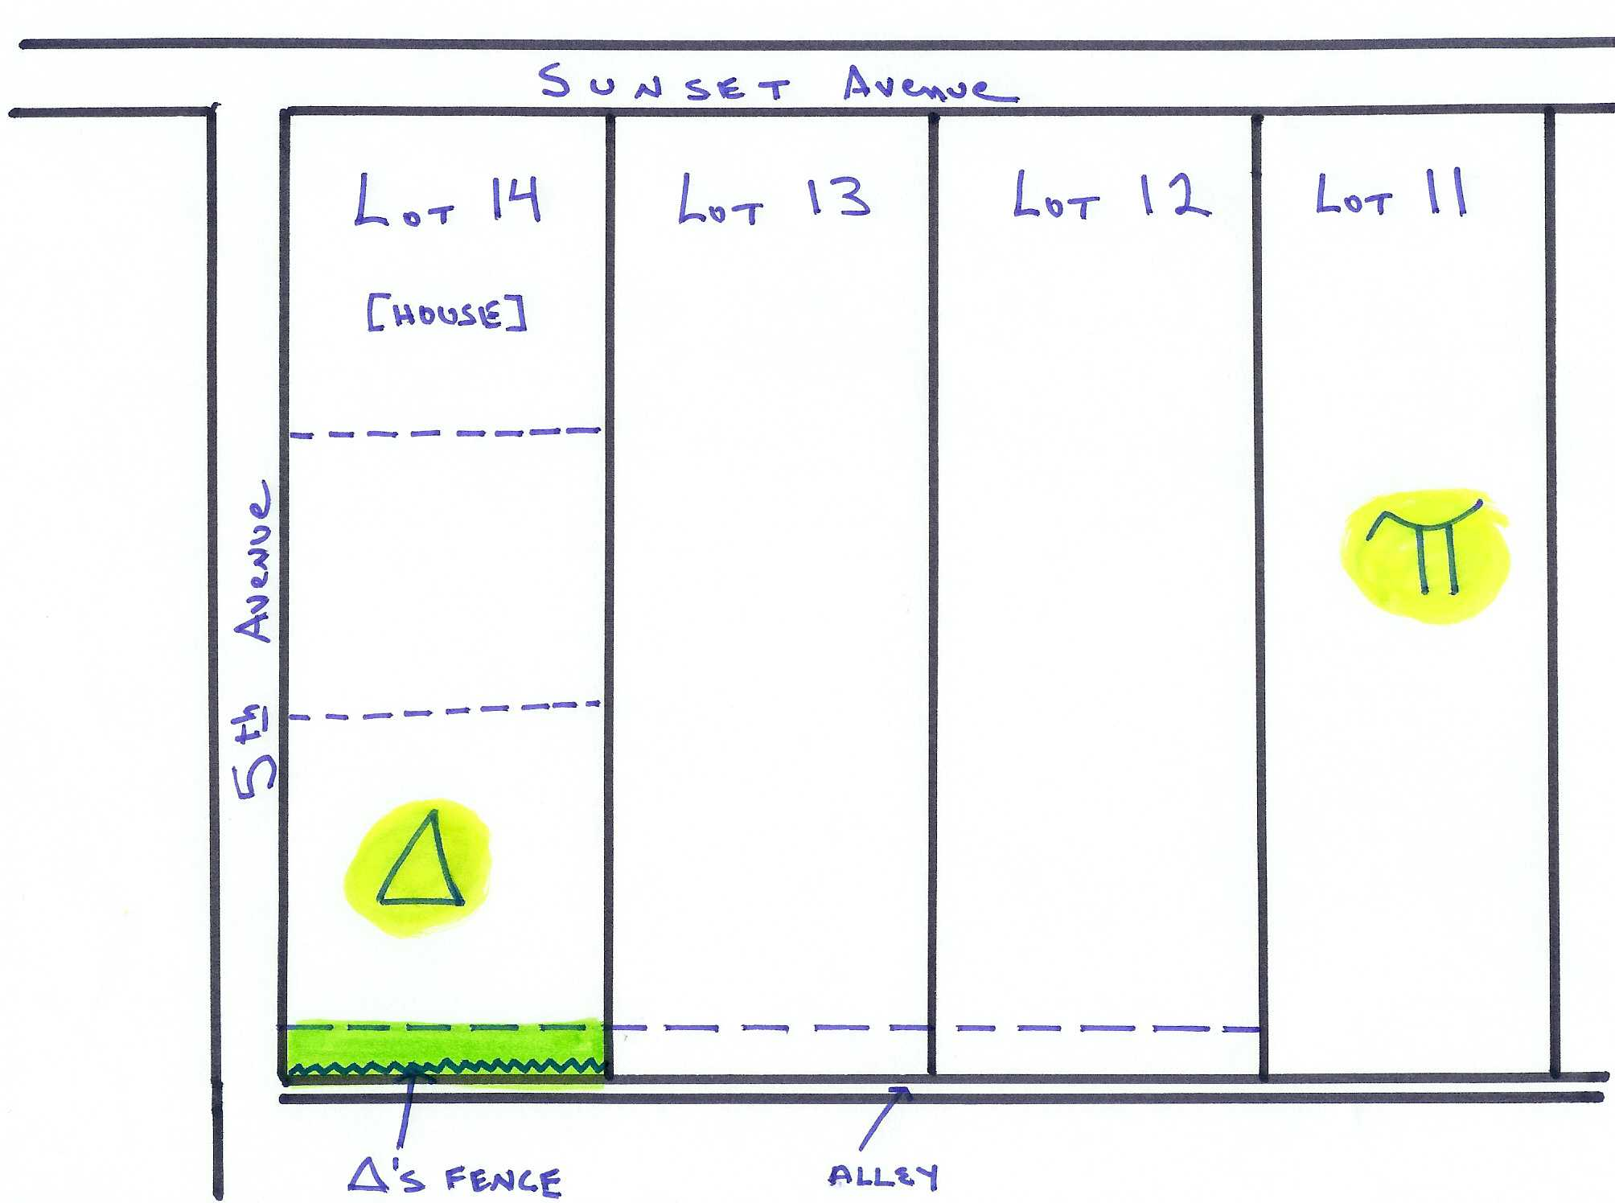

Slide 10
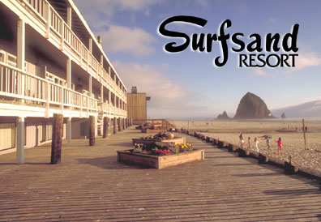
State ex. Rel. Thornton v. Hay
Notes:
http://www.ohwy.com/or/s/surfsand.htm

Slide 11
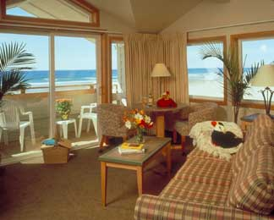
Notes:
http://www.surfsand.com

Slide 12
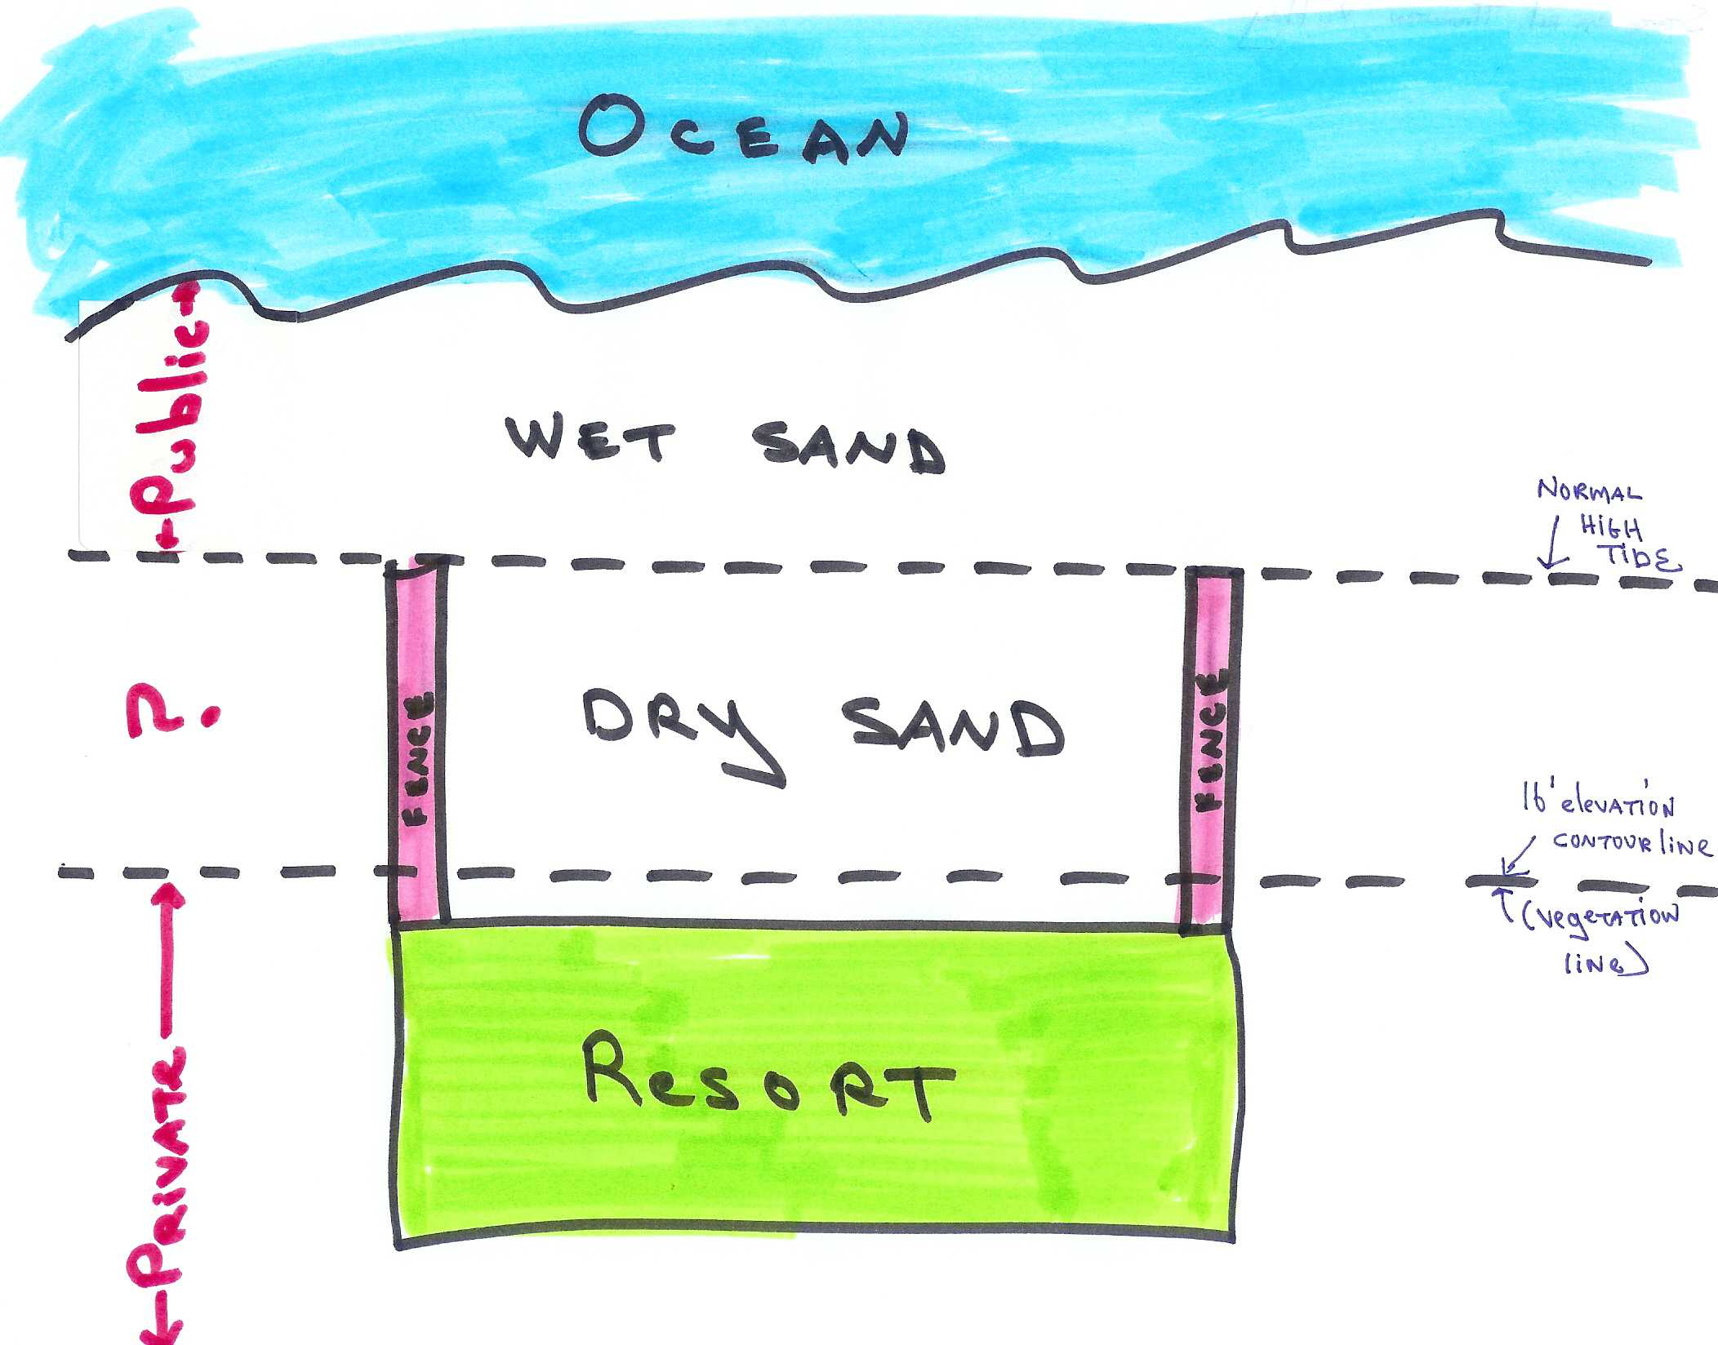

Slide 13
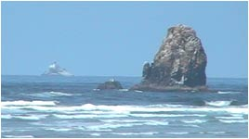
Scene from Goonies with Haystack Rock
Notes:
Follow this link http://www.thegoonies.org/locations.htm#haystack to view scenes from the movie Goonies http://www.imdb.com/title/tt0089218/ in which this Rock is predominantly featured.

Slide 14
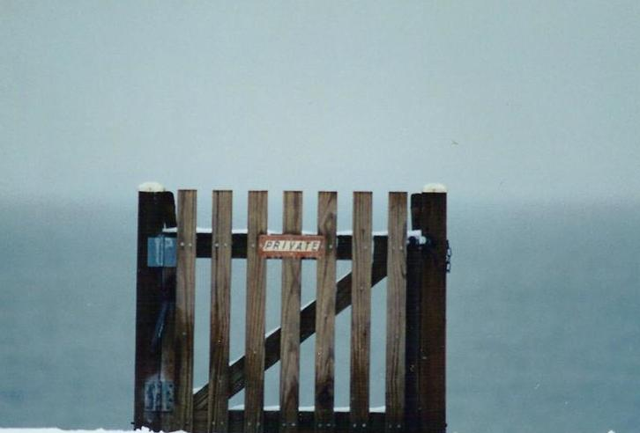
Notes:
From Kurt Glass, Spring 2007, TTU

