Slide 1
Implied Easements

Slide 2

Basic Idea
Implied from circumstances (not in the deed)
“coulda woulda shoulda”

Slide 3
Requirement
Severance of commonly-owned parcels required:
Deed conveys some, but not all, of grantor’s land, or
Deed conveys grantor’s land to different grantees.
[Implied easements not allowed over stranger’s land.]

Slide 4
Types of Implied Easements
1. By Necessity
2. By Prior Use
[quasi-easement]

Slide 5
Implied by Necessity
Owner of Rectangle conveys Oval to Grantee

Slide 6
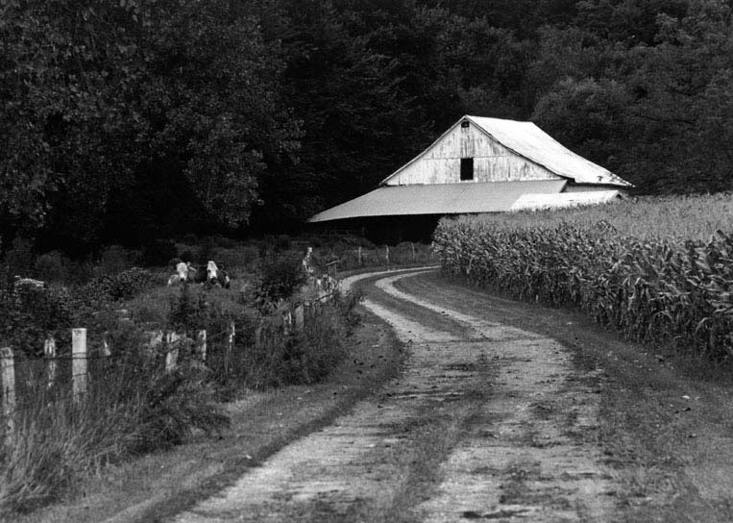
Finn v. Williams
Notes:
http://www.sabine-mag.com/archive/images/sangamon.jpg

Slide 7
Implied by Prior Use [quasi-easement]
Use must exist prior to the severance, and
Satisfy court that it is justified to impose the easement (parties merely “forgot” to place easement in deed).

Slide 8
Implied by Prior Use
Factors Courts Examine
1. Prior use apparent or discoverable by reasonable inspection.

Slide 9
Implied by Prior Use
Factors Courts Examine
2. Permanent or Continuous

Slide 10
Implied by Prior Use
Factors Courts Examine
3. Necessary and Beneficial
Note potential difference between implied grant and implied reservation.

Slide 11
Implied by Prior Use
Factors Courts Examine
4. Other factors, e.g.,
Price paid
Existence of reciprocal benefits
Exact language of deed

Slide 12
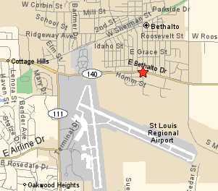
Granite Properties v. Manns

Slide 13
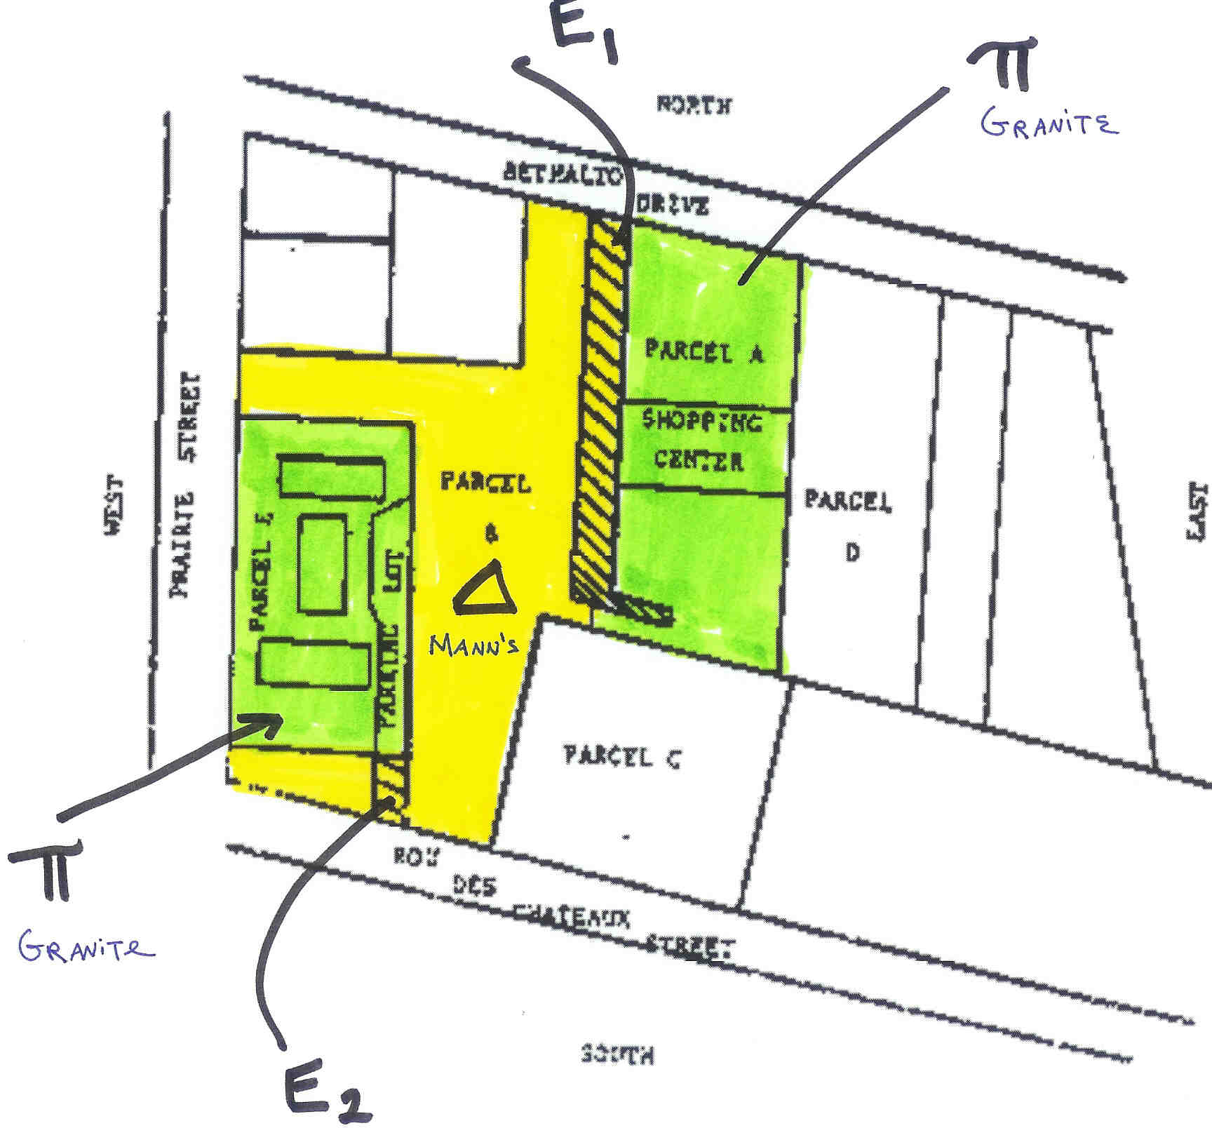

Slide 14
Practical Advice
__________________________
__________________________

