Slide 1
Express
Easements

Slide 2
Common Law Types
Roads & rights of way
Support
Water
Fences
Air
Light

Slide 3
Creation Methods
1. Grant
  Express grant from servient tenant to dominant tenant in a deed.

Slide 4
Creation Methods
2. Reservation to Grantor
  Grantor reserves an easement in the deed when conveying the land.

Slide 5
Creation Methods
3. Exception to Grantor
  Grantor conveys property to the grantee except for the easement.
  Would not work at common law but often works under modern law.

Slide 6
Creation Methods
4. Reservation to Third Party
  Grantor reserves an easement for a third party.
  Many courts do not recognize this method as at the common law.
  Instead, grantor should reserve the easement and then convey it to the third party.

Slide 7
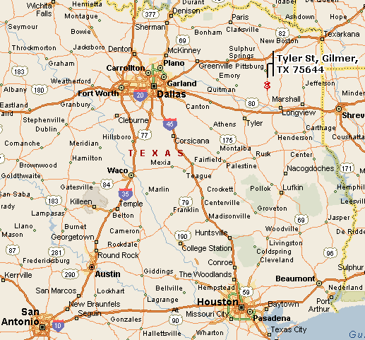
Mitchell v. Castellaw
Gilmer

Slide 8
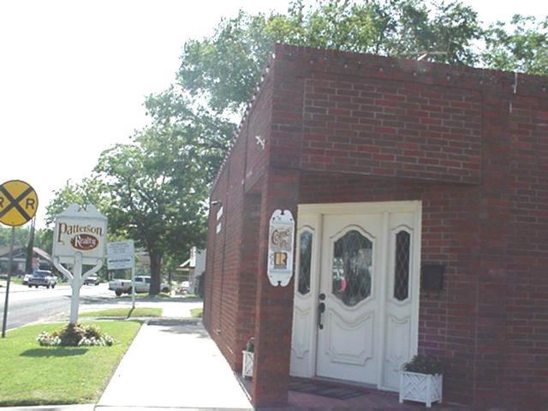
Mitchell v. Castellaw
Patterson Realty -- Corner of West Tyler and Trinity
Notes:
http://www.gilmer-tx.com/business/patterson_realty.htm

Slide 9
Mitchell v. Castellaw
“and that grantor shall have the right to use this part of said lot as a driveway”
Notes:
http://www.gilmer-tx.com/business/patterson_realty.htm

Slide 10
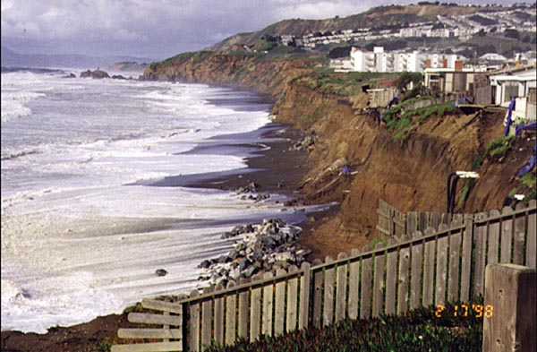
Willard v. First Church of Christ, Scientist, Pacifica
Notes:
http://coastal.er.usgs.gov/hurricanes/mappingchange/images/elnino/pacifica.jpg

Slide 11
Willard v. First Church of Christ, Scientist, Pacifica
“subject to an easement for automobile parking during church hours for the benefit of the church”
Notes:
http://coastal.er.usgs.gov/hurricanes/mappingchange/images/elnino/pacifica.jpg

Slide 12
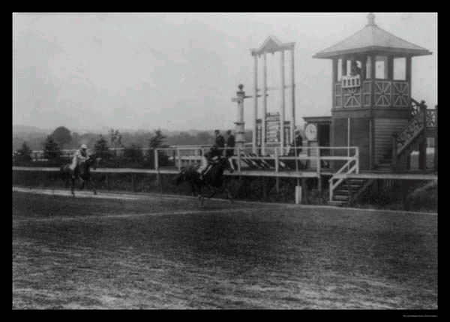
Marrone v. Washington Jockey Club
Notes:
http://63.251.54.141/images/HorseRacingWashingtonDC1922.jpg

Slide 13
Marrone v. Washington Jockey Club
Bennings Race Track
“A half mile horse track was built outside Bennings (between the present Hayes and Jay Streets) in 1885, and was first used for car racing on the 5th September 1905. It was used through until 1937, when the Jockey Club abandoned the track, and it was subsequently built upon.”
Notes:
http://www.silhouet.com/motorsport/tracks/bennings.html

