Slide 1
Easements, Profits, & Licenses
Introduction

Slide 2
Easements -- Generally
1. Right to a limited use or enjoyment of
another’s land
  Does not include the right to possess.
  “Smaller” interest than a tenant.

Slide 3
Easements -- Generally
2. Protected against interference by third
parties

Slide 4
Easements -- Generally
3. Not revocable by grantee landowner
  Fee simple interest unless otherwise provided in grant.
  Grantor cannot say “no”

Slide 5
Easements -- Generally
4. Not a normal incident of ownership of
the land that easement holder may own.
  The easement is an “extra” bundle of sticks.

Slide 6
Easements -- Generally
5. May be created by conveyance

Slide 7
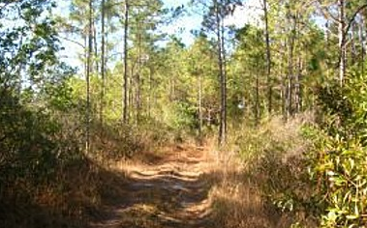
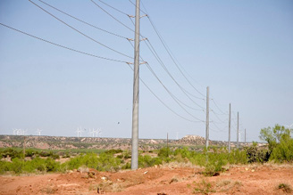
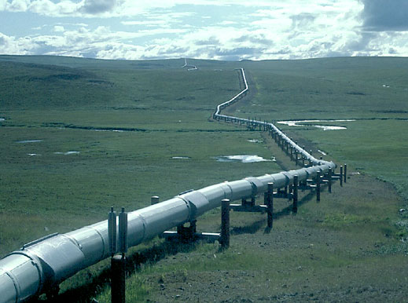
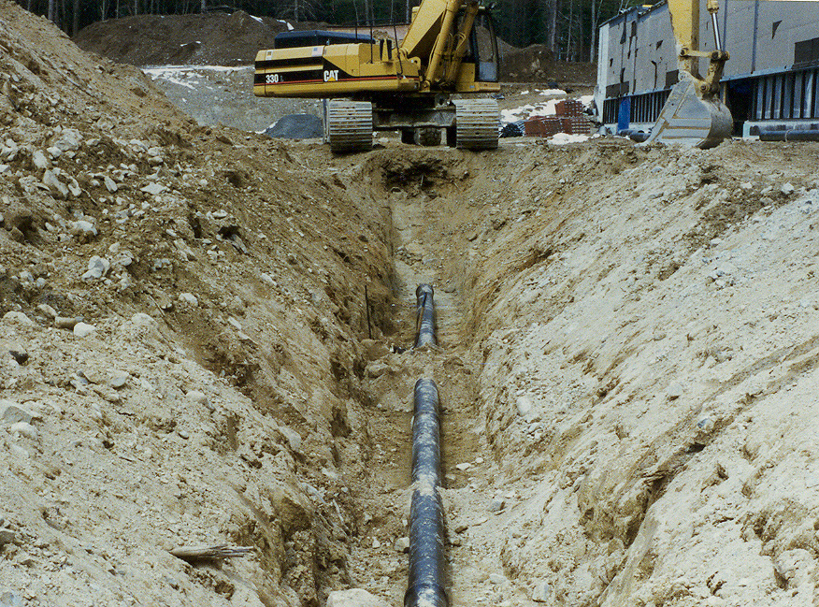
Easements -- Examples

Slide 8
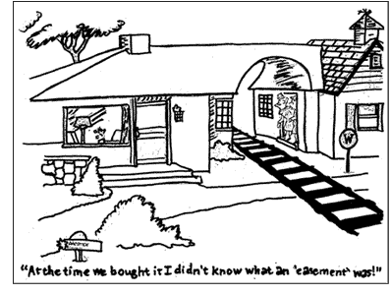
Easements -- Examples

Slide 9
Easements – Servient vs. Dominant
Servient Tenement
Land burdened by the easement
Land which “suffers” because of the easement
Dominant Tenement
Land (if any) benefited by the easement
Land which is made “more valuable” because of the easement

Slide 10
Easements – Affirmative vs. Negative
Affirmative
Easement holder may do something on the servient tenement.
[Most easements are affirmative]
Negative
Easement holder may prevent something from being done on the servient tenement.

Slide 11
Easements – Duties Generally
Owner of burden property has no duty to do something on the burdened property.
Instead, the burden property owner (servient) must either:
  Allow something to be done (affirmative), or
  Refrain from doing something (negative).

Slide 12
Easements – Appurtenant vs. in Gross
Appurtenant
Dominant tenant owns land benefited by the easement.
Easement benefits land.
In Gross
No benefited land.
Easement benefits a person, the dominant tenant.
[Not originally recognized at common law.]

Slide 13
Profits à Prendre
Dominant tenant also has right to remove a portion of the servient land or its products.
Examples: soil, timber, crops, minerals
Modern Law: treated under the same rules as easements.

Slide 14
Licenses
Use of land that is revocable by the servient tenant.
Often deemed too weak to be a true interest in land.
  Just a contract right.

Slide 15
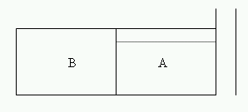
Example 1
A grants to B the right to drive across A’s land to reach road.

Slide 16
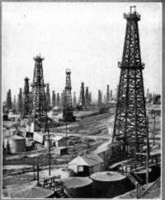
Example 2
A grants B the right to drill for and remove oil on A’s land for five years.
Notes:
http://www.pocanticohills.org/rockefeller/oilderrick.htm

Slide 17

Example 3
You have tickets to May 1’s performance.

Slide 18
Example 4
Why is a lease not an easement?

Slide 19
Creation Methods
Express
Implication
Prescription

