Slide 1
Landlord-Tenant

Slide 2
Introduction
Owner (landlord; lessor) conveys right to occupy (lease) to a tenant (lessee) for a certain period of time.
Owner retains a reversion.
Historically, a lease transformed from being a pure conveyance to being a hybrid of a conveyance and a contract.
Under modern law, highly regulated by statute, especially if residential.

Slide 3
Introduction
Non-Freehold estate
No “seisin” at common law
Tenant’s interest treated as personal property
Chattel real
Termination of tenant’s interest usually is known or can be calculated.

Slide 4
Types of Tenancies
1. Tenancy for a term (also called “estate for years” or “term for years”)
Automatically ends when time elapses.
E.g., a one year lease, a nine month lease, a 99 year lease.

Slide 5
Types of Tenancies
2. Periodic Tenancy
Fixed term which renews automatically unless steps are taken to terminate.
“month-to-month” “year-to-year”

Slide 6
Types of Tenancies
3. Tenancy at Will
No definite term
Continues until either party terminates

Slide 7
Types of Tenancies
4. Tenancy at Sufferance
The “hold over” tenant who has not yet been evicted.

Slide 8
What type of tenancy to you have?
Tenancy for a term.
Periodic tenancy.
Tenancy at will.
Tenancy at sufferance.
I am not a tenant.

Slide 9
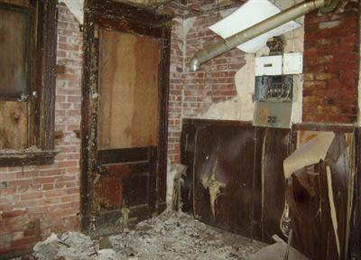
Brown v. Southall Realty
[Not actual property]

Slide 10
Statute of Frauds
Statute of Frauds (1677)
If over three years, must be in writing.
Modern Law – common view include:
If over one year, must be in writing (Texas).
All leases must be in writing.

Slide 11
Statute of Frauds
Business & Commerce Code § 26.01
A promise or agreement described in Subsection (b) of this section is not enforceable unless the promise or agreement, or a memorandum of it, is (1) in writing; and (2) signed by the person to be charged with the promise or agreement or by someone lawfully authorized to sign for him.
Subsection (a) of this section applies to: * * * (5) a lease of real estate for a term longer than one year * * *.

Slide 12
Access to Rental Market

Slide 13
Access to Rental Market
Common law = landlord could exclude anyone for any or no reason.
Contrast with innkeeper rule.
Modern law = restricted by federal, state, and local law

Slide 14
Federal Fair Housing Act
Cannot discriminate based on:
Race
Color
Religion
Sex
Family status (pregnant or having children)
National origin
Handicap

Slide 15
Other grounds?

Slide 16
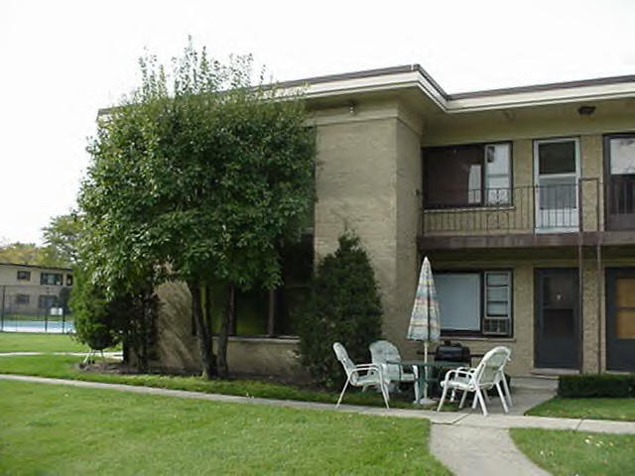
Jancik v. HUD
Notes:
KING ARTHUR'S COURT NORTHLAKE IL. 60164 http://www.gogorealty.com/%60northlakecondo.htm

Slide 17
Jancik v. HUD
NORTHLAKE deluxe 1 BR apt, a/c, newer quiet bldg, pool, prkg, mature person preferred, credit checked. $395 . . . .

Slide 18
Jancik v. HUD
Do you think an ordinary reader would think “mature person preferred” is code for discrimination?
Yes, in all circumstances.
It is likely discriminatory but circumstances could show otherwise.
It is likely not discriminatory but circumstances could show otherwise.
No, in all circumstances.

Slide 19
Tenant’s Right to Possession

Slide 20
Tenant’s Right to Possession
Lease transfers a present possessory estate to the tenant.
But, landlord has right to protect the landlord’s reversion from waste.

Slide 21

Obtaining Possession
If tenant cannot possess because a third party is in unauthorized possession when lease starts, what happens?

Slide 22
Obtaining Possession
1. American View
Landlord’s duty is to deliver legal possession.
Thus, tenant must remove unauthorized occupier.
Minority approach in U.S.

Slide 23
Obtaining Possession
2. English View
Landlord’s duty is to deliver actual (not just legal) possession.
Thus, landlord must remove unauthorized occupier.
Majority approach in U.S., including Texas.

Slide 24
Obtaining Possession
3. Lease Terms
Study lease to see if it expressly deals with this issue.
State law may require residential landlords to place tenant in actual possession regardless of lease terms.

Slide 25
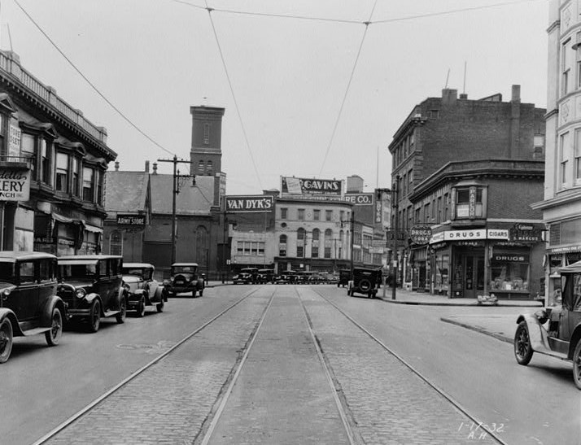
Adrian v. Rabinowtiz
Notes:
Picture from 1932
http://www.patersonhistory.com/pictures/pictures/109406pv.jpg

Slide 26
Which rule do you prefer?
English Rule
American Rule
I don’t like either rule!

Slide 27

Obtaining Possession
Possession disrupted by third party after tenant has possession.
General rule is that this is tenant’s problem.

Slide 28
The Holdover Tenant
Landlord’s options for treating former tenant:
Trespasser and evict.
Periodic tenant.

Slide 29

Commonwealth Building Corp. v. Hirschfield

Slide 30
Condition of Premises

Slide 31
1. Common Law
Lease was a conveyance.
Landlord not responsible for condition of premises.
Tenant had duty to protect landlord’s reversion and not commit waste.
Value of lease was the use of the land itself (farming & grazing), not the buildings.

Slide 32
1. Common Law
Landlord’s duties
Not misrepresent condition
Reveal known undiscoverable hidden defects
Independent covenants

Slide 33
2. Modern Law
Implied Warranty of Habitability
Primarily for residential tenancies
By court judgment
By legislation

Slide 34
3. Texas
Kamarath v. Bennett, 568 S.W.2d 658 (Tex. 1978).
“[A]t the inception of the rental lease, there are no latent defects in the facilities that are vital to the use of the premises for residential purposes and that these essential facilities will remain in a condition which makes the property livable.”

Slide 35
3. Texas
Enactment in 1979 of Property Code § 92.052
Abrogated Kamarath implied warranty.
Created limited duty of landlord to repair.

Slide 36
3. Texas
Davidow v. Inwood North Professional Group-Phase-I, 747 S.W.2d 373 (Tex. 1988).
Implied warranty of suitability by landlord in commercial lease that premises suitable for their intended commercial purposes.

Slide 37
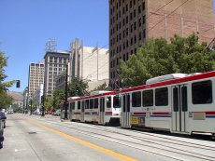
Richard Baron Enterprises v. Tsern
Notes:
Generic picture of downtown buildings
http://www.saltlakecityinfo.org/saltlakecity.photos.htm

Slide 38
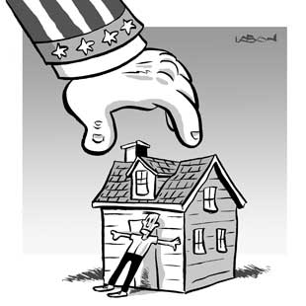
Eminent Domain
Does tenant need to continue to pay rent even though the government has taken the property?

Slide 39
Possible Tenant’s Remedies
Warning: Highly regulated by state law.
Withhold rent
Repair and deduct
Sue for damages
Treat as constructive eviction and move out

Slide 40

Reality Check
In most situations, the tenant is at fault and has been very destructive to the building.

Slide 41
Rent

Slide 42

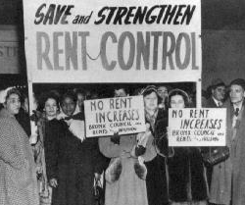
Determination of Rent
1. Agreement between landlord and tenant (free market)
2. Limited by government (rent control)

Slide 43
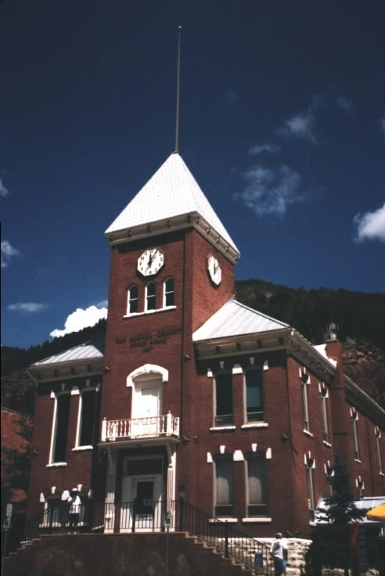
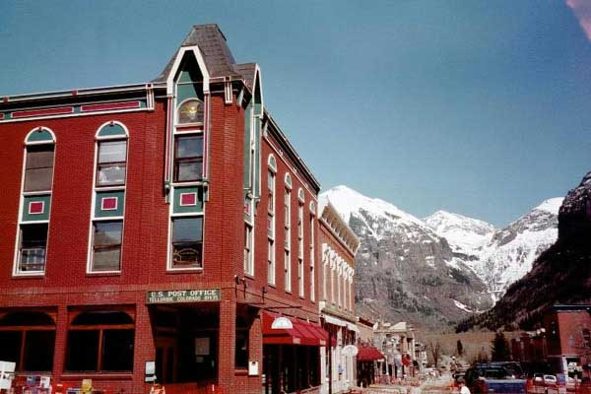
Town of Telluride
Notes:
Courthouse and Post Office

Slide 44
What do you think of rent control laws?
Should be illegal under all circumstances; free market should determine rent (capitalistic approach).
All rent should be governmentally controlled to protect tenants (socialistic approach).
It all depends – but in many cases, rent control may be justified.
It all depends – but in only a few rare cases would rent control be justified.

Slide 45
Use of Premises

Slide 46
General Rules
Silent lease = any legal use
Lease indicates use = precatory; not a limitation (unless residential)
Lease restricts use = only the allowed use

Slide 47
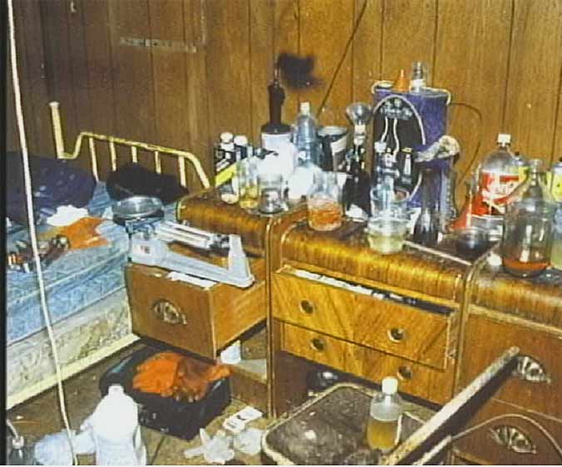

Effect of tenant’s illegal activities on property

Slide 48
Tenant’s illegal activities on property
Common Law
Unless lease provision, tenant does not forfeit lease
Modern Law
Tenant forfeits lease (also, forfeiture typically provided by lease provision)

Slide 49
Waste
Tenant has duties (similar to a life tenant) not to commit voluntary or involuntary waste.
Note interface with implied warranty of habitability.

Slide 50
Fixtures v. Improvements
If tenant installed fixture, tenant may remove and take as long as
No substantial damage, and
Repair (or pay for) all damage.
If tenant made improvement, it stays with property.
Issue = Has personal property (fixture) morphed all the way to real property?

Slide 51
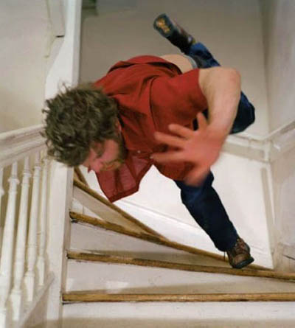
Injuries to Persons on Property

Slide 52
Common Law
Landlord not responsible unless:

Slide 53
Common Law
Landlord not responsible unless:
Fail to disclose known latent defects

Slide 54
Common Law
Landlord not responsible unless:
Fail to disclose known latent defects
Leased for admission of public

Slide 55
Common Law
Landlord not responsible unless:
Fail to disclose known latent defects
Leased for admission of public
Short-term lease of furnished dwellings

Slide 56
Common Law
Landlord not responsible unless:
Fail to disclose known latent defects
Leased for admission of public
Short-term lease of furnished dwellings
Breach of express covenant to repair

Slide 57
Common Law
Landlord not responsible unless:
Fail to disclose known latent defects
Leased for admission of public
Short-term lease of furnished dwellings
Breach of express covenant to repair
Negligence in making repairs

Slide 58
Common Law
Landlord not responsible unless:
Fail to disclose known latent defects
Leased for admission of public
Short-term lease of furnished dwellings
Breach of express covenant to repair
Negligence in making repairs
Injury in common area under landlord’s control

Slide 59
Common Law
Landlord not responsible unless:
Fail to disclose known latent defects
Leased for admission of public
Short-term lease of furnished dwellings
Breach of express covenant to repair
Negligence in making repairs
Injury in common area under landlord’s control
Breach of statutory duty to repair

Slide 60
Modern Law
Movement to adopt tort-based rule of reasonable care and foreseeability.

Slide 61
Landlord’s duty to protect tenant from third parties
Traditional rule = no duty
Modern rule = Was landlord negligent?

Slide 62
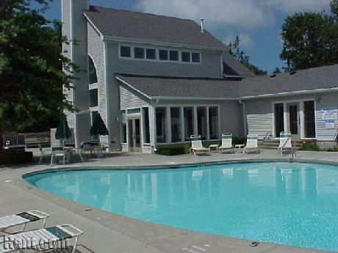
Walls v. Oxford Management Co.
Notes:
http://www.rent.com/apartments/new-hampshire/manchester-and-vicinity/nashua/432717/

Slide 63
Landlord’s Remedies

Slide 64
Basic landlord remedies
1. Terminate lease

Slide 65
Basic landlord remedies
1. Terminate lease
2. Sue for damages

Slide 66
Basic landlord remedies
1. Terminate lease
2. Sue for damages
3. Retain part or all of security deposit

Slide 67
Basic landlord remedies
1. Terminate lease
2. Sue for damages
3. Retain part or all of security deposit
4. Evict

Slide 68
Basic landlord remedies
1. Terminate lease
2. Sue for damages
3. Retain part or all of security deposit
4. Evict
5. Use landlord’s lien on contents

Slide 69

Eviction
Before 1381
Force allowed as long as no serious injury or death resulted.

Slide 70
Eviction
1381 Statute of Forcible Entry
Self-help eviction still allowed but must be peaceful.
Forcible entry not allowed.

Slide 71
Eviction
Modern law
Heavily regulated by statute.
Often long and costly procedures before landlord can have authorities remove a tenant.
Some states prevent landlord from denying services even to non-paying tenant.
Forcible detainer (“change locks”) may be prohibited, even if peaceful.

Slide 72

Retaliatory Eviction
Landlord takes action (e.g., evict, raise rent, terminate lease) to “get even” with tenant who asserts rights.
Texas = Prohibited under Property Code § § 92.331-.335

Slide 73
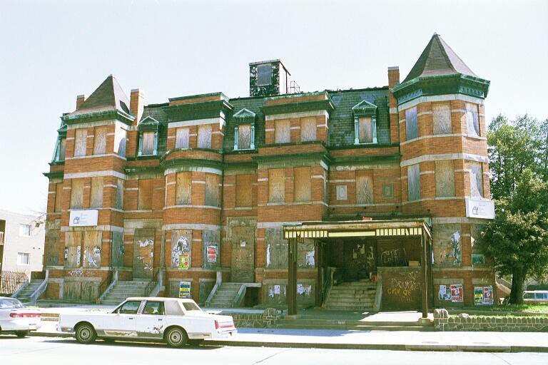
Edwards v. Habib
Notes:
Not real premises; just idea.
http://www.smartgrowthamerica.com/images/library/Abandoned%20Buildings/Boarded%20Columbia%20Heights.jpg

Slide 74
Transfers

Slide 75
By Landlord
Landlord may transfer the reversion (aka, sell the property).
Common law concept of “attornment” requiring the landlord to obtain the tenant’s consent is generally abolished (England = 1705).

Slide 76
By Tenant -- Generally
May landlord limit?
Commonly restricted by lease.
Courts normally uphold restriction but strictly construed.
But, growing trend to prevent landlord from withholding consent in an unreasonable manner.
But, also growing trend to require landlord’s express consent even if lease silent.

Slide 77
By Tenant -- Texas
Texas Property Code § 91.005.
“During the term of a lease, the tenant may not rent the leasehold to any other person without the prior consent of the landlord.”
Enacted in 1983 and never amended.

Slide 78
1. Assignment
Tenant transfers entire interest to assignee.
“substitution” analogy
Assignee is now tenant of landlord and they owe duties to each other.
But, original tenant still liable to landlord under original terms of lease unless landlord executes a release (not a mere consent).

Slide 79
2. Sublease
Tenant transfers less than entire interest to subtenant.
“Subinfeudation” analogy
Subtenant’s duties are to tenant, not landlord.
Landlord’s duties are to tenant, not subtenant.

Slide 80
3. How determine which?
Under given facts, may be difficult to determine.
Modern trend is to treat all lease transfers as assignments.

