Slide 1


Slide 2
Concurrent Ownership

Slide 3
General Idea
More than one person simultaneously has rights to the same interest or estate

Slide 4
Ways concurrent ownership may arise
Deed
Will
Intestate distribution

Slide 5
Basic types
Tenants in Common (voluntary)
Joint Tenants (voluntary)
Tenancy by the Entirety (voluntary)
Marital Estates (by operation of law)
Condos, Co-ops, Time Shares (modern)

Slide 6
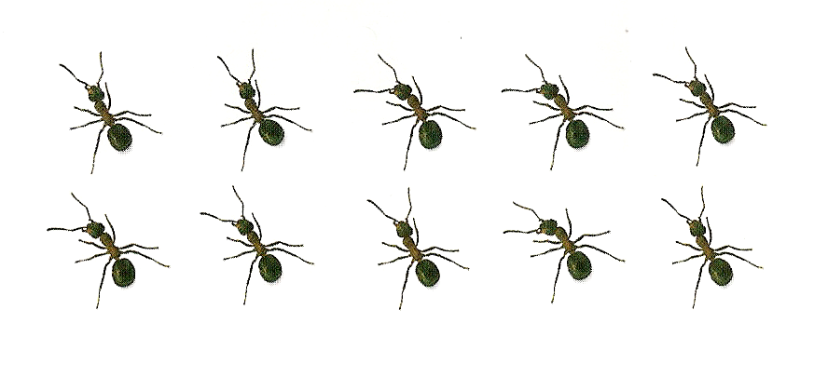
Tenants in Common

Slide 7
Tenants in Common
Default method under modern law
Sample grants:
  “To A and B”
  “To A and B as tenants in common”
  Passage to co-heirs by intestacy

Slide 8
Tenants in Common
No survivorship rights
  Upon death, deceased co-tenant’s share passes to successors in interest:
    Heirs, if intestacy
    Beneficiaries, if testate

Slide 9
Tenants in Common
No unity of time, title, or interest required.

Slide 10
Tenants in Common
Co-tenants have undivided interests
  Each has right to occupy the premises.
  Each has duty not to interfere with other co-tenants.
  Each has right to partition
    Agreement
    Court order

Slide 11
Joint Tenants
Default method under common law
Survivorship feature
“To A and B as joint tenants”
Note that many states require the survivorship feature to be expressly stated.
  “To A and B as joint tenants with right of survivorship.”
  Why?

Slide 12
Joint Tenants – Unities Required
1. Time
  O to “A and B as joint tenants.”
  O to “O and A as joint tenants.”

Slide 13
Joint Tenants – Unities Required
2. Title
  Take by same instrument
    Deed
    Will

Slide 14
Joint Tenants – Unities Required
3. Interest
  O to “A, B, and C as joint tenants.”
  O to “A 50%, B 25%, and C 25% as joint tenants.”

Slide 15
Joint Tenants – Unities Required
4. Possession
  Each has right to occupy the premises.
  Each has duty not to interfere with other co-tenants.

Slide 16
Joint Tenants
O to “A and B as joint tenants.”
  A conveys her interest to C.
  B and C are now tenants in common.
    Why?

Slide 17
Tenancy by the Entirety
Special type of joint tenancy between spouses which exists in about a dozen states.
A fifth unity – joint owners are married.
“To A and B as tenants by the entireties”

Slide 18
Marital Estates
Arise by operation of law, not because of intent of the parties.

Slide 19
Jure Uxoris
Upon marriage but before birth of child.
Husband has a life estate in wife’s property for the life of wife.
  Wife was considered not sui juris at common law.

Slide 20
Curtesy Initiate
Upon birth of first child and while wife is still alive.
Husband will have life estate in wife’s property until husband dies.
  Wife has, in effect, a reversion if Husband dies first.

Slide 21
Curtesy Consummate
Upon wife’s death assuming at least one child was born to the marriage.
Husband has life estate in wife’s property.

Slide 22
Dower
Wife has no lifetime interest in husband’s property.
Upon husband’s death, wife receives a life estate in 1/3 of husband’s real property he owned anytime during the marriage.
  Wife could waive her dower right.

Slide 23
Modern Protections for the
Surviving Spouse

Slide 24
Modern Protections for Surviving Spouse
1. Spouse made an heir.

Slide 25
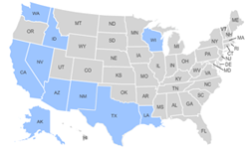
Modern Protections for Surviving Spouse
2. Common law marital property states = forced (elective) share

Slide 26
Modern Protections for Surviving Spouse
3. Community property marital property states = community property

Slide 27
Modern Protections for Surviving Spouse
4. Homestead
  Occupancy right
  Creditor protection

Slide 28
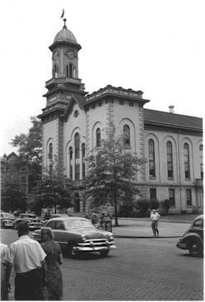
In re Estate of Micheal
Courthouse where case was litigated
Notes:
Courthouse: http://williamsport-pa.com/doyouremember/earlywpt/lyccourthouse.jpg

Slide 29
In re Estate of Michael
“To H and B, tenants by the entireties, and F and He, tenants by the entireties, with right of survivorship.”
H dies first; then B dies.
What interest, if any, did B own when B died?

Slide 30
Jackson v. O’Connell
A, B, and C held as joint tenants with survivorship rights.
A sold A’s interest to B.
B died leaving her interest to 4 nieces.
How much do the nieces receive?

Slide 31
Concurrent Ownership
[continued]

Slide 32
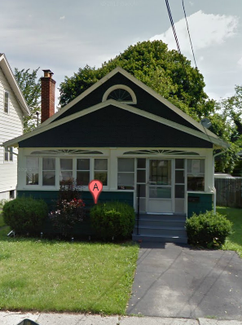
Matter of Estate of Vadney

Slide 33
Matter of Estate of Vadney
A conveyed “to A and B.”
A died.
How much does B now own?
  If TiC = A’s will beneficiaries takes A’s share
  If JT = B owns all

Slide 34

Duncan v. Vassaur

Slide 35
Duncan v. Vassaur
Husband and Wife owned property as joint tenants with survivorship rights.
Wife killed Husband.
Wife conveyed her share to her Father.
How much does Father own?

Slide 36

Laura v. Christian
Notes:
http://sangres.com/photos/culebra.htm

Slide 37
Laura v. Christian
Laura, Christian, and others hold as TiC.
Property in foreclosure.
Laura pays all amounts due.
What are Christian’s rights?
Notes:
http://sangres.com/photos/culebra.htm

Slide 38
Possession
Each co-tenant has right to occupy premises.
Each co-tenant has duty not to interfere with other co-tenant’s right to occupy.
General rule is that the occupying co-tenant does not owe rent to non-occupying co-tenants.

Slide 39
Income
Statute of Anne (1704) – A co-tenant who receives more than proportionate share of rent from third party must account to other co-tenants for the excess.
Accounting is for net profits.

Slide 40
Partition
Terminate concurrent ownership.
Voluntary
Judicial
  In Kind
  By Sale
Right of first refusal
Future interests?

Slide 41
Modern Forms of Concurrent Ownership

Slide 42
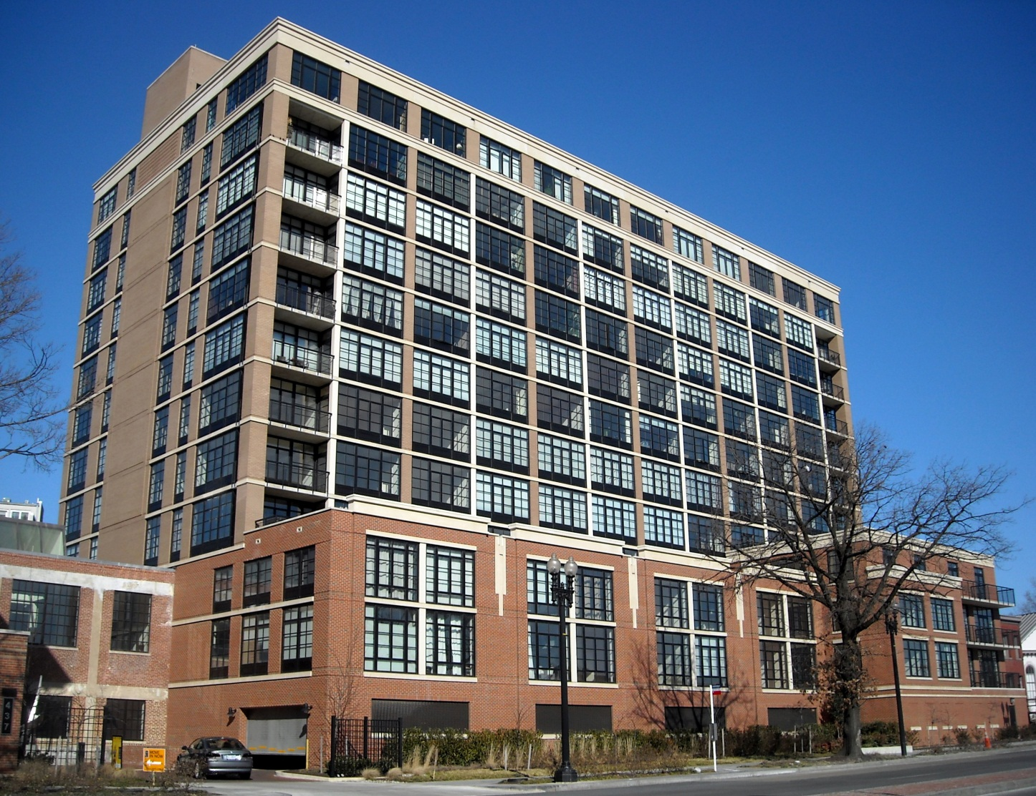
1. Condominium
Ownership of a designated vertical space.
Concurrent ownership of common areas.
Issue = Condominium conversion

Slide 43

2. Cooperative
Title to building held by a corporation
Individual buys stock to acquire right to occupy.
No true concurrent ownership of property.
More common in Northeast.

Slide 44


3. Time Share
Concurrent ownership but with occupancy right divided temporally.

