Slide 1
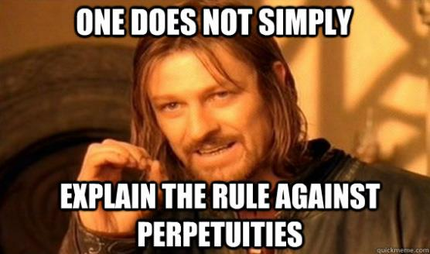

Rule Against Perpetuities

Slide 2

“Law student’s worst nightmare”

Slide 3
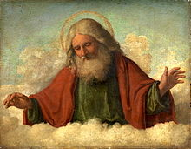

Who can explain it to you?
In 2017, the President of the State Bar of Texas Frank E. Stevenson, explained that he knew only two people who could explain RAP.

Slide 4
Classic Statement of RAP
An interest is not good* unless it must vest**, if at all, not later than 21 years after some life in being*** at the time of the creation of the interest, plus a period of gestation.
  * good = valid
  ** vest = “touch” the owner:
    Born,
    Ascertained, and
    No conditions precedent
  *** life in being = alive; born but not yet dead

Slide 5
RAP Goals -- Policies
Prevent remote vesting of contingent interests:
  Prevent long-term uncertainty regarding who owns the property without restrictions.
  Prevent undue restraints on land transfer which hurts economy.
  Limited dead-hand control.
  Keep property marketable.
  Curb power of wealthy families.

Slide 6
Interests Affected by RAP
The Test
All of the following must be true for RAP to apply:
  Future interest
    Not a present interest
  Partially or totally contingent, and
    Not totally vested
  Held by a non-charitable transferee
    Not an interest retained by grantor
    Not a charitable transferee

Slide 7
Interests Affected by RAP
The Interests
Thus, if you classify an interest as one of the following, you must always check for a RAP violation:
  Contingent remainder,
  Vested remainder subject to open, and
  Executory interest (including a trust).
  No other interests require a RAP analysis!!

Slide 8
Effect of Violation – Common Law
The violating interest is void from moment of creation.
Read grant as if the violating interest is not there.
Thus, a grantee or beneficiary loses ownership of the interest.

Slide 9
Determining violation – Date
Analyze grant from date of creation (not now):
  Deed = when the grantor executed the deed
  Will = when the testator died
  Trust = when trust becomes irrevocable

Slide 10
Determining violation – Test
If any hypothetical fact pattern at date of determination could violate RAP, then RAP is violated, regardless of how unlikely it is to happen.
  No one is ever too young or too old to have children.
  No one’s death is imminent regardless of how old or ill.

Slide 11
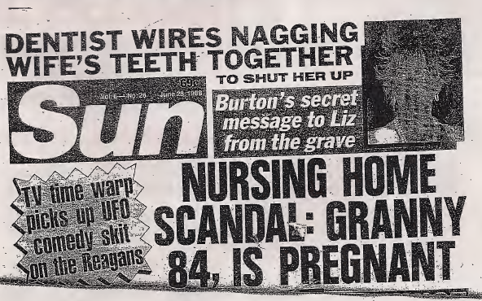
“Proof” of Unusual Situations

Slide 12
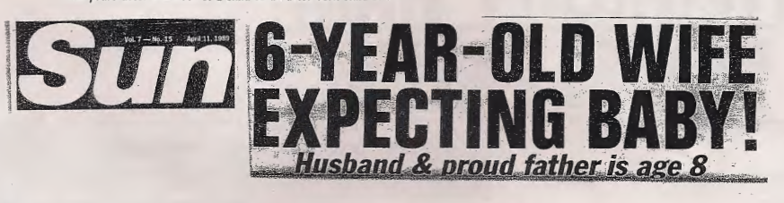
“Proof” of Unusual Situations

Slide 13
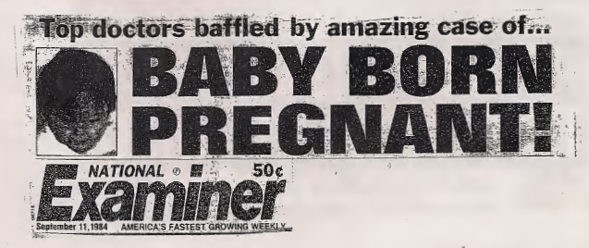
“Proof” of Unusual Situations

Slide 14
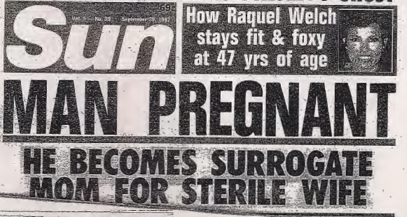
“Proof” of Unusual Situations

Slide 15
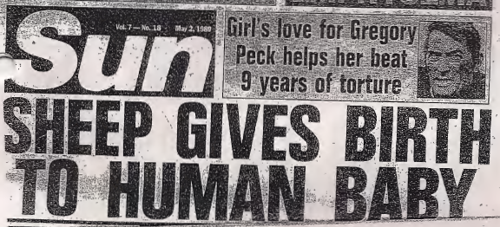
“Proof” of Unusual Situations

Slide 16



Slide 17
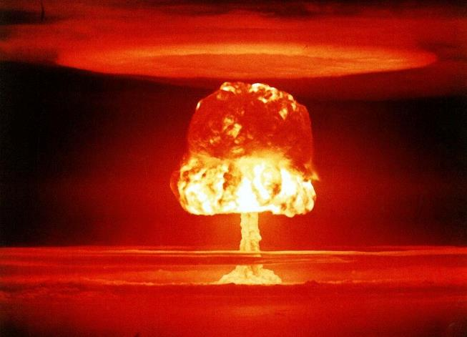
The Armageddon Approach

Slide 18
The Armageddon Approach
5:00 a.m. = interest created to which RAP applies
  Deed delivered, or
  Testator dies
6:00 a.m. = all lives in being give birth to a healthy baby.
  These babies are not lives in being.
Noon = all lives in being die but were successful in saving all of the babies born earlier in the day.
At 12:01 p.m., do you know for sure that the interest will vest (or not vest – born, ascertained, no conditions precedent) by the end of the next 21 years?
  If yes = RAP not violated; interest is OK.
  If no = RAP is violated; interest is void

Slide 19
“Big Picture” Steps
1. Classify interests as written.
2. See if RAP applies to each interest.
3. If yes, apply RAP analysis.
4. If RAP violated, strike out interest.
5. Reclassify and repeat.

Slide 20
Example 1
“To A and his heirs for so long as no liquor is consumed on the premises.”

Slide 21
Example 2
“To A and his heirs for so long as no liquor is consumed on the premises, but if liquor is consumed on the premises, then to B and her heirs.”

Slide 22
Example 3
“To A and his heirs as soon as liquor is sold on the premises.”

Slide 23
Example 4
A trust provides:
  “The property is to be held in trust for Clark (my son) for life, then after Clark’s death, to Clark’s children (my grandchildren) equally when the youngest reaches age 25.”
  The interest to Clark’s children is void!

Slide 24
Example 5
“To the American Red Cross, but if the land is not used for hospital purposes, then to The Texas Tech University School of Law.”

Slide 25
Example 6
“To A for life, then to A’s children for their lives, and then to A’s grandchildren and their heirs who are living when A’s last surviving child dies.”
  A is alive and has two living children, X and Y.

Slide 26

Rule Against Perpetuities

Slide 27
Modern Changes to RAP
1. Wait and see
    Look at what really happens, not what could happen.
    Make decision of validity at end of RAP time rather than at time of grant.

Slide 28
Modern Changes to RAP
2. Expand time period
    Nevada = 365 years
    Wyoming = 1,000 years
    Delaware = 110 years

Slide 29
Modern Changes to RAP
3. Reformation using cy pres
    Equitable approximation of the grantor’s intent.

Slide 30
Modern Changes to RAP
4. Uniform Statutory Rule Against Perpetuities
  90 year period
  Runs from date of grant (rather than death of lives in being)
  Wait and see
  If still violates, mandatory reformation

Slide 31
Modern Changes to RAP
5. Complete repeal

Slide 32
Example 4 (redux)
A trust provides:
  “The property is to be held in trust for Clark (my son) for life, then after Clark’s death, to Clark’s children (my grandchildren) equally when the youngest reaches age 25.”
  The interest to Clark’s children is void!

Slide 33

What happens if RAP violated in Texas?
Reformation – Property Code § 5.043
  Court must reform or construe interests that violate RAP.
  Follow settlor’s ascertainable general intent.
  Court must liberally construe statute.
  Court may use cy pres when it reforms or construes.

Slide 34
Kettler – Tex. Sup. Ct. 1964
“I want my ranch * * * to be set up in a perpetual trust. I specify that it must never be sold. The income to be divided equally between my direct blood heirs as long as there is a blood heir of mine living * * *.”

Slide 35
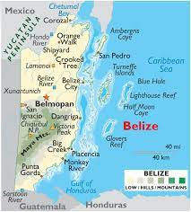

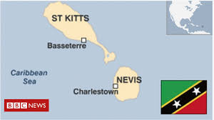
Move Offshore -- examples
  Cook Islands
  Belize
  Nevis

Slide 36
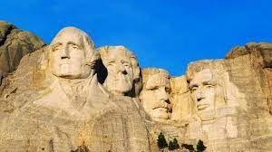

Move to Dynasty friendly states
South Dakota
Nevada

Slide 37

Texas was left out

Slide 38

Texas joins!
Attempts were made for almost 20 years.
Finally succeeded in 2021.
Property Code
§ 112.036.

Slide 39
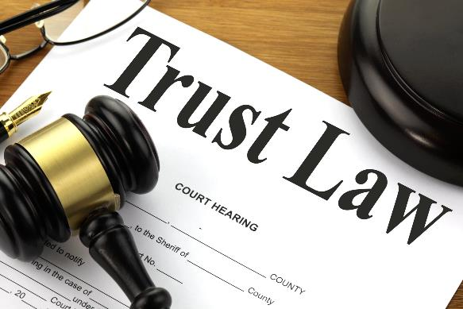
Limitation
Applicable only to property held in trust.

Slide 40
Key Fact – Date of Irrevocability
Inter Vivos Trust
  Date of creation if irrevocable.
  Date trust becomes irrevocable by the terms of the trust:
    Amendment making revocable trust irrevocable.
    Death of all people who could revoke.
Testamentary Trust
  Date of the testator’s death.

Slide 41

If irrevocable on or after 9/1/21
The trust interest may last for 300 years.

Slide 42
If irrevocable before 9/1/21
“Old” Rule Against Perpetuities applies unless trust instrument provides vesting under Property Code § 112.036.

Slide 43

Limitation
The settlor cannot direct that real property be retained or not sold for more than 100 years.

Slide 44

Are changes unconstitutional?
“Perpetuities * * * are contrary to the genius of a free government, and shall never be allowed * * *.” Art. 1, § 26.

Slide 45

Take risk? “Do you feel lucky?”
Wait for Texas Supreme Court decision, or
Continue to go out-of-state or offshore?

Slide 46
Possible approach – Option 1
Draft trust to end both ways.
  If the amendments are deemed constitutional, then the trust ends 300 years after my death.
  But if the amendments are deemed unconstitutional, then the trust ends 21 years after the death of the survivor of my spouse, my descendants, and the descendants of Queen Elizabeth II of England who are alive at the time of my death.

Slide 47
Possible approach – option 2
“If a court of proper jurisdiction finds that this [grant or trust] violates the Rule Against Perpetuities, the remaining trust property shall be distributed to [Named Grantee/Beneficiary].”

Slide 48
Recent Texas Cases

