Slide 1


Slide 2
Executory Interests

Slide 3
Elements of
Executory Interests
In favor of a transferee (not the grantor),
and
Does not qualify as a remainder.

Slide 4
The “Gap”
“To A and her heirs one month from today.
  A has executory interest (one month gap)
  Grantor has fee simple subject to executory limitation

Slide 5
The “Divestment”
“To A and her heirs as long as lottery tickets are not sold on the premises; but if lottery tickets are sold on the premises, then to B and his heirs.”
  B has executory interest.
  A has fee simple subject to executory limitation.

Slide 6
Common Law Background
Executory interests not recognized.
Equity courts would, however, recognize them as equitable interests.
Development of the use
  But, crown not like as avoided feudal incidents.
  But, owner not like as law courts not recognize.

Slide 7
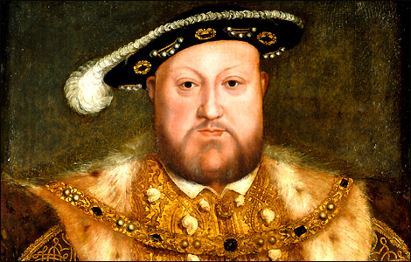
Statute of Uses -- 1535
The “execution”
  “To A and his heirs for the use of B and his heirs.”
    B’s equitable
    interest
    eliminated.
    B obtains FSA.

Slide 8
Statute of Uses -- 1535
The “use on use” exception
  “To A and his heirs for the use of B and his heirs for the use of C and his heirs.”
    B would hold for the use of C.

Slide 9
Statute of Uses -- 1535
The “active use” exception
  “To A and his heirs for the use of B and his heirs.”
    Use not executed if A had duties with respect to the land.
    This exception developed into modern trust law.

Slide 10
Statute of Uses -- Texas
Texas Trust (Property) Code § 112.032
  (a) Except as provided by Subsection (b), title to real property held in trust vests directly in the beneficiary if the trustee has neither a power nor a duty related to the administration of the trust.
  (b) The title of a trustee in real property is not divested if the trustee's title is not merely nominal but is subject to a power or duty in relation to the property.

Slide 11
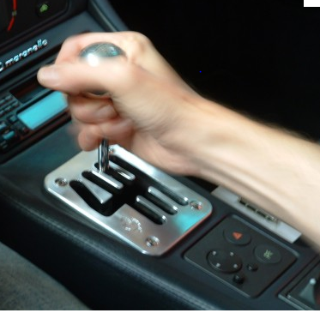
Shifting Executory Interest
To become possessory, the interest:
  Divests a present interest or a vested future interest, and
  Divests another transferee (not the grantor)

Slide 12
Shifting Executory Interest
“To A and his heirs as long as liquor is never sold on the premises and if it is, then to B and her heirs.”
  A = fee simple subject to an executory limitation
  B = shifting executory interest (B’s interest will divest a prior transferee, that is, A)

Slide 13

Springing Executory Interest
Divests the grantor of a retained interest after some period of time during which no other transferee has a present interest. [the “gap” situation]

Slide 14
Springing Executory Interest
“To A and his heirs, this deed to take effect three years after its date.”
  Grantor = Fee simple subject to a springing executory limitation
  A = springing executory interest

Slide 15
Springing Executory Interest
“To A for life and one year after A’s death, to B for life.”
  A = life estate
  B = springing executory interest in a life estate
  Grantor = reversion
    after A dies, for one year, and
    after B dies

Slide 16
Powers of Appointment

Slide 17
Powers of Appointment
“stick” of right [not a duty] to name new owner
General = everyone (even donee)
Special or limited = as donor provided

Slide 18
Trusts

Slide 19
Basic Idea
Settlor
Legal Equitable
Interest Interest
Trustee Beneficiary

Slide 20
Basic Functioning
Settlor transfers legal title to trustee (honest and reliable) and equitable title to beneficiary (deserving of windfall).
Trustee manages property according to legal duties and settlor’s instructions.
Trustee distributes to beneficiaries according to settlor’s instructions.
Trust ends when duties complete.

Slide 21
Purposes and Uses of Trusts
1. Provide for and protect beneficiary
  Minors
  Incompetents
  People without management skills
  Spendthrifts

Slide 22
Purposes and Uses of Trusts
2. Flexibility of asset distribution
  Spread benefits over time.
  Give trustee discretion whom to pay and how much to pay.
  Set standards.
  Impose conditions.

Slide 23
Purposes and Uses of Trusts
3. Protection against settlor’s incompetence
  The “stand by” trust

Slide 24
Purposes and Uses of Trusts
4. Professional management of property

Slide 25
Purposes and Uses of Trusts
5. Probate avoidance.

Slide 26
Purposes and Uses of Trusts
6. Tax benefits

