Slide 1
Future Interests
Introduction

Slide 2
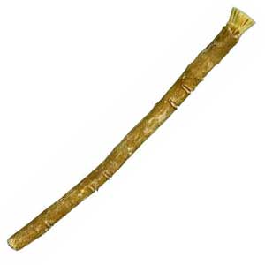
What is a future interest?
An estate that will or may become possessory at a future time.
The owner lacks the “stick of possession” but might obtain it at a later time.

Slide 3
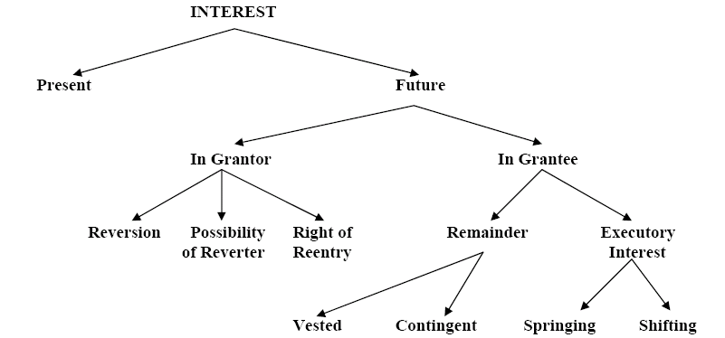
Future Interest Chart

