Slide 1
Remainders

Slide 2
Remainders – Generally
1. Future interest held by someone other than grantor
    Warning: Not all future interests held by a non-grantor qualify as remainders; they could be executory interests.

Slide 3
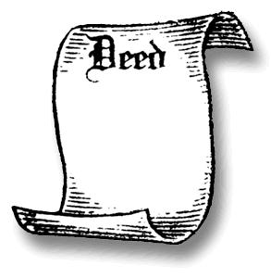
Remainders – Generally
2. Created by the same instrument (deed or will) as the possessory interest

Slide 4

Remainders – Generally
3. Becomes possessory immediately upon the expiration of the prior estate (no gaps).
  “To A for life, then one year after A’s death, to B and his heirs” would NOT create a remainder.
X

Slide 5

Remainders – Generally
4. Does not divest or shorten a prior estate; the prior estate must end naturally
  “To A for life, but if X becomes U.S. President, then to B and her heirs” would NOT create a remainder.
X

Slide 6
Remainder interests can be:
Fee simple
  Absolute (“and his/her heirs”)
  Determinable (“so long as,” “until,” “while”)
  Subject to condition subsequent or executory limitation (“but if . . ., then”)
Life estate
Estate for years

Slide 7

Vested Remainder
1. Owner is born and ascertained
2. Interest is not subject to condition precedent
  Nothing must happen for the owner to get “stick of possession” other than prior estate to end naturally.

Slide 8

1. Indefeasibly Vested Remainder
Owner of remainder will get possession
  “To A for life, then to B and her heirs.”

Slide 9
2. Vested Subject to Partial Divestment (Subject to Open)
Remainder limited to a class of which there is at least one living member.
  “To A for life, then to B’s children and their heirs” assuming:
    B has at least one child at the time of the conveyance, and
    B is still alive (so could have more children).

Slide 10
3. Vested Subject to Total Divestment
Vested remainder (either of the other two types) which is subject to a condition subsequent (“but if . . . , then”).
  “To A for life, then to B and her heirs, but if B predeceases A, then to C and his heirs.”

Slide 11
1. Indefeasibly Vested Remainder
Owner of remainder will get possession
  “To A for life, then to B and her heirs.”

Slide 12
2. Vested Subject to Partial Divestment (Subject to Open)
Remainder limited to a class of which there is at least one living member.
  “To A for life, then to B’s children and their heirs” assuming:
    B has at least one child at the time of the conveyance, and
    B is still alive (so could have more children).

Slide 13
3. Vested Subject to Total Divestment
Vested remainder (either of the other two types) which is subject to a condition subsequent (“but if . . . , then”).
  “To A for life, then to B and her heirs, but if B predeceases A, then to C and his heirs.”

Slide 14
Review Session Attendance
Will you attend the Review Session on Friday, February 20 from 11 a.m. to 1 p.m. and would enjoy having pizza for lunch?
  I will attend and will eat.
  I will attend but I will not eat.
  I will not attend.
  I will not attend but I might stop by to eat anyway.

Slide 15
Remainders
[continued]

Slide 16
Vested Remainders Review
Characteristics Generally
    Nothing must happen for the owner to get “stick of possession” other than prior estate to end naturally thus:
      Owner is born and ascertained, and
      Interest is not subject to condition precedent.
Types:
    Indefeasible Vested Remainder
      Owner of remainder will get possession.
    Vested Subject to Partial Divestment
      Owner of remainder will get possession but share may reduced if additional members join the class of grantees.
    Vested Subject to Total Divestment
      An event could occur to prevent grantee from getting possession,
      “but if” (condition subsequent) construction.

Slide 17
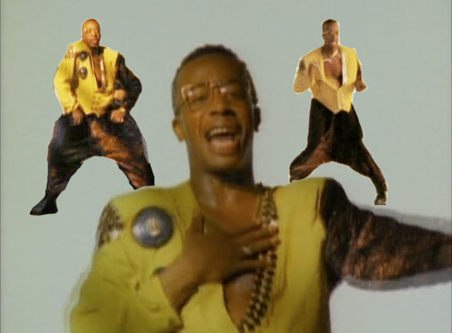
Contingent Remainder
Holder is unborn or unascertained.
or
A condition precedent must occur before the holder of the interest actually has the possibility of
obtaining possession.

Slide 18
Contingent Remainder – unborn scenario
“To A for life, then to B’s children and their heirs” assuming:
  B has no children, and
  B is still alive.
  Grantor retains a reversion because B could die without having a child.

Slide 19
Contingent Remainder – unascertained scenario
“To A for life, then to B’s heirs” assuming:
  B is still alive
    Cannot have heirs while alive.
  Grantor retains a reversion because B could die without heirs.

Slide 20
Contingent Remainder – subject to condition precedent scenario
“To A for life, then to B and her heirs if B marries before A’s death” assuming:
  B is still unmarried.
  Grantor retains a reversion because B might not marry before A’s death.

Slide 21
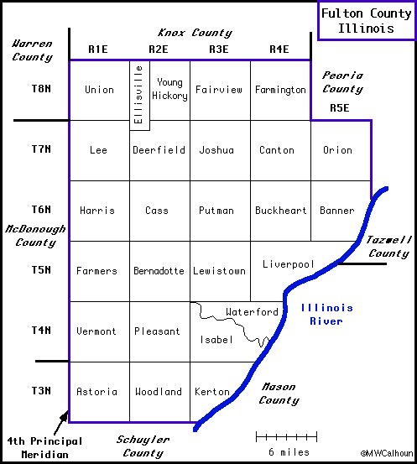
Kost v. Foster
Astoria Township -- NE 1/2 of Section 7, East 3/8 of S 1/2 of NW 1/2 of said Section 7, T3N R1E
Notes:
Property is in Astoria Township The Kost deed was recorded in Astoria Township and the legal is as follows:
NE 1/2 of Section 7, East 3/8 of S 1/2 of NW 1/2 of said Section 7, T3N R1E

Slide 22
Kost v. Foster
“To Ross * * * for his natural life only, at his death to his lawful children [one of whom is Oscar who went bankrupt] [and if a child predeceases, to that child’s descendants by representation].”
Issue = Is this a vested or contingent remainder?
    Important as under Illinois law at the time, contingent remainders were inalienable.
Notes:
Property is in Astoria Township The Kost deed was recorded in Astoria Township and the legal is as follows:
NE 1/2 of Section 7, East 3/8 of S 1/2 of NW 1/2 of said Section 7, T3N R1E

Slide 23
Destructibility of Contingent Remainders
What if the contingency could still happen after the prior estate ends?
  “To A for life, remainder to B and her heirs if B marries X”
    A could die with both B and X surviving but not yet married.
  To A for life, then to B and his heirs if B attains age 21”
    A could die with while B is still alive but under age 21.

Slide 24
Destructibility of Contingent Remainders
What if the contingency could still happen after the prior estate ends?
  Common law = contingent remainder destroyed, grantor’s reversion takes effect, and grantor has fee simple absolute.
  Modern law = grantor has fee simple subject to executory limitation, grantee has executory interest.

Slide 25
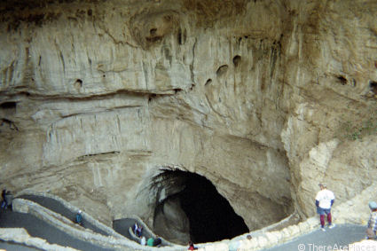
Abo Petroleum Corp.
Notes:
Carlsbad Caverns are in Eddy County

Slide 26
Problems – pp. 322-323
Life Estate
Reversion
Indefeasibly Vested Remainder
Vested Remainder Subject to Partial Divestment
Vested Remainder Subject to Total Divestment
Contingent Remainder
Executory Interest
Nothing

Slide 27
Remainders
[continued]

Slide 28
Rule in Shelley’s Case
Triggering facts:
  Grantee has a freehold interest in real property,
  and
  Heirs of same grantee have a remainder interest in same property.
    Remainder is contingent as grantee has no heirs until grantee dies.

Slide 29
Rule in Shelley’s Case
Result if Rule applies:
  Grantee’s heirs lose their contingent remainder.
  Grantee gains a remainder.
  If no intervening interests or conditions, grantee now has fee simple absolute.
    The sticks merge into a “full bundle.”

Slide 30
Rule in Shelley’s Case
“To A for life, then to A’s heirs.”
“To A for life, then to A’s heirs.”
Merger occurs (sticks come back into one bundle as in common ownership) thus giving A fee simple absolute.

Slide 31
Rule in Shelley’s Case
“To A for life and then to A’s heirs if A graduates from the Texas Tech University School of Law.”
“To A for life and then to A’s heirs if A graduates from the Texas Tech University School of Law.”

Slide 32
Rule in Shelly’s Case
“To A for life and then to A’s children and their heirs.”

Slide 33
Rule in Shelley’s Case
Historical Background

Slide 34
Rule in Shelley’s Case
Texas
  Sybert v. Sybert – p. 323
  Abolished for conveyances on or after
  January 1, 1964

Slide 35
Rule in Shelley’s Case
Problems – p. 328

Slide 36
Doctrine of Worthier Title
Triggering facts:
  Future interest transferred inter vivos to heirs of the grantor.

Slide 37
Doctrine of Worthier Title
Result:
  Future interest in heirs of the grantor is void.
    Read the deed as if the words are not there.
  Thus, grantor has a retained interest (reversion, possibility of reverter, etc.).

Slide 38
Doctrine of Worthier Title
From Grantor “to A for life and then to my [Grantor’s] heirs.”
From Grantor “to A for life and then to my [Grantor’s] heirs.”

Slide 39
Doctrine of Worthier Title
“To A and his heirs until A gets married, then to my heirs.”
“To A and his heirs until A gets married, then to my heirs.”

Slide 40
Doctrine of Worthier Title
Texas
  Abolished for conveyances on or after
  January 1, 1964

Slide 41
Doctrine of Worthier Title
Problem – page 334

