Slide 1

Defeasible Estates

Slide 2
Defeasible Estates
Grant of land that is, in some manner, conditional [not “absolute”]
Grantee could lose the “bundle of sticks”
Conditions may be added to:
Fee Simple
Life Estate
Term for Years
Three types

Slide 3
1. Fee Simple Determinable
“To A and her heirs so long as no alcoholic beverages are sold on the property.”
Word of Purchase = “To A”
Words of Limitation – Fee Simple = “and her heirs”
Words of Limitation – Determinable = “so long as no alcoholic beverages of sold on the property”

Slide 4
1. Fee Simple Determinable
“Magic” words of limitation to create a determinable estate:
“so long as [condition exists]”
“until [condition occurs]”
“while [condition exists]”

Slide 5
1. Fee Simple Determinable
Grantor’s retained interest is a Possibility of Reverter
Automatic divestment when condition breached
But court action may be needed if grantee does not leave voluntarily.

Slide 6
2. Fee Simple Subject to (on) a Condition Subsequent
“To A and his heirs but if alcohol is sold on the premises, the grantor may reenter and claim the land.”
Words of Purchase = “To A”
Words of Limitation – Fee Simple = “and his heirs”
Words of Limitation – Condition Subsequent = “but if alcohol is sold on the premises, the owner may reenter and claim the land.”

Slide 7
2. Fee Simple Subject to (on) a Condition Subsequent
“Magic” words of limitation to create a condition subsequent:
“but if [condition occurs], then”
“provided that if [condition occurs], then”
“on the condition that if [condition occurs], then”

Slide 8
2. Fee Simple Subject to (on) a Condition Subsequent
Grantor’s retained interest is:
Right to Reenter, or
Power of Termination
Divestment requires grantor’s affirmative act.
Interest could be lost by waiver or estoppel.

Slide 9


Slide 10
Defeasible Estates [continued]

Slide 11
Review
Fee simple determinable
Key words of limitation = so long as, until while
Grantor retains “possibility of reverter”
Automatic divestment when condition breached
Fee simple subject to a conditional subsequent
Key words of limitation = “but if … then” format
Grantor retains “right of reentry” or “power of termination”
Divestment requires grantor to take action

Slide 12
3. Fee Simple Subject to Executory Limitation
“To A and her heirs so long as no alcoholic beverages are sold on the property, then to B and his heirs.”
Words of Purchase = “To A”
Words of Limitation – Fee Simple = “and her heirs”
Words of Limitation – Executory Limitation = “as long as no alcoholic beverages are sold on the property”
“then to B and his heirs” gives B an executory interest in fee simple absolute

Slide 13
3. Fee Simple Subject to Executory Limitation
Interest of third party = Executory Interest
Automatic divestment if condition breached.

Slide 14
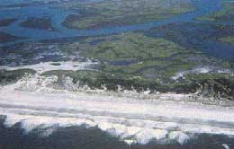
Oldfield v. Stoeco Homes

Slide 15
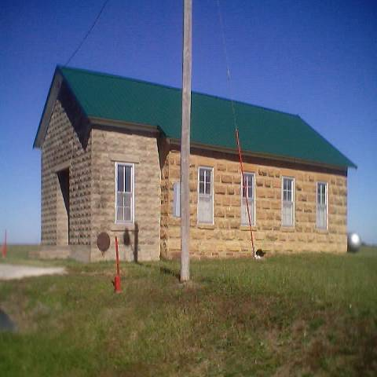
Roberts v. Rhodes
Notes:
Dear Professor Beyer,
Here are the pictures that I promised you from Kansas to go along with the Rhodes case. Both the white and brown sandstone buildings were school houses (now used for the Eager Beavers' 4-H house), probably around the same time as the one in the case, and they are located not too far from where the schoolhouse in the case was located. The other pictures you might need to adjust your monitor to see more clearly. The outdoor pic is right across the street from the sandstone school and it is a cementary which I thought went along with the case as well. Last but not least, there is a pic of my twin nieces sleeping after an afternoon of playing photographer and a pic of our local bar, Bert's Tavern, slogan is "We just look expensive". Hope this gives you a bigger insight into the wonderful land of OZ!
See you tommorrow,
Kandice Sanaie

Slide 16
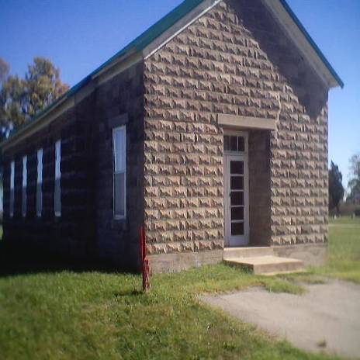
Roberts v. Rhodes
Notes:
Dear Professor Beyer,
Here are the pictures that I promised you from Kansas to go along with the Rhodes case. Both the white and brown sandstone buildings were school houses (now used for the Eager Beavers' 4-H house), probably around the same time as the one in the case, and they are located not too far from where the schoolhouse in the case was located. The other pictures you might need to adjust your monitor to see more clearly. The outdoor pic is right across the street from the sandstone school and it is a cementary which I thought went along with the case as well. Last but not least, there is a pic of my twin nieces sleeping after an afternoon of playing photographer and a pic of our local bar, Bert's Tavern, slogan is "We just look expensive". Hope this gives you a bigger insight into the wonderful land of OZ!
See you tommorrow,
Kandice Sanaie

Slide 17
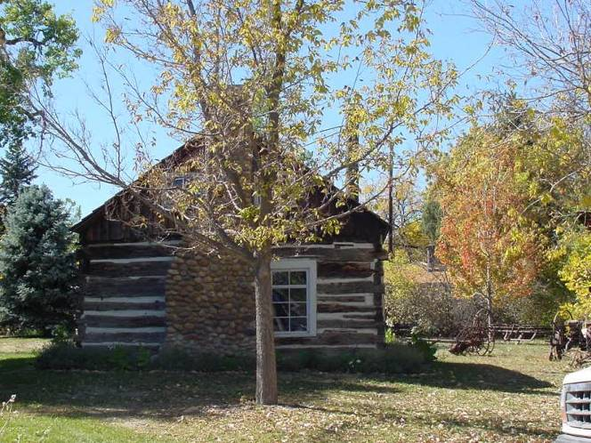
Johnson v. City of Wheat Ridge
Johnson Park
Notes:
http://community.webshots.com/photo/52430492/52430648wlhoUY
This is picture of actual Johnson Park

Slide 18
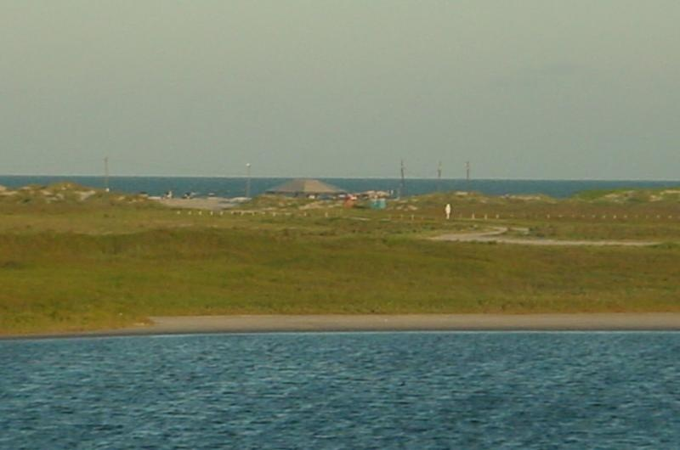
Leeco Gas v. County of Nueces
Packery Channel Park
Notes:
Hi Professor Beyer!
I did not notice that the land in question was on South Padre Island in Nueces County, which is about 3 hours from where I live, as opposed to the South Padre Island in Cameron County, which is about 30 minutes from where I live. I thought I would get a chance to drive by the Nueces County beach on my way back up to San Antonio yesterday, but the weather really didn't permit that. While surfing the net, I did find a picture of the Packery Channel Park, which I believe is the land in question in the Leeco case. Please find the picture attached and I apologize for not getting anything better to you. Have a great evening and I'll see you in class tomorrow!
Sincerely,
Noemi Garcia

Slide 19
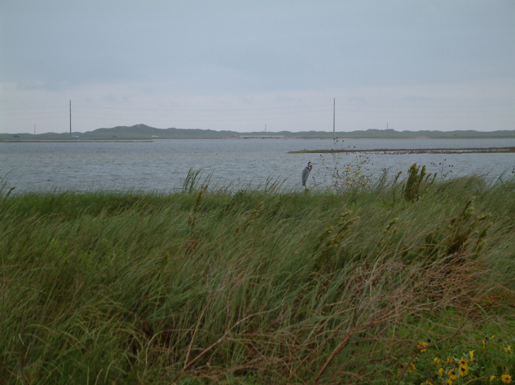
Leeco Gas v. County of Nueces
Packery Channel Park
Notes:
Professor Beyer,
I was able to get two pictures of the land on Padre
Island for you, aka Packery Channel Park.
It was a little bit of an exercise in research to find
it. I talked with a few locals who ran the visitor's
center there, who said that the Packery Channel park
(the name that was mentioned in the appellate brief
that was published), was still in operation in the
same spot, even after it was "closed". After the park
was condemned and the case was over, Nueces County
kept the land as a public use park, but took out all
of the park amenities (playground equipment, tables,
etc.) It is now just a piece of land that neighbors
the Packery Channel and the first homes built on Padre
Island.
The two pictures are of looking over the land towards
Park Road 22, and the other is overlooking the channel
(I was able to include a Heron in the photo at no
additional charge).
-John Rightmyer

Slide 20
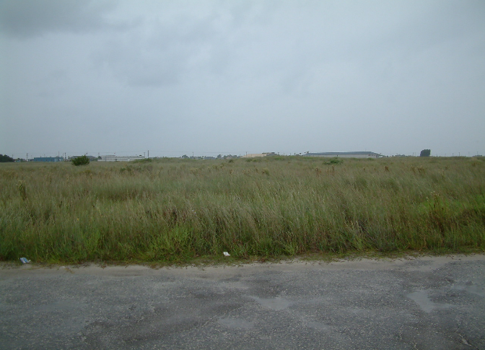
Leeco Gas v. County of Nueces
Packery Channel Park

Slide 21
Defeasible Estates Problems [pp. 299-300]
Nothing (stickless).
Fee simple absolute.
Life estate.
Fee simple determinable.
Fee simple subject to condition subsequent.
Fee simple subject to executory limitation.
Reversion.
Remainder.
Possibility of reverter.
Power of termination [right of reentry].
Executory interest.

Slide 22
Defeasible Estates [continued]

