Slide 1
Life Estates

Slide 2
Life Estate Characteristics
1. Possessory rights
Current, and
Until death

Slide 3
Life Estate Characteristics
2. Ability to transfer
May sell or gift but new owner has possessory rights only until prior owner dies.
Life estate pur autre vie
(for the life of another)

Slide 4
Life Estate Characteristics
3. Measuring life may be someone other than grantor or grantee
“A to B for the life of C.”

Slide 5
Life Estate Characteristics
4. Ability to transfer at death
Life estate = no
Life estate pur autre vie = yes

Slide 6
Life Estate Characteristics
5. Upon measuring person’s death:
Reversion – back to grantor
Remainder – to person specifically mentioned by grantor

Slide 7
Life Estates [continued]

Slide 8
Life Estate Creation
“To A for life”
“To A” = words of purchase
“for life” = words of limitation

Slide 9
Lewis v. Searles
Second, I devise to my niece, Hattie L. Lewis, all of my real and personal property * * * so long as she remains single and unmarried. In the event that the said Hattie L. Lewis shall marry, then and in this event I desire that all of my property, * * * be divided equally between my nieces and nephews as follows, to the said Hattie L. Lewis, an undivided one third, to Letitia A. LaForge, wife of A. C. LaForge, an undivided one third, and to James R. Lewis an undivided one third.

Slide 10
Rights & Duties of Life Tenant
1. Keep property in repair

Slide 11
Rights & Duties of Life Tenant
2. Pay property taxes

Slide 12
Rights & Duties of Life Tenant
3. Pay interest on mortgage
Life tenant is not responsible for paying principal of mortgage.

Slide 13
Rights & Duties of Life Tenant
4. Entitled to rents and profits

Slide 14
Rights & Duties of Life Tenant
5. Cannot create interests that extend beyond measuring person’s life.

Slide 15
Rights & Duties of Life Tenant
6. Allow reasonable inspection by reversioner or remainderman

Slide 16
Rights & Duties of Life Tenant
7. Cannot commit waste
Voluntary waste
Deliberate or destructive action
Permissive waste
Failing to exercise reasonable care to preserve and protect

Slide 17
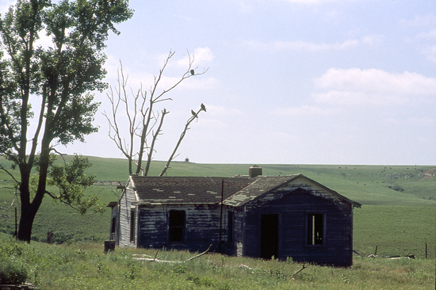
Moore v. Phillips

Slide 18

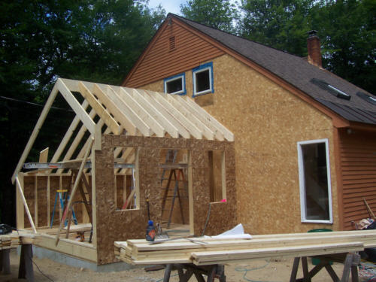
What if waste improves property?
Common law = waste
Example: ________________
Ameliorating waste exception
Perhaps if property value increased
Example:

Slide 19
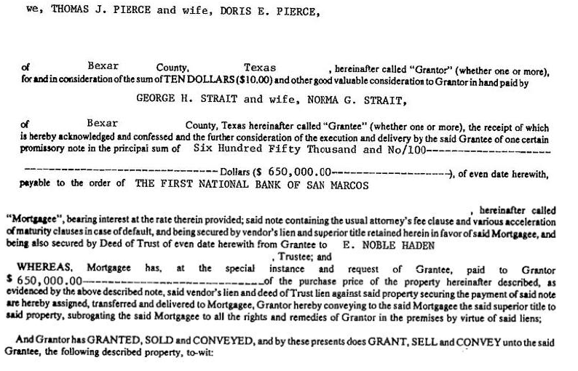
George Strait Deed

Slide 20
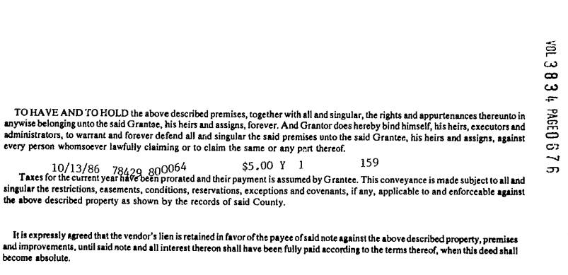
George Strait Deed

