Slide 1
Private Interests in Land Introduction

Slide 2
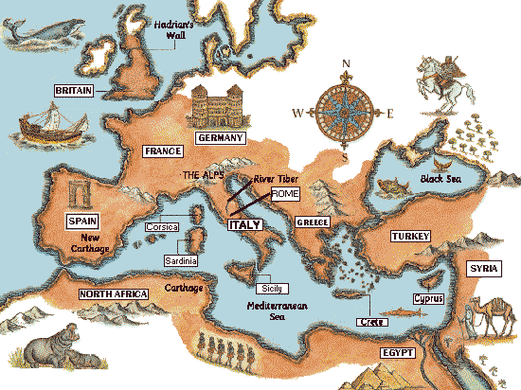
Roman Empire Flourishes

Slide 3
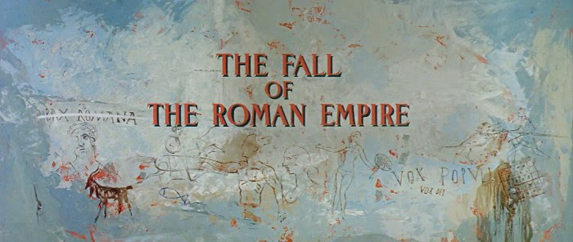
Roman Empire Collapses

Slide 4
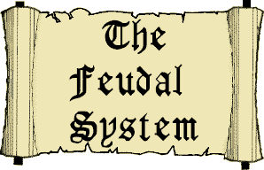
Rise of Feudalism

Slide 5
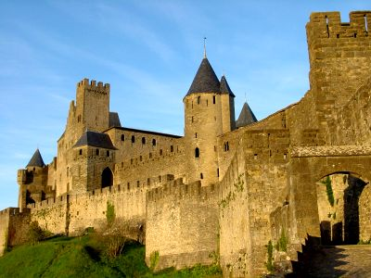
Overlords provide protection

Slide 6
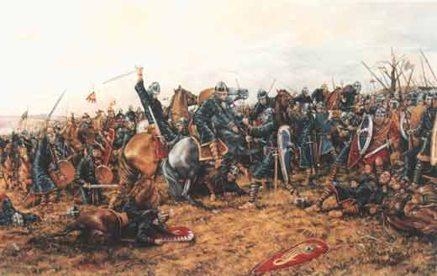
Norman Conquest -- 1066
Battle of Hastings
William the Conqueror prevails

Slide 7
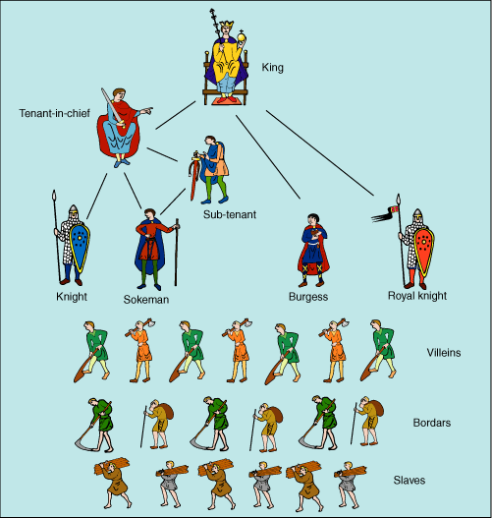
English Feudalism

Slide 8
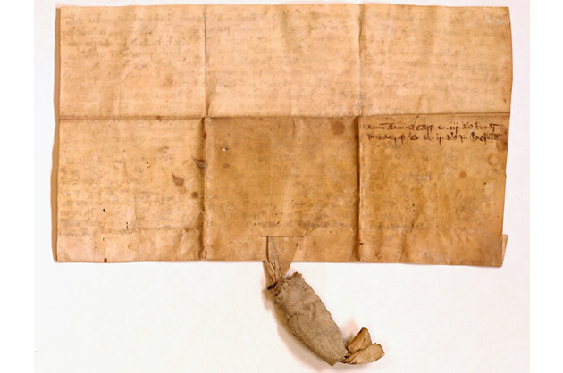
Statute of Quia Emptores 1290
Abolishes subinfeudation
Conveyance now by substitution

Slide 9
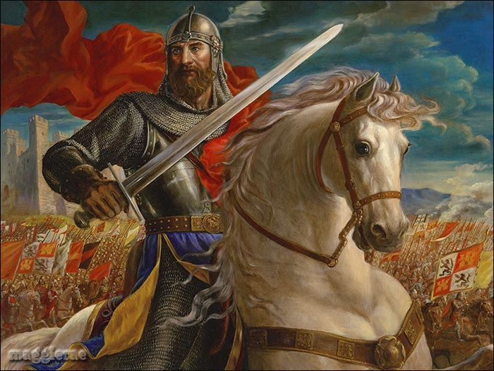
Forms of Free Tenure
Knight Service

Slide 10
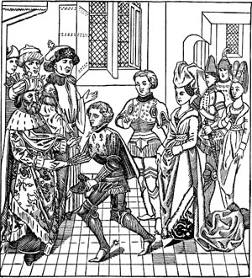
Forms of Free Tenure
Serjeanty

Slide 11
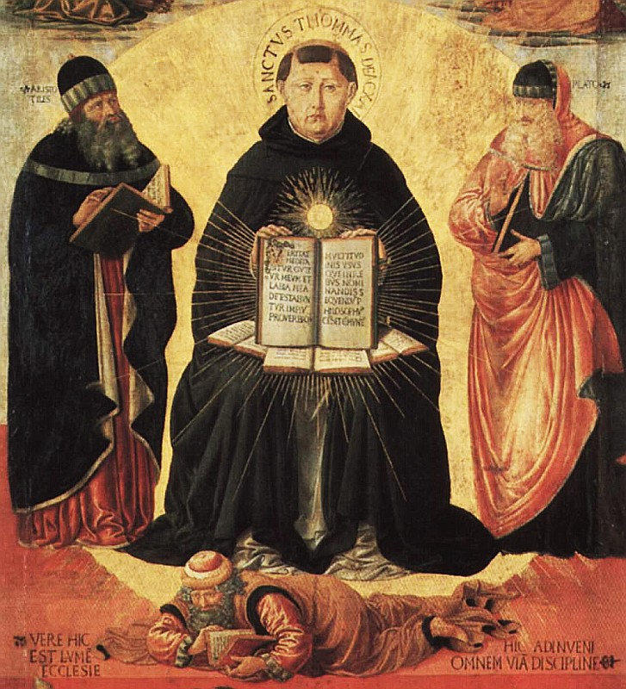
Forms of Free Tenure
Frankalmoin

Slide 12
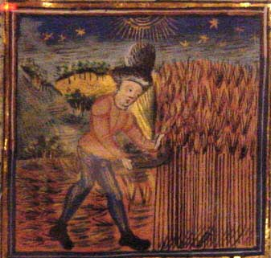
Forms of Free Tenure
Socage

Slide 13
Common Incidents of Tenure
1. Homage

Slide 14
Common Incidents of Tenure
1. Homage
2. Fealty

Slide 15
Common Incidents of Tenure
1. Homage
2. Fealty
3. Aids (financial support)

Slide 16
Common Incidents of Tenure
1. Homage
2. Fealty
3. Aids (financial support)
4. Escheat

Slide 17
Common Incidents of Tenure
1. Homage
2. Fealty
3. Aids (financial support)
4. Escheat
5. Relief

Slide 18
Common Incidents of Tenure
1. Homage
2. Fealty
3. Aids (financial support)
4. Escheat
5. Relief
6. Wardship

Slide 19
Common Incidents of Free Tenures
1. Homage
2. Fealty
3. Aids (financial support)
4. Escheat
5. Relief
6. Wardship
7. Marriage

Slide 20
Unfree Tenures
Villeins
Copyholders

Slide 21
Private Interests in Land Introduction [continued]

Slide 22
“Modern” English Developments
1660 – Statute of Tenures
Many feudal incidents changed into mere monetary duties
1925 – Property Legislation
All feudal incidents abolished

Slide 23
Tenure in the U.S.
English grants
“free and common socage”
After Revolution
Abolish all feudal tenures
Treat all land as free
Ignore (presumably, all free)

Slide 24
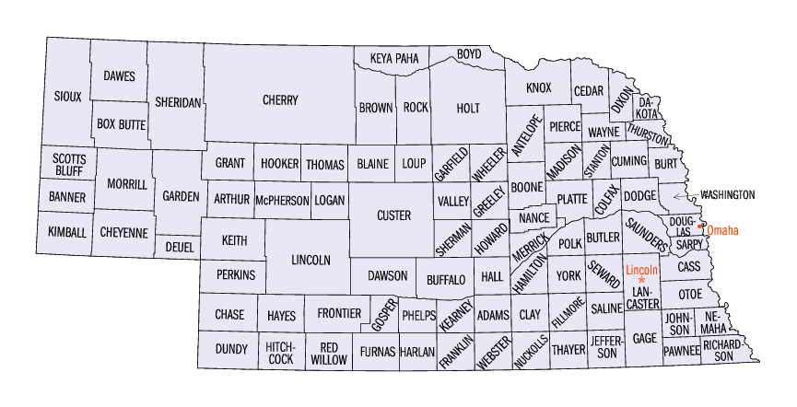
In re O’Connor’s Estate
Adams County

