Slide 1
57th Grammy Awards
What did you think of the Awards show?
Did not watch and do not care.
Great to see AC/DC perform Highway to Hell.
Always fun to see Kim and Kayne.
Sam Smith is awesome!
Disappointed that FFDP was not even nominated for Wrong Side of Heaven.

Slide 2
Freehold Estates Introduction

Slide 3
Characteristics of Real Property Interests (the “sticks”)
1. Duration – how long does interest last?
Forever
Life only
Fixed number of years
Only as long as a condition satisfied

Slide 4
Characteristics of Real Property Interests (the “sticks”)
2. Ability to Transfer
Inter Vivos
Gift
Sell
At Death
To heirs (intestacy)
To beneficiaries (will)

Slide 5
Characteristics of Real Property Interests (the “sticks”)
3. Limitations on use of land

Slide 6
Freehold Estates
Based on free tenures at common law.
Owner has “seisin” – a right greater than possession (more than a tenant).
Transfer by “livery of seisin”
“turf and twig”

Slide 7
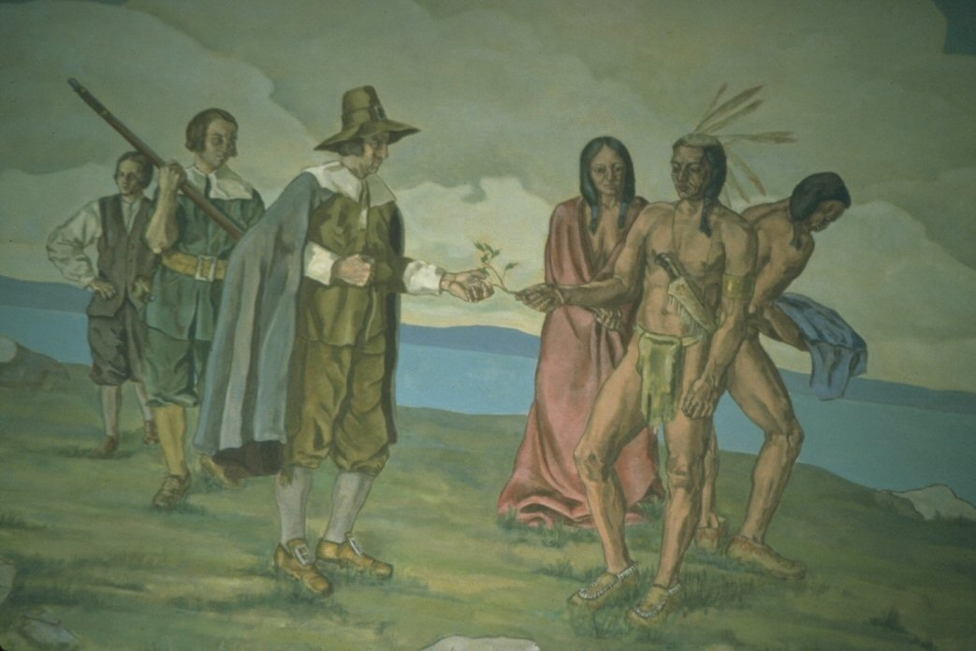
Livery of seisin
twig
grantee
grantor
witnesses

Slide 8
Fee Simple Absolute

Slide 9
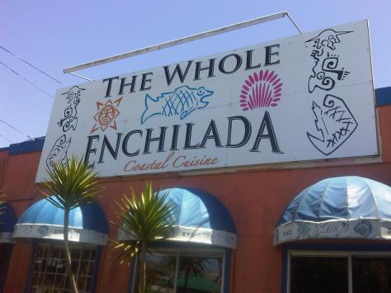
Fee Simple Absolute

Slide 10
Fee Simple Absolute
Largest estate known at common law (biggest bundle of sticks).
Present right to possess
Right to possess until death
No conditions on possession (except societal ones)
Transferable inter vivos (gift or sell)
Transferable at death (heirs or beneficiaries)

Slide 11
Fee Simple Absolute
“To A and his heirs.”
“To A” = Words of Purchase [who takes] [does not mean grantee paid for land]
“and his heirs” = Words of Limitation [what is taken] [heirs received nothing]

Slide 12
Texas Property Code § 5.001
(a) An estate in land that is conveyed or devised is a fee simple unless the estate is limited by express words or unless a lesser estate is conveyed or devised by construction or operation of law. Words previously necessary at common law to transfer a fee simple estate are not necessary.
(b) This section applies only to a conveyance occurring on or after February 5, 1840.

Slide 13
Cole v. Steinlauf
“To A and assigns forever.”
Does this create:
fee simple absolute, or
life estate?

