Slide 1
Donative Transfers Introduction

Slide 2
Basic Idea
True owner
Transfers property intentionally
Gratuitously (no consideration)
To person who then becomes the true owner

Slide 3
Overview of Donative Transfers
1. Inter Vivos Gifts
Donor alive when gift made.

Slide 4
Overview of Donative Transfers
1. Inter Vivos Gifts
Donor alive when gift made.
2. Gifts Causa Mortis
Donor alive when gift made but made in contemplation of death.

Slide 5
Overview of Donative Transfers
1. Inter Vivos Gifts
Donor alive when gift made.
2. Gifts Causa Mortis
Donor alive when gift made but made in contemplation of death.
3. At Death Gifts
Intestate succession
Testate succession (will)
Non-probate transfers (contracts, survivorship rights, etc.)

Slide 6
Policies behind requiring formalities
Formalities needed; otherwise, transfer typically ineffective. Why?
1. ____________________
2. ____________________
3. ____________________

Slide 7
Inter Vivos Gifts

Slide 8
Summary of inter vivos gift elements
1. Present donative intent
2. Delivery
3. Acceptance

Slide 9
1. Present Donative Intent
Voluntary

Slide 10
1. Present Donative Intent
Voluntary
No consideration or compensation

Slide 11
1. Present Donative Intent
Voluntary
No consideration or compensation
Presently effective

Slide 12
1. Present Donative Intent
Voluntary
No consideration or compensation
Presently effective
Irrevocable

Slide 13
1. Present Donative Intent
Voluntary
No consideration or compensation
Presently effective
Irrevocable
Evidence of present donative intent:
______________________________________

Slide 14

2. Delivery
1. Physical delivery of property from donor to donee

Slide 15

2. Delivery
2. Delivery of property to a third party, who is not under donor’s control, with irrevocable instructions to deliver to donee

Slide 16

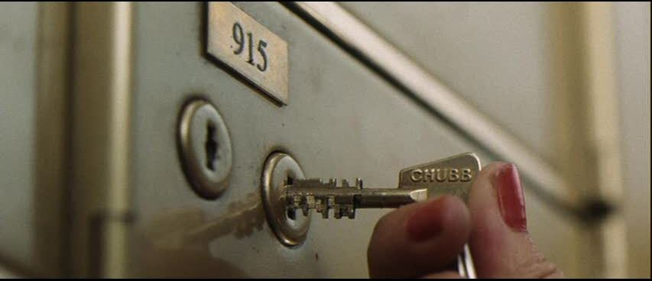
2. Delivery
3. Constructive Delivery
Donor transfers to donee the means of obtaining possession and control of the property.

Slide 17
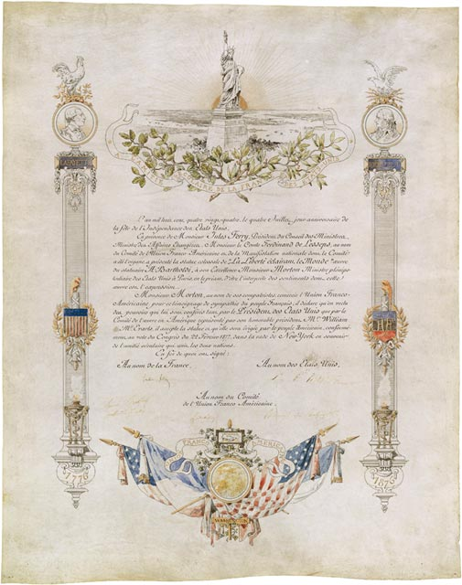
2. Delivery
4. Symbolic Delivery
Deed of gift for Statue of Liberty

Slide 18
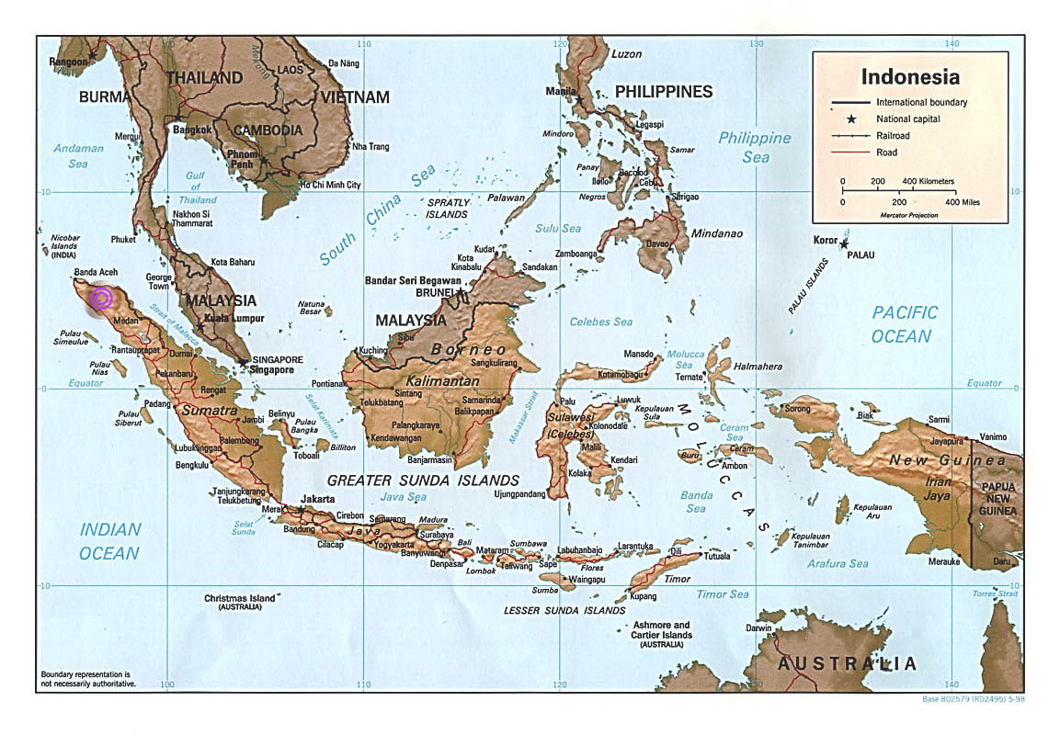
In re Cohn
Sumatra
Notes:
http://www.scripophily.net/asumtab.html

Slide 19
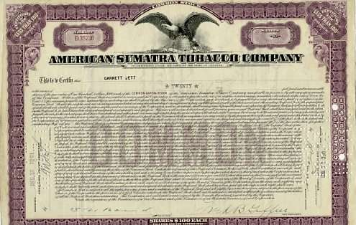
In re Cohn
Notes:
http://www.scripophily.net/asumtab.html

Slide 20
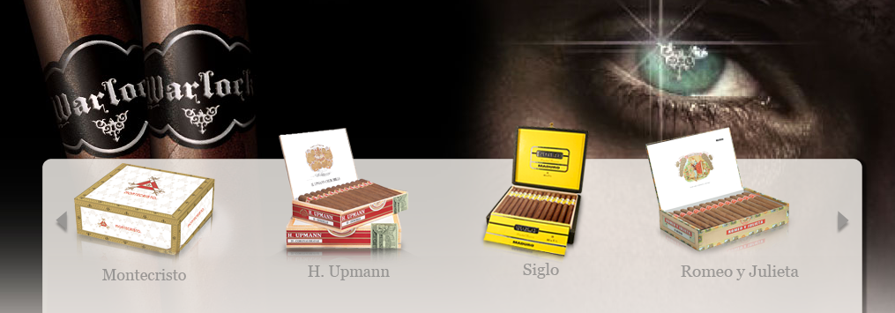
In re Cohn
American Sumatra Tobacco Company is now Altadis USA, Inc.

Slide 21
In re Cohn
West End, N. J., Sept. 20, 1911.
I give this day to my wife, Sara K. Cohn, as a present for her (46th) forty-sixth birthday (500) five hundred shares of American Sumatra Tobacco Company common stock.
/s/ Leopold Cohn

Slide 22
Inter Vivos Gifts [continued]

Slide 23
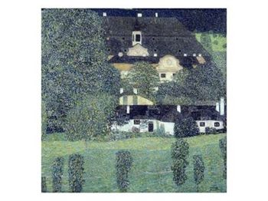
Gruen v. Gruen
Schloss Kammer Am Attersee II
Gustav Klimt

Slide 24

Gruen v. Gruen
Spire seen in painting
Attersee in western Austria on the border with Germany

Slide 25
Gruen v. Gruen
Donor splits temporal ownership.
Donor [dad] retains life estate.
“stick” of present possession
Donee [son] receives remainder interest.
“stick” of future possession

Slide 26
3. Acceptance
Presumed if gift is beneficial to donee.

