Slide 1
Transfers Upon Death

Slide 2
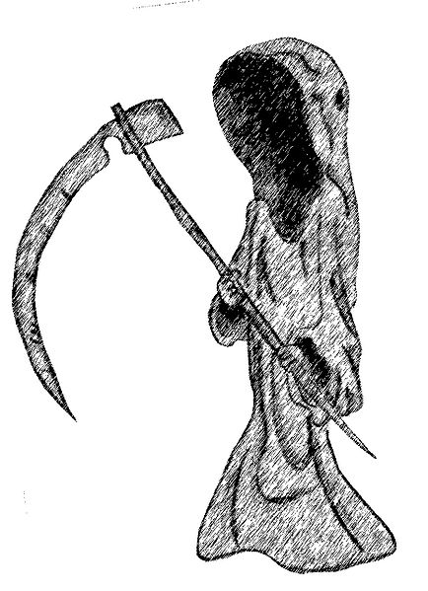
Basic Premise
Life is 100% fatal.

Slide 3
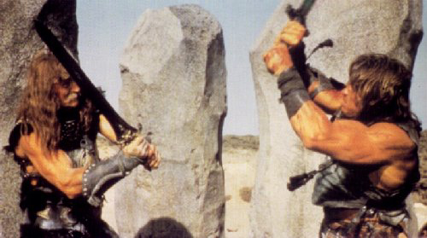
History of At-Death Property Disposition
1. Physical Strength and/or Finding

Slide 4
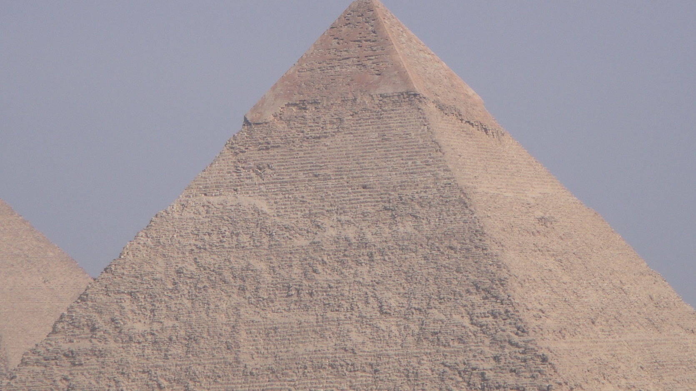
History of At-Death Property Disposition
2. Bury with Decedent

Slide 5
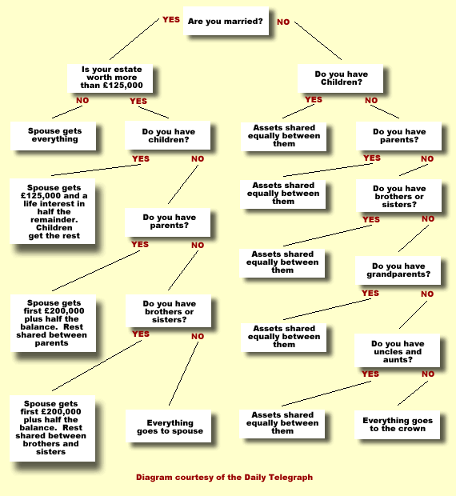
History of At-Death Property Disposition
3. Intestate Succession

Slide 6
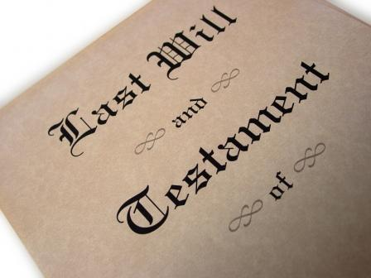
History of At-Death Property Disposition
4. Wills

Slide 7
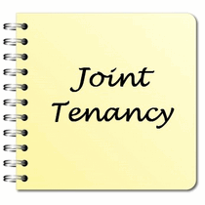
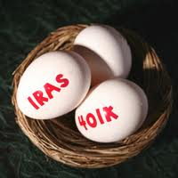


History of At-Death Property Disposition
5. Will Substitutes

Slide 8
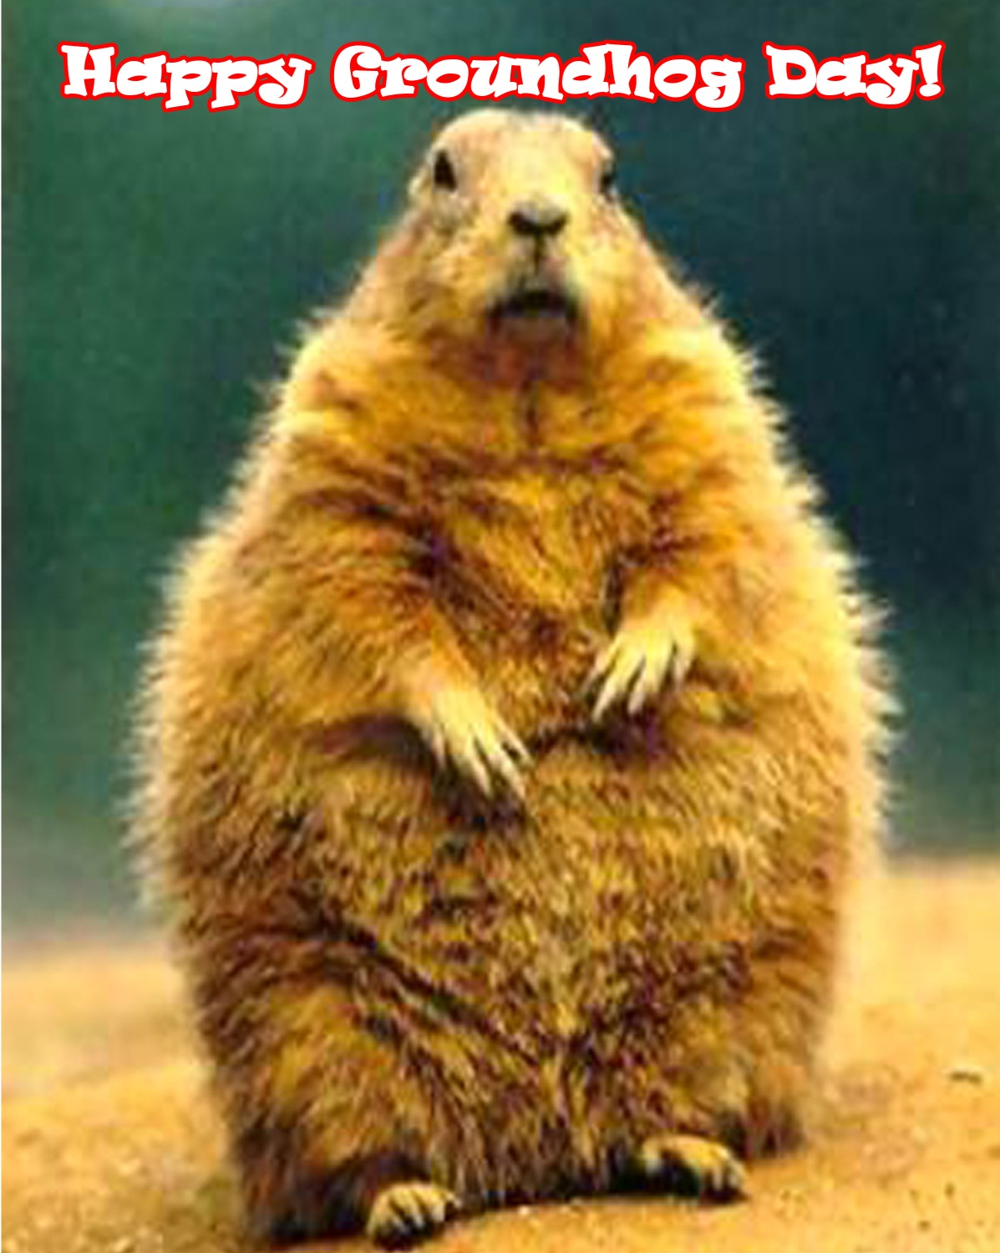

Slide 9
Intestate Succession
Common Law Split:
Crown = real property
Church = personal property

Slide 10

Intestate Succession -- Terminology
Descent = succession to real property

Slide 11

Intestate Succession -- Terminology
Distribution = succession to personal property

Slide 12

Intestate Succession -- Terminology
Heir = person who receives property from an intestate decedent

Slide 13
Testate Succession -- Terminology
At common law –
Will = real property
Testament = personal property

Slide 14
Testate Succession -- Terminology
Devise = gift of real property

Slide 15
Testate Succession -- Terminology
Bequest = gift of personal property

Slide 16

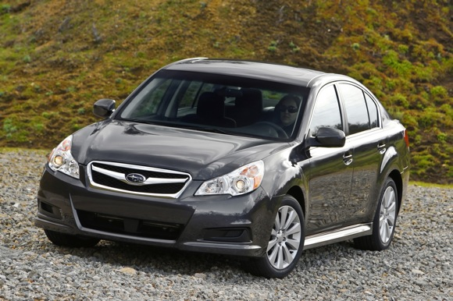
Testate Succession -- Terminology
Legacy – gift of money
X

Slide 17
Testate Succession -- Terminology
Beneficiary = any recipient of property (any type)

Slide 18

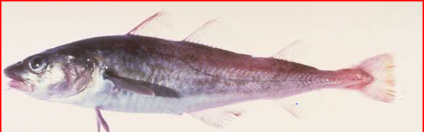
Testate Succession -- Terminology
Codicil = amendment to an existing will

Slide 19
Requirements of a Valid Will
1. Legal Capacity

Slide 20
Requirements of a Valid Will
1. Legal Capacity
2. Testamentary Capacity (“sound mind”)

Slide 21
Requirements of a Valid Will
1. Legal Capacity
2. Testamentary Capacity
3. Testamentary Intent

Slide 22
Requirements of a Valid Will
1. Legal Capacity
2. Testamentary Capacity
3. Testamentary Intent
4. Formalities
Attested will (written, signed, witnessed)
Holographic will (handwritten, signed)
Nuncupative will (oral)

