Slide 1
Gifts Causa Mortis

Slide 2
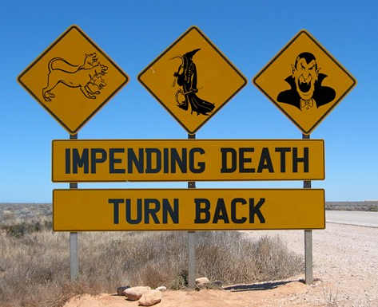
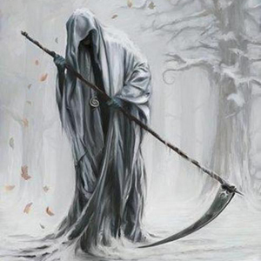
Additional Element
Donor made gift in contemplation of impending or imminent death.

Slide 3
Conditional
Gift is revoked if:
Donor revokes while still alive
Donor survives the peril
Automatic revocation – traditional rule
Failure to revoke timely makes gift irrevocable – Restatement rule
Donee predeceases donor

Slide 4

Foster v. Reiss
A konyhában, az alján a szekrény, ahol a kék serpenyőben van, a borosüveg, van 100 dollár.

Slide 5

Scherer v. Hyland

