Slide 1
Engagement Gifts

Slide 2
Issue
May a gift be revoked if the marriage does not occur?
Must determine true characterization of gift:
Is it “courtship” gift?
Is it “engagement” gift?

Slide 3
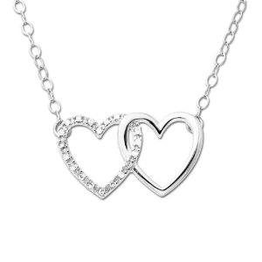

Courtship Gift
Irrevocable.
Designed by donor to entice donee to continue dating.

Slide 4
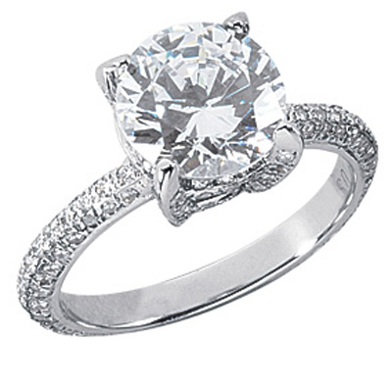

Engagement Gift
Possibly revocable
Conditioned on marriage occurring

Slide 5
Engagement Gift Approach
1. Fault Approach (traditional)
Donor breaks off engagement – donee keeps
Donee breaks off engagement – return to donor, unless donee has legal justification
Mutual break up – return to donor
Death – Donee (or donee’s estate) keeps

Slide 6
Engagement Gift Approach
2. No-Fault Approach (modern)
Donor may always recover engagement gifts.

Slide 7
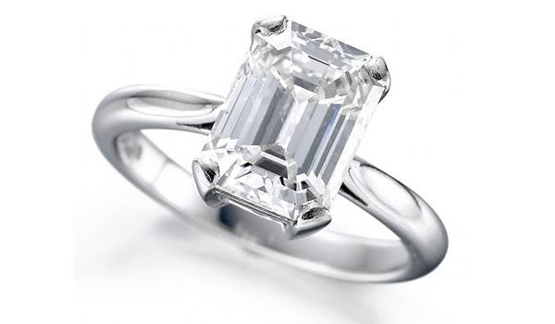
Lindh v. Surman

