Slide 1
Bona Fide Purchaser

Slide 2
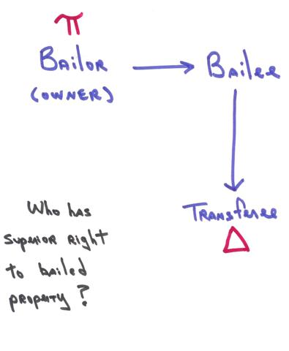
The Situation

Slide 3
Common Law BFP Elements
1. Transferee paid value
  Not a gift
  Thus, “earned” protection

Slide 4
Common Law BFP Elements
2. Transferee had no notice of true owner’s claim
  Thus, “deserved” protection

Slide 5
U.C.C. BFP Basic Idea -- § 2-403
A purchaser of goods acquires all title which the transferor (bailee) either:
  Actually had, or
  Had the power to transfer
    Expressly from true owner, or
    Implied by law.

Slide 6
U.C.C. BFP Elements -- § 2-403
1. True owner “entrusts” goods
  Generally, a bailment
  Not an acquisition by theft

Slide 7
U.C.C. BFP Elements -- § 2-403
2. The “evil” bailee is a merchant
  The transferor sells goods as a business

Slide 8
U.C.C. BFP Elements -- § 2-403
3. Merchant (bailee) deals with goods of the kind
  Merchant (bailee/seller) sells the same type of goods as those the true owner entrusted.

Slide 9
U.C.C. BFP Elements -- § 2-403
4. Transferee (Purchaser) is a “buyer in the ordinary course of business” (BIOCOB)

Slide 10
U.C.C. BFP Elements -- § 2-403
4. Transferee (Purchaser) is a “buyer in the ordinary course of business” (BIOCOB)
  A. Good faith
    Honesty in fact (subjective), plus
    Observance of reasonable commercial standards (objective).

Slide 11
U.C.C. BFP Elements -- § 2-403
4. Transferee (Purchaser) is a “buyer in the ordinary course of business” (BIOCOB)
  A. Good faith
  B. Without knowledge that sale violates ownership rights of entruster

Slide 12
U.C.C. BFP Elements -- § 2-403
4. Transferee (Purchaser) is a “buyer in the ordinary course of business” (BIOCOB)
  A. Good faith
  B. Without knowledge that sale violates ownership rights of entruster
  C. Pays value
    Not a gift

Slide 13
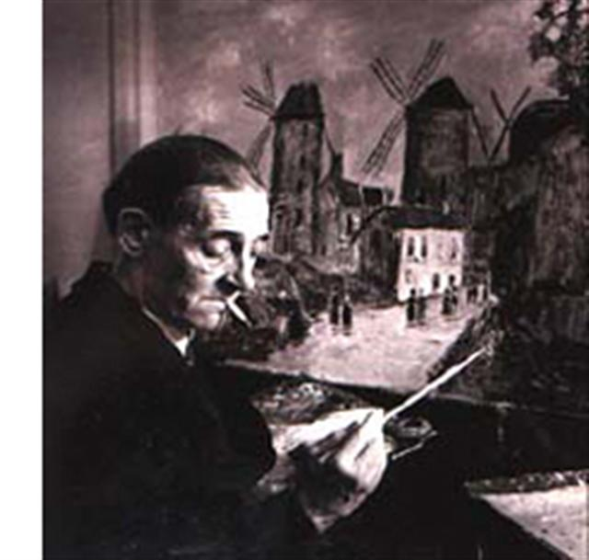
Porter v. Wertz
Maurice Utrillo

Slide 14

Porter v. Wertz

Slide 15

Porter v. Wertz

Slide 16

Porter v. Wertz

Slide 17
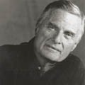
Porter v. Wertz
Richard Feigen

Slide 18
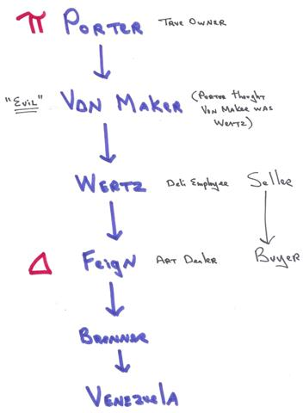
Porter v. Wertz
e

Slide 19
Porter v. Wertz
Why is Feigen not a BIOCOB?
  _______________
  _______________

Slide 20
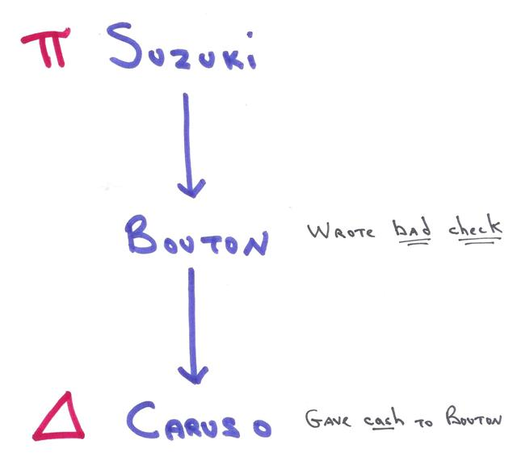
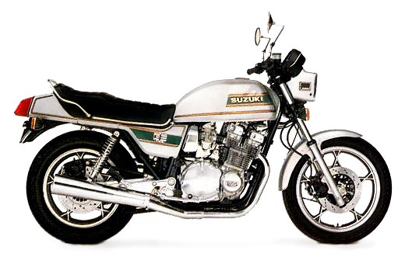
Sheridan Suzuki

Slide 21
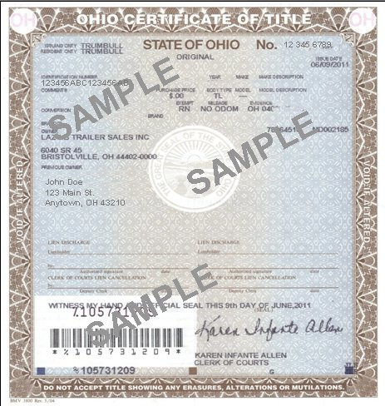
Certificate of Title

