Slide 1
Accessions:
Improving Another Person’s
Property by Mistake

Slide 2
Basic Issue
When a person improves another’s personal property by mistake, what are the rights of:
  Owner?
  Improver?

Slide 3
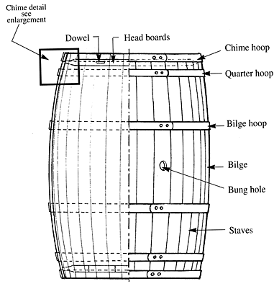
Wetherbee v. Green
Notes:
http://www.bouchardcooperages.com/australia/research/barrel_diagram.html

Slide 4
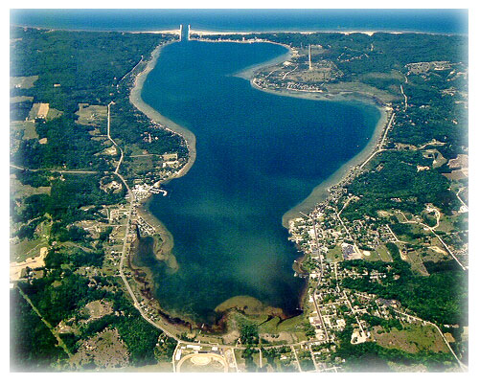
Isle Royale Mining Co. v. Hertin
Portage Lake
Ariel View
Notes:
http://www.onekama.info/localbusiness.html#

Slide 5
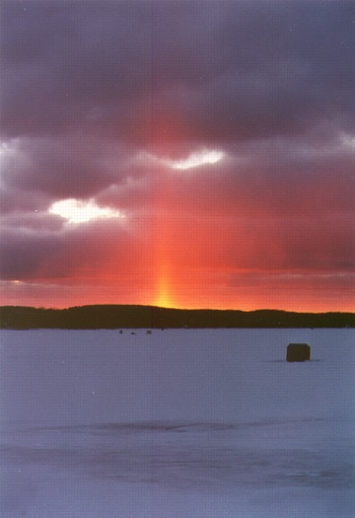
Isle Royale Mining Co. v. Hertin
Portage Lake
in Winter
Notes:
http://www.capturedmomentsphotography.com/

Slide 6
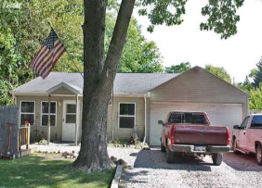
Hardy v. Burroughs
Similar house in Carton Park – currently on market for $39,900

