Slide 1
Unauthorized Possession

Slide 2

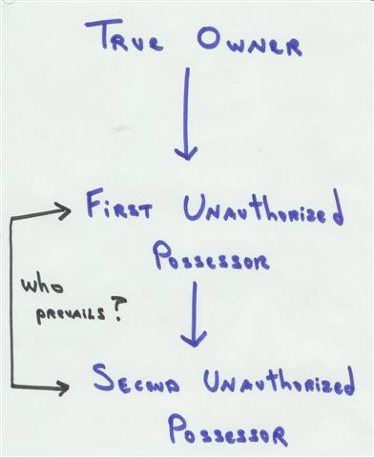
The Situation
No! Yes

Slide 3
Examples of Unauthorized Possessors
1. Finders
2. Innocent convertors
3. Evil convertors (aka thieves)

Slide 4
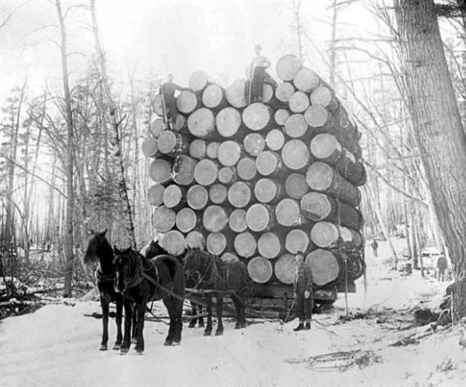
Anderson v. Gouldberg
Ann River Logging Company 1892 Photo

Slide 5

Russell v. Hill
Nantahalla River

Slide 6
Adverse Possession of Personal Property

Slide 7
Basic issue
Can the interest of a non-owner possessor of personal property (e.g., a finder) ripen into title that is good against the true owner?
Contrast with mere running of statute of limitations preventing remedies against the possessor.

Slide 8
Elements of Adverse Possession
1. Possessor openly and notoriously holds the property.
2. Possessor holds property hostilely (i.e., without true owner’s permission).
3. For the statutory period of time.

Slide 9
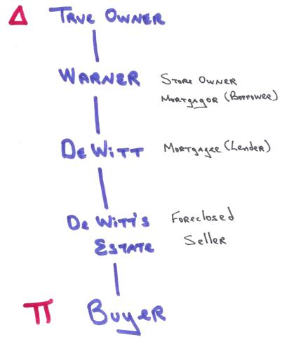
Chapin v. Freeland
1881 repossesses
counters (self-help)
1867
1867 nails down counters
1871 mortgage
1879 foreclosure
and sale

Slide 10

O’Keeffe v. Snyder
Georgia O’Keeffe -- 1943

Slide 11

O’Keeffe v. Snyder
Barry Snyder’s son, Gary
Notes:
http://www.garysnyderfineart.com/html/gary.htm

Slide 12
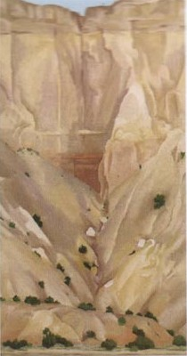
O’Keeffe v. Snyder
Cliffs

Slide 13
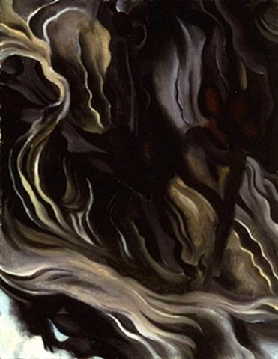
O’Keeffe v. Snyder
Seaweed

