Slide 1

Happy Lunar New Year!

Slide 2
Bailments

Slide 3
Bailment Defined
1. Rightful possession
2. Of personal property
3. By some who is not the true owner

Slide 4
Bailment Parties
Bailor:
True owner, or
Prior possessor.
Bailee:
In rightful possession but without ownership.
Thus, “finding” creates a bailment with the finder being the bailee for the true owner.

Slide 5
Sole Benefit of Bailor (owner)
Examples:
______________
______________
Standard of Care:
Slight care
Only liable for gross negligence

Slide 6
Sole Benefit of Bailee (possessor)
Examples:
______________
______________
Standard of Care:
High care
Liable even if slight negligence
Not strict liability

Slide 7
Mutual Benefit
Examples:
______________
______________
Standard of Care:
Ordinary care
Reasonably prudent person
Under same or similar circumstances

Slide 8
Modern Trend
Duty of care the same for all types of bailments based on traditional mutual benefit standard.
Ohio retains traditional distinction.

Slide 9
Source of Duties
1. Express agreement
Contract between bailor and bailee.
2. Implied agreement
e.g., duty of a finder

Slide 10

Allen v. Hyatt Regency
Previously, the Hyatt Regency-Nashville

Slide 11
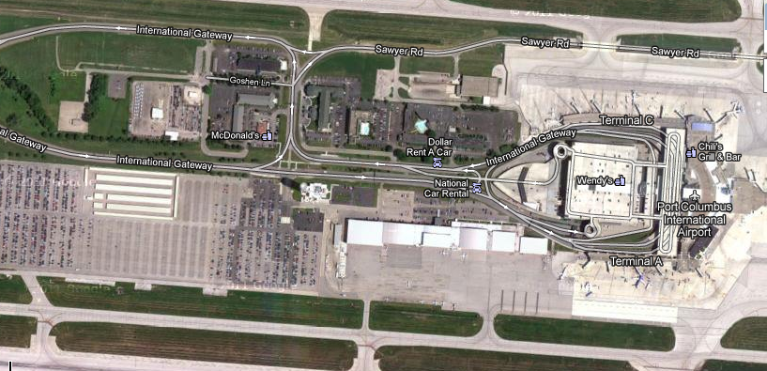

Is Les Miller out of luck?
The Blue Lot
1992 Chevy Silverado

Slide 12
Other bailment issues
Liability for contents of bailed items
Misdelivery as conversion?

