Slide 1
Personal Property Introduction

Slide 2
Why study personal property first?
Less complex legal rules.
Easier to have personal identification with issues.
Provides foundation for later material, both in Property and other law school courses.

Slide 3
Overview of Acquisition Methods
Find

Slide 4
Overview of Acquisition Methods
Find
Borrow (hold as bailee)

Slide 5
Overview of Acquisition Methods
Find
Borrow (hold as bailee)
Purchase

Slide 6
Overview of Acquisition Methods
Find
Borrow (hold as bailee)
Purchase
Take in unauthorized manner (convert/steal)

Slide 7
Overview of Acquisition Methods
Find
Borrow (hold as bailee)
Purchase
Take in unauthorized manner (convert/steal)
Benefit from another’s mistaken improvement

Slide 8
Overview of Acquisition Methods
Find
Borrow (hold as bailee)
Purchase
Take in unauthorized manner (convert/steal)
Benefit from another’s mistaken improvement
Receive as a gift:
From living donor (inter vivos gift; gift causa mortis, trust, etc.)
Receive from dead donor (intestacy, wills, non-probate transfers, etc.)

Slide 9
Finding

Slide 10
“Finder” defined
A person who rightfully acquires possession of personal property that did not originally belong to the person.
“rightful” – not conversion or theft
“possession” – not necessarily ownership

Slide 11
Types of property that may be found
1. First occupant
Property which has not yet been subject to ownership.

Slide 12

Types of property that may be found
2. Lost
True owner has parted with casually, involuntarily, accidentally, unconsciously, etc.

Slide 13
Types of property that may be found
3. Misplaced/Mislaid
True owner intentionally placed the property somewhere and then unintentionally left it and/or forgot where it was left.

Slide 14


Types of property that may be found
4. Abandoned
Owner has intentionally relinquished possession and claim to the property.

Slide 15
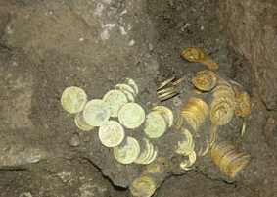
Types of property that may be found
5. Treasure Trove
Money (gold, silver, etc.) concealed in the ground or 0ther hiding place with no known owner.

Slide 16
Claimants to Found Property
Finder
True Owner
Owner of land on which property was found
Government

Slide 17
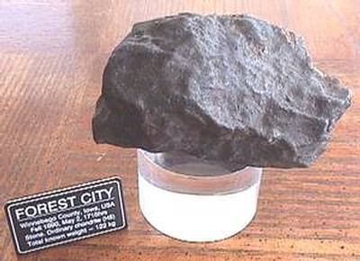
Goddard v. Winchell

Slide 18
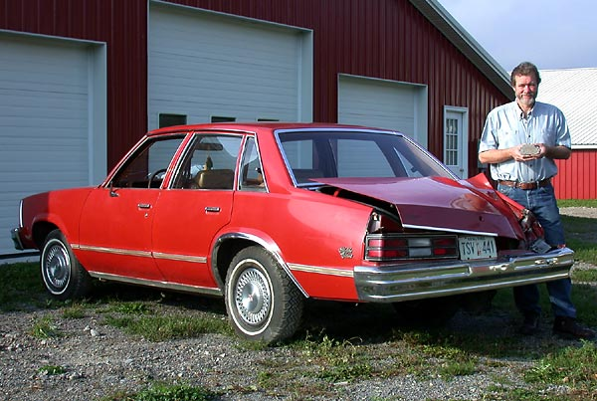
Peekskill Car

Slide 19
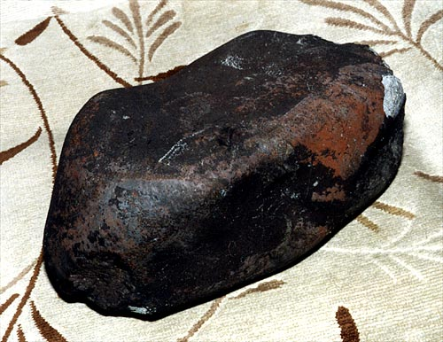
Peekskill Meteorite

Slide 20

Hole made by meteorite in Freehold Township, New Jersey in January 2007.

Slide 21
Philip Mani, San Antonio lawyer, who specializes in meteorite law

Slide 22

Eads v. Brazelton
Steamboat
America

Slide 23
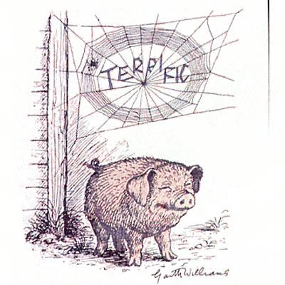
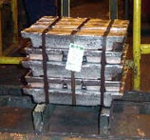
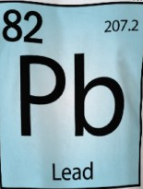
Eads v. Brazelton
Which one is “lead in pigs”

Slide 24

Popov v. Hayashi
Barry Bonds hitting home run number 73 on October 7, 2001.
Watch video
[YouTube Link]

Slide 25
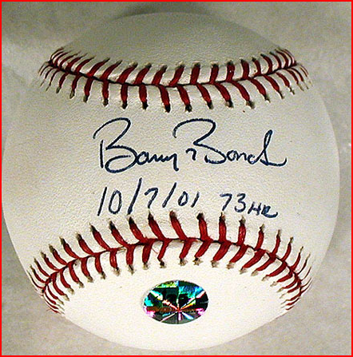
Popov v. Hayashi
The actual ball.

Slide 26


Popov v. Hayashi
Initially “caught” ball
Picked up ball as it was rolling around

Slide 27


Popov v. Hayashi
Todd McFarlane purchased ball at auction for $450,000 plus $67,500 in fees [total of $517,500].

Slide 28

Popov v. Hayashi
Play Trailer
Made into movie – “Up for Grabs”

Slide 29
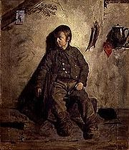
Armory v. Delamirie
Finder of lost property vs. Person who took away from finder

Slide 30

Bridges v. Hawkesworth
Finder of lost property
vs.
Owner of land on which property found

Slide 31

South Staffordshire Water v. Sharman
Finder of lost property
vs.
Owner of land on which property found
[but, is there more?]

Slide 32
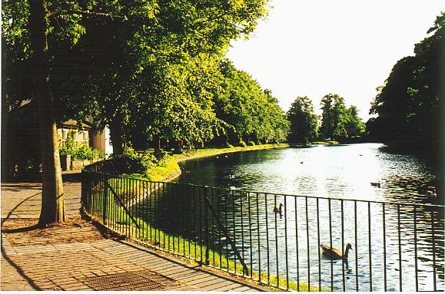
South Staffordshire Water v. Sharman
Minster Pool

Slide 33

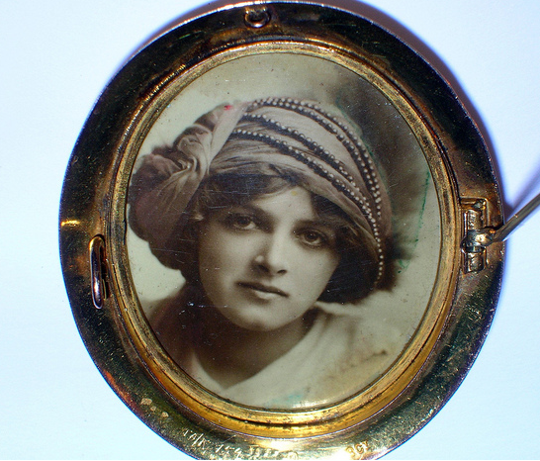
Hannah v. Peel
Finder vs. Property owner
Classification of found property?

Slide 34

Hannah v. Peel
Overton-on-Dee

Slide 35


McAvoy v. Medina
Finder of mislaid property
vs.
Owner of property on which property found

Slide 36

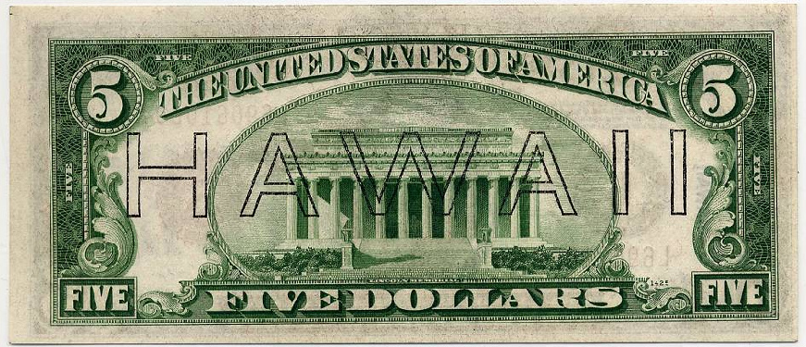
Schley v. Couch
Is “treasure trove” still a viable type of found property?

Slide 37
Who owns found property?
True owner (unless first occupant or abandoned)
If cannot find true owner:
Finder
Landowner
Government
Divide between/among claimants

