Slide 1
Role of Property in Society

Slide 2
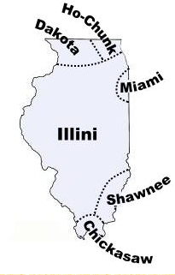
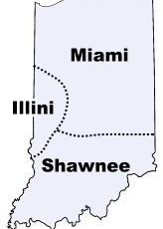
Johnson v. McIntosh
includes Piankeshaw Nation

Slide 3
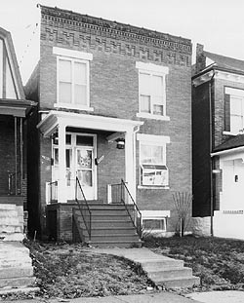
Shelley v. Kraemer
House Shelley purchased

Slide 4
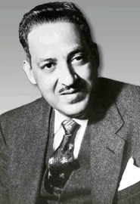
Shelley v. Kraemer
Shelley’s Lawyer Thurgood Marshall

