Slide 1
Attributes of Property Disposition

Slide 2
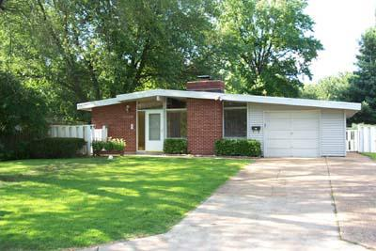
Jones v. Alfred H. Mayer Co.
Similar House in Same Neighborhood

Slide 3
Jones v. Alfred H. Mayer Co.
On what ground, legal or not, have you been discriminated against (or in favor) when renting an apartment or house?

