Slide 1
Attributes of Property

Slide 2
Traditional Most Important Property Traits (“sticks”)
Right to Use
Right to Exclude Others
Right to Transfer

Slide 3
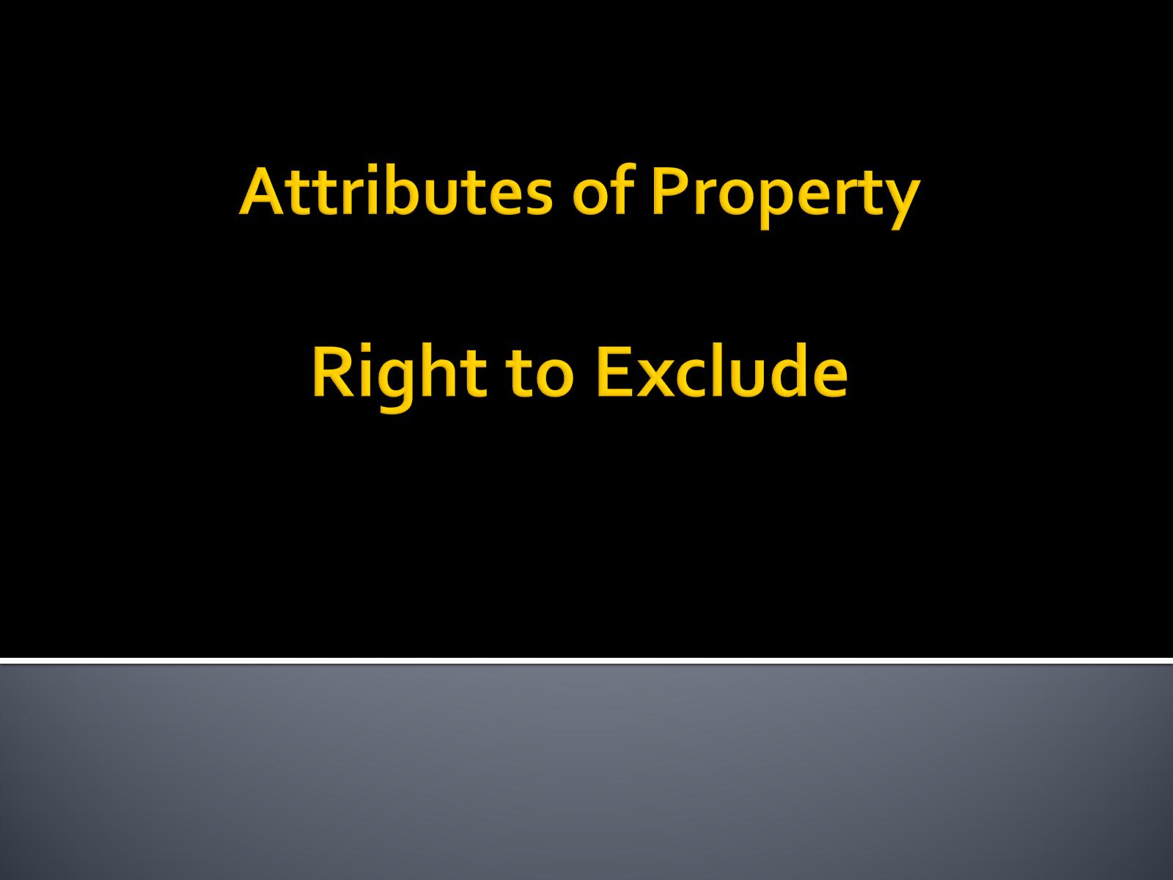
Attributes of Property Right to Exclude

Slide 4
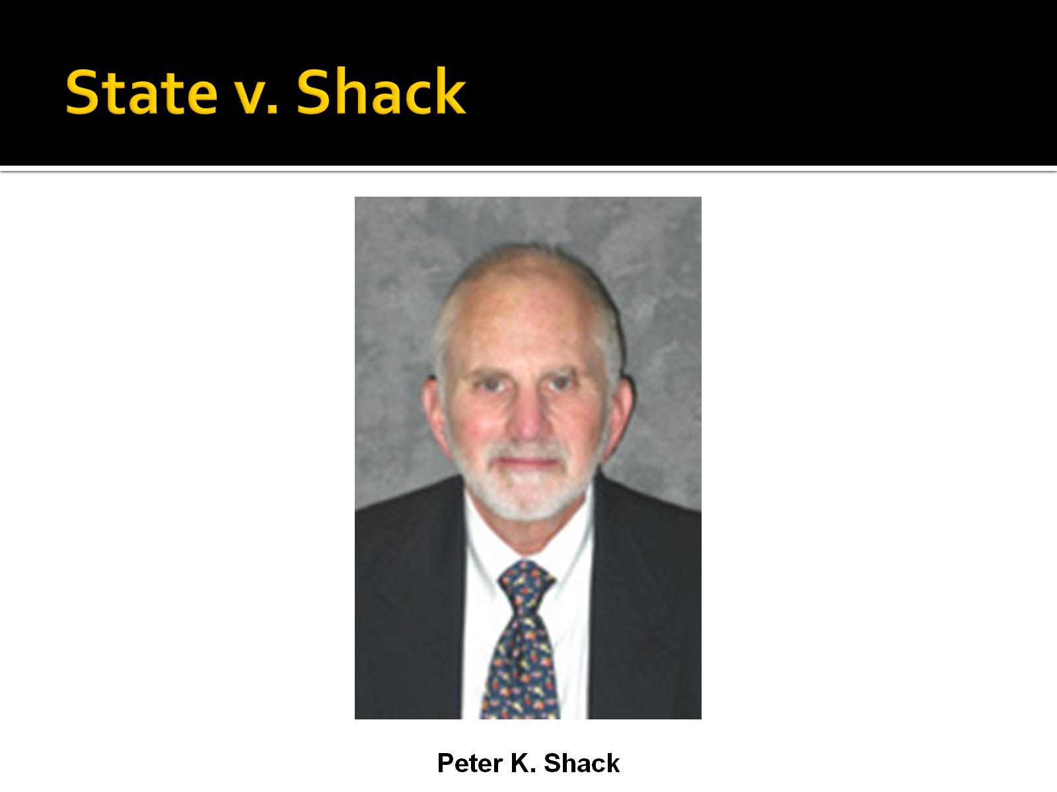
State v. Shack

Slide 5
State v. Shack
Which one of the following statements best reflects your opinion?
Shack was a trespasser and thus Tedesco had the right to make him leave Tedesco’s property regardless of Shack’s purpose.
Although I agree some permitted trespassing is necessary (e.g., police), Shack lacked the necessity necessary to justify the trespass.
The court got it right.
The court did not go far enough. In this situation, Tedesco should not be able to keep anyone not involved in a criminal or tortious act from being on the property.

Slide 6
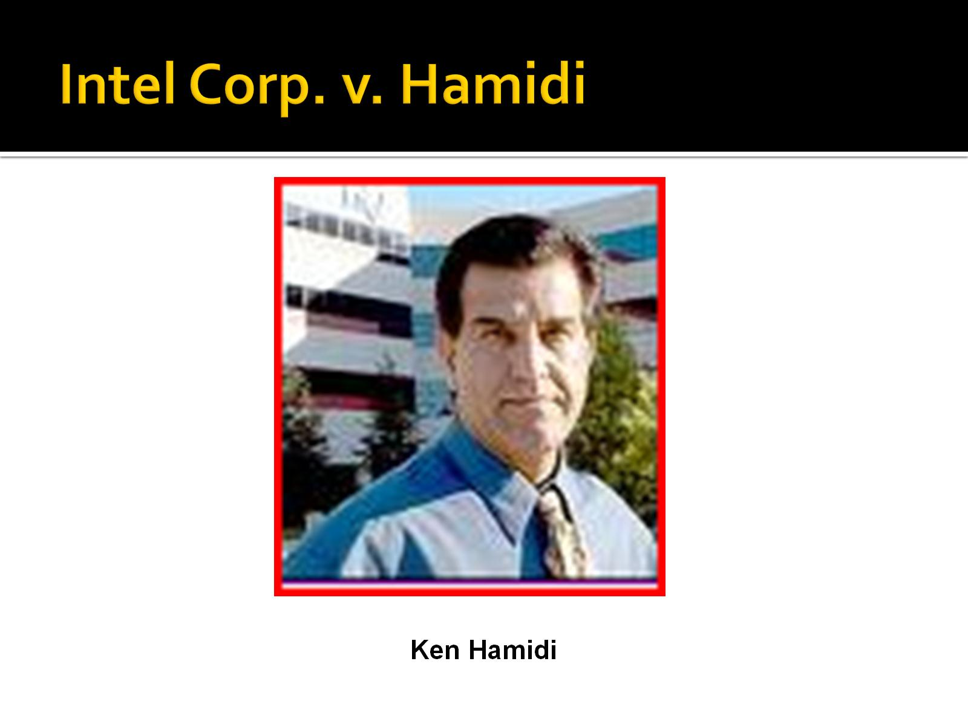
Intel Corp. v. Hamidi

Slide 7
Intel Corp. v. Hamidi
Which of the following statements best reflects your opinion?
No trespass occurred.
Trespass occurred but no remedy as no damage.
Trespass occurred and thus remedy should be available even without damage.
Property law is the wrong area to handle this. Intel should bind employees by contract regarding use of e-mail.

