Slide 1
Property Defined Judicial Opinions

Slide 2
Context = Did conversion occur?
If alleged thing converted is not property in the first place, there can be no conversion recovery.

Slide 3
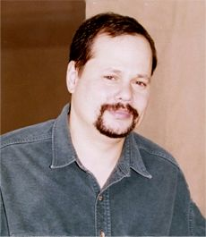
Kremen v. Cohen
Gary Kremen

Slide 4

Kremen v. Cohen
Stephen Cohen

Slide 5
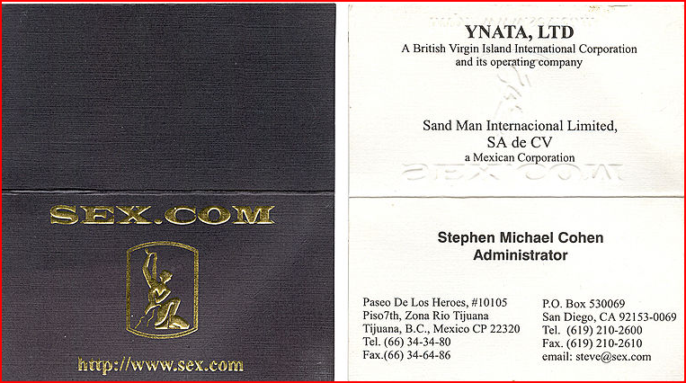
Kremen v. Cohen
Stephen Cohen’s Business Card

Slide 6
Kremen v. Cohen
In 2010, sex.com was sold for how much?
$20 million
$13 million
$10 million
$5 million

Slide 7
Kremen v. Cohen
Which of the following domain names is the most expensive domain name ever sold ($35 million)?
VacationRentals.com
Porn. com
Beer.com
Casino.com

Slide 8
Kremen v. Cohen
What property theory is behind the decision?
Occupation
Natural Rights
Labor
Social Utility

Slide 9



Human Body and Its Parts
§ 2-316

Slide 10
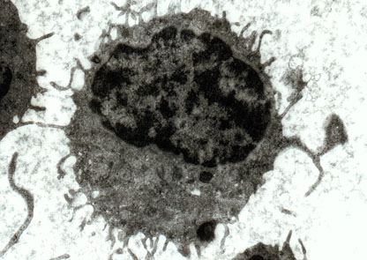
Moore v. Regents
Hairy Cell Leukemia Electron Micrograph

Slide 11
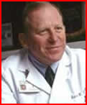
Moore v. Regents
Dr. David W. Golde died 8/8/2004

Slide 12
Moore v. Regents
Do you think Moore should have recovered for conversion?
No, the majority opinion got it right.
Yes, the dissenting opinion got it right.
Regardless, there should be legislation addressing these issues.
This is too complex for me to make a quick decision – I need to think some more.

