Slide 1
Property ----- Introduction Section 1 Spring 2022
Dr. Gerry W. Beyer
Governor Preston E. Smith Regents Professor of Law
Texas Tech University School of Law

Slide 2


Slide 3



Slide 4
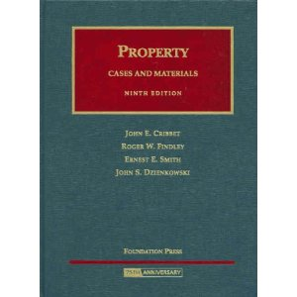
Cribbet Casebook

Slide 5


Office Information

Slide 6

E-mail Updates

Slide 7
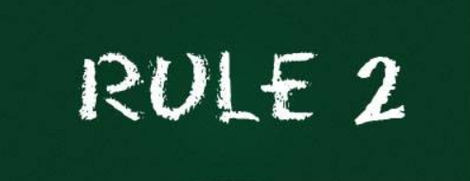


Slide 8

Attendance
Attendance taken
via Top Hat.
Attendance will close at 1:00.00 p.m.

Slide 9

Technology Etiquette

Slide 10

Respond when requested

Slide 11
Class Procedure
Combination of:
Lecture
Socratic Method
Top Hat Responses
Discussion

Slide 12
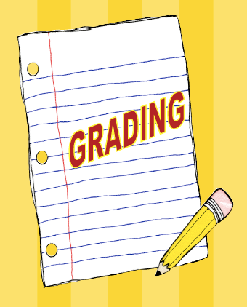
Grading

Slide 13
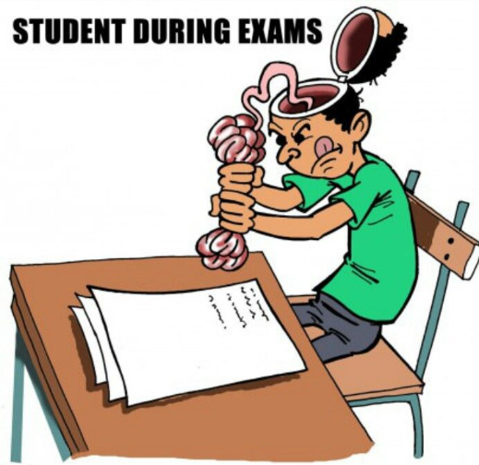
Examinations
Practice for Exam (0%)
February 3, 2021
In class
Mid-Term Exam (40%)
March 9, 2022
1:00 p.m. to 3:00 p.m.
Final Exam (40%)
May 10, 2022
1:00 p.m. to 3:00 p.m.

Slide 14

Quizzes (20%)

Slide 15
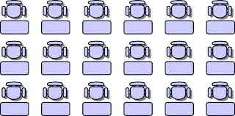
Seating Chart
Wednesday

Slide 16

Tutors
Grant Coffey
Sarah Dickie

Slide 17

Course Outline

Slide 18

Course Purposes

Slide 19

Questions?

Slide 20
What is Property?

Slide 21
What is “Property”?
Non-legal
Legal
Property “does not refer to a thing but rather to the rights between a person and a thing.”
Bailey v. Smith, 581 S.W.3d 374 (Tex. App.—Austin 2019, pet. denied.
Analogy = Bundle of Sticks

Slide 22
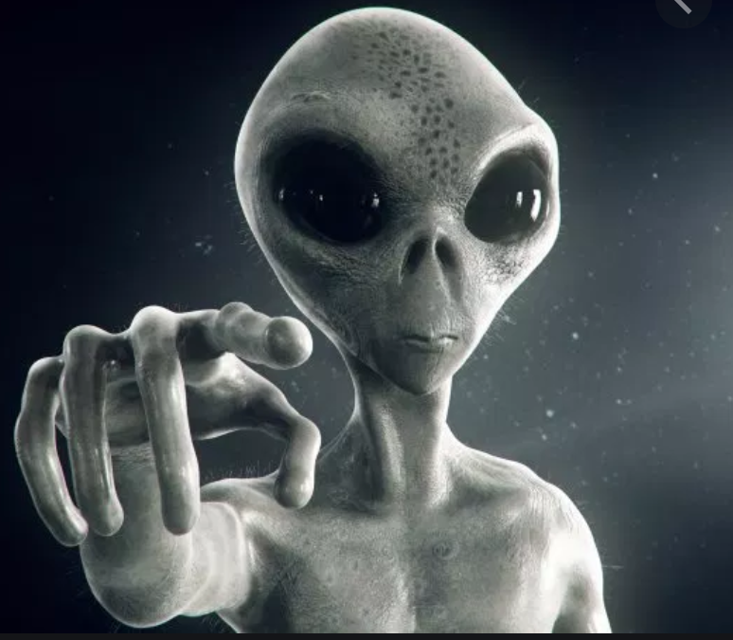
Define property:
Include all things that are property, and
Exclude all things that are not property.

Slide 23
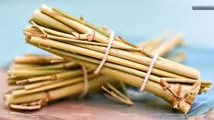
Define by Example – The “Bundles”

Slide 24
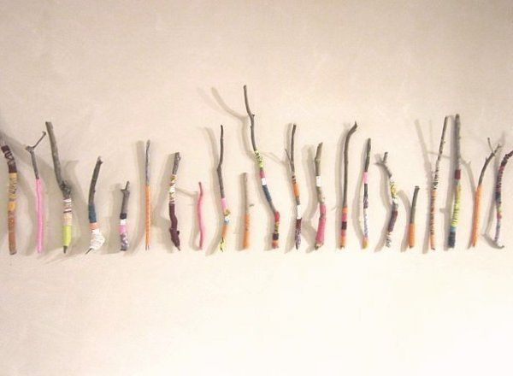
Define by Traits – The “Sticks”

Slide 25
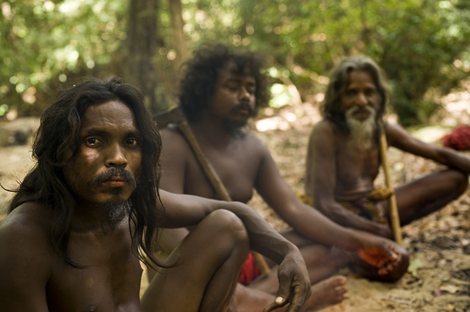
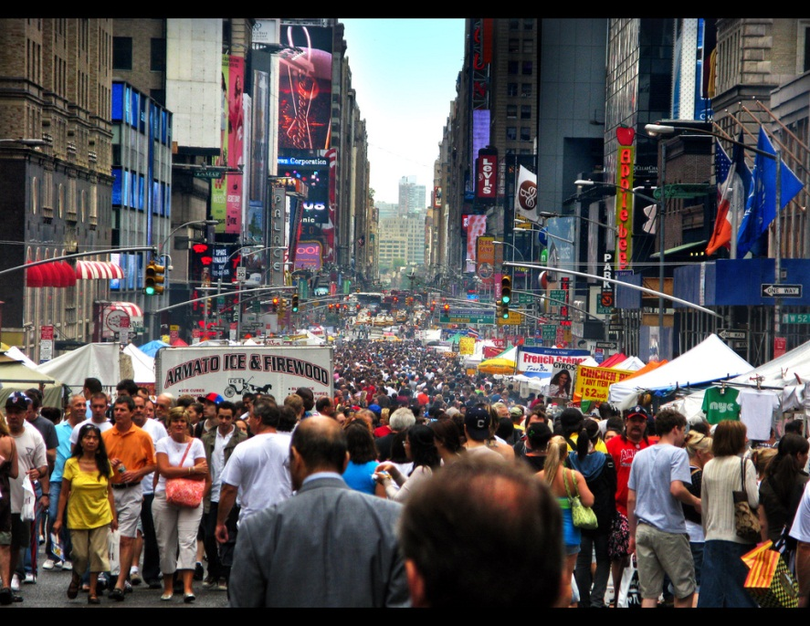
Universality of Property Concept
Vedda of Ceylon – p. 4
The people of New York

Slide 26

Theories of Private Property

Slide 27
Theories of Private Property
1. Occupation

Slide 28
Theories of Private Property
1. Occupation
2. Natural Rights

Slide 29
Theories of Private Property
1. Occupation
2. Natural Rights
3. Labor

Slide 30
Theories of Private Property
1. Occupation
2. Natural Rights
3. Labor
4. Legal

Slide 31
Theories of Private Property
1. Occupation
2. Natural Rights
3. Labor
4. Legal
5. Social Utility

Slide 32
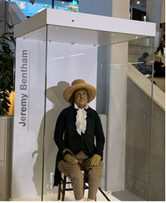
Other Concepts
Bentham – entirely the work of law

Slide 33
Other Concepts
Tragedy of the Commons
Individually rational decisions involving non-owned land eventually produce collectively irrational results.

Slide 34
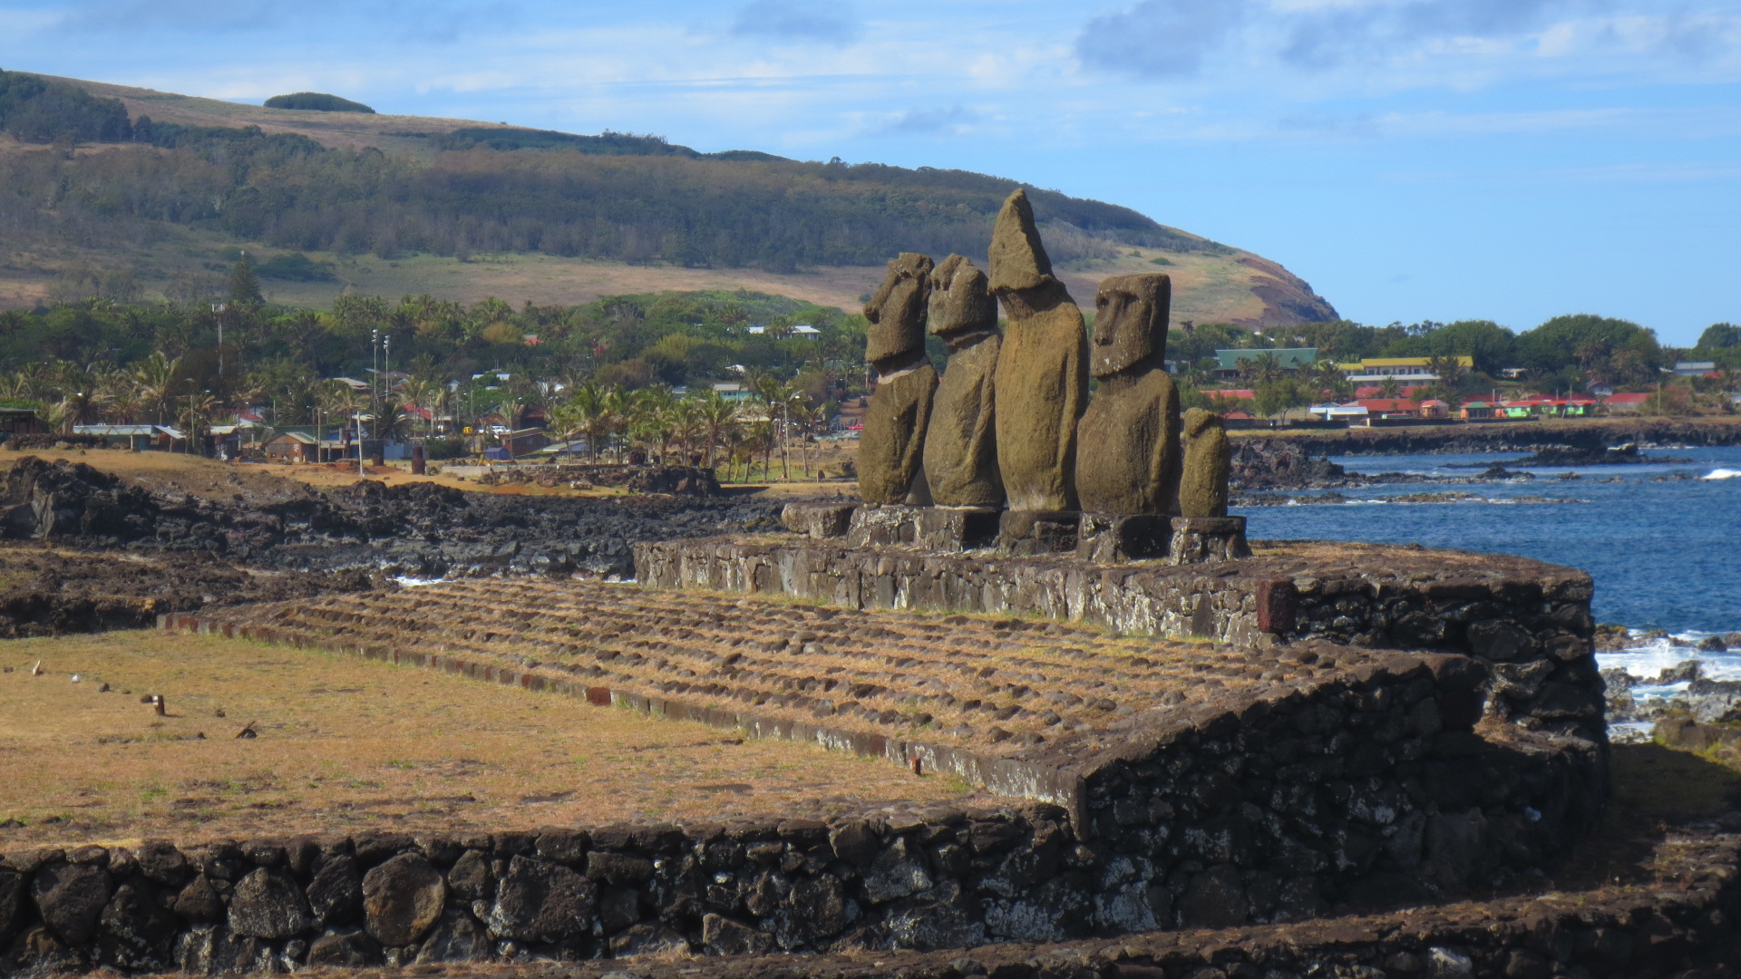
Tragedy of the Commons

Slide 35
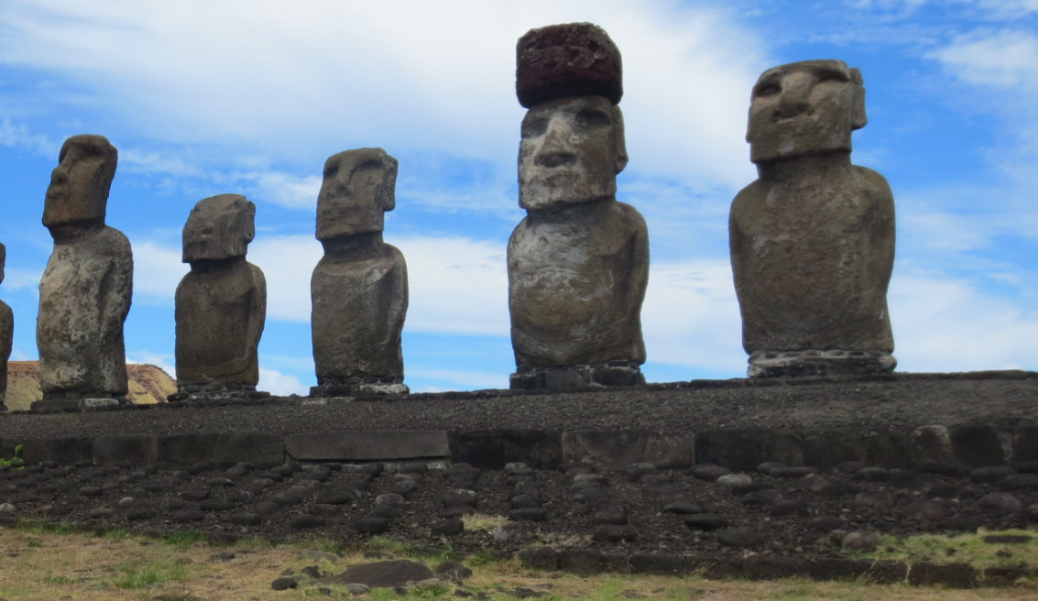
Tragedy of the Commons

Slide 36
Other Concepts
Economic Theory
Universality
Exclusivity
Transferability

Slide 37
Seating Chart

Slide 38


