Slide 1
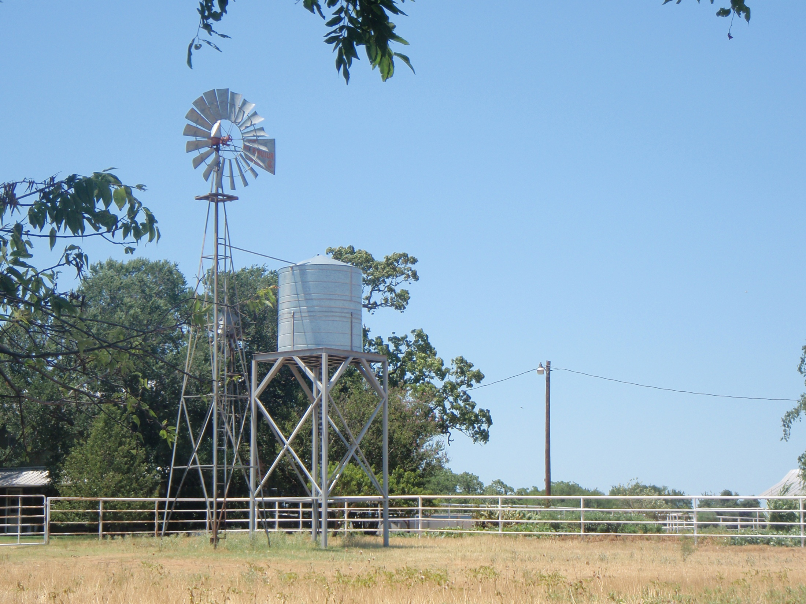
The Client’s Windmill and Water Tank

Slide 2
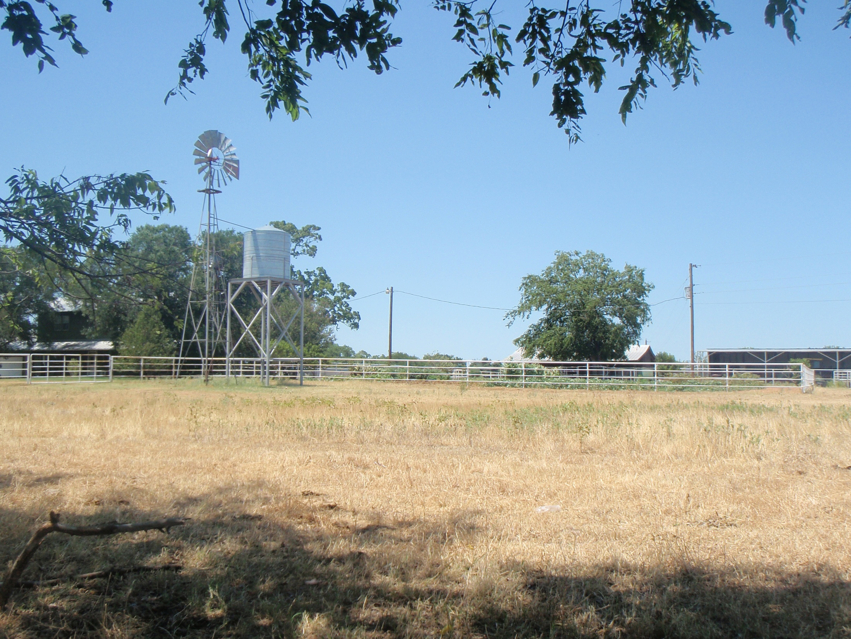
Client’s Windmill and Farmhouse

Slide 3
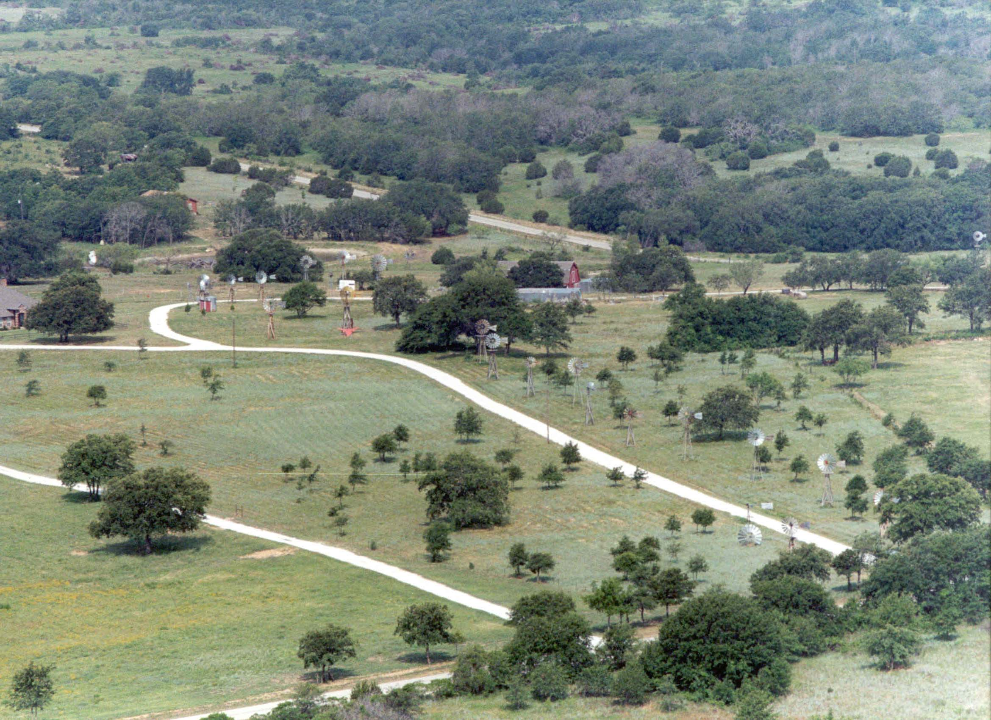
View of water-pumping windmills on neighbor’s property

Slide 4
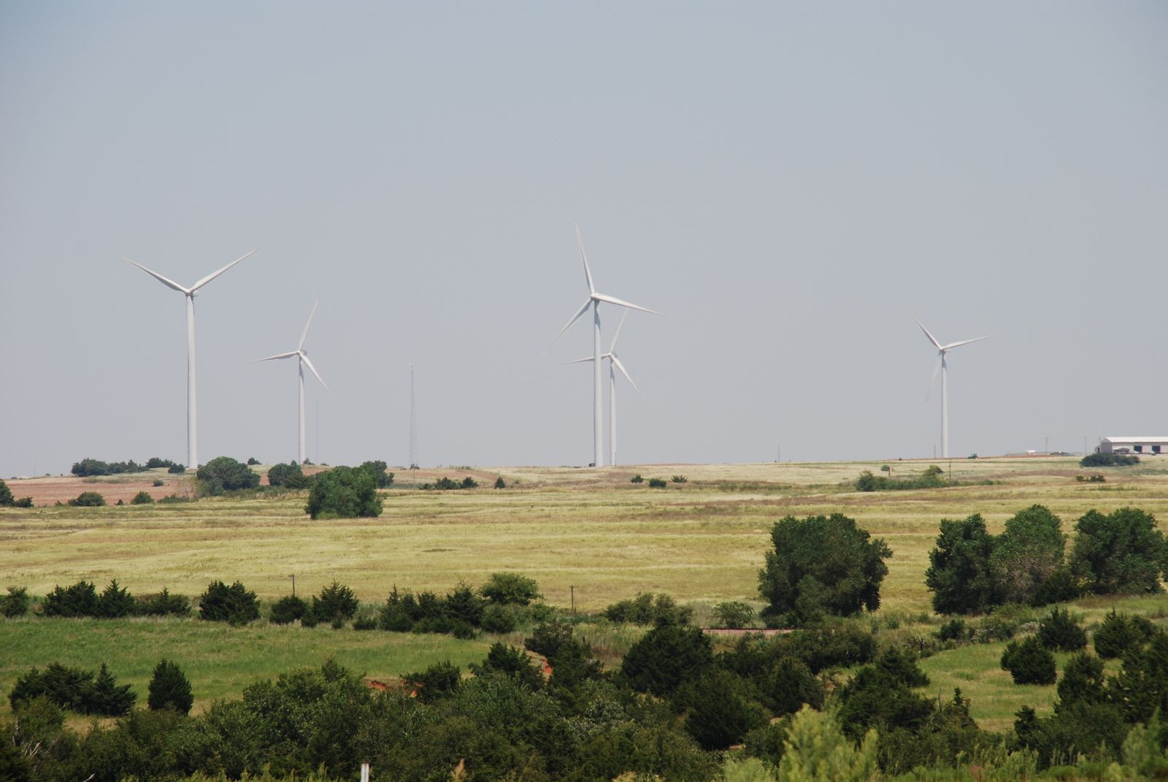
View of electricity-generating windmills on neighbor’s property

