Slide 1
Covenants and Servitudes
The following four pictures represent the home Jerry and Patty Jones wish to buy. Study the pictures carefully and compare them to the deed of sale, as well as the Ruby Slippers Homeowners Association’s bylaws and deed restrictions to determine if there are any violations or potential problems.

Slide 2
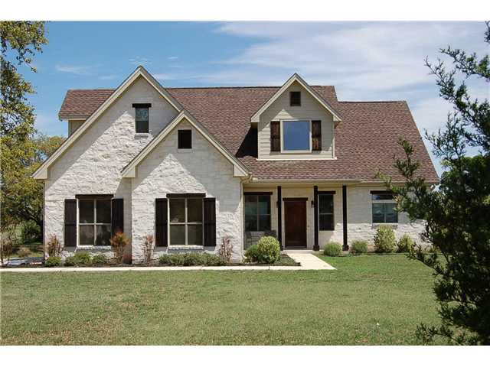

Slide 3
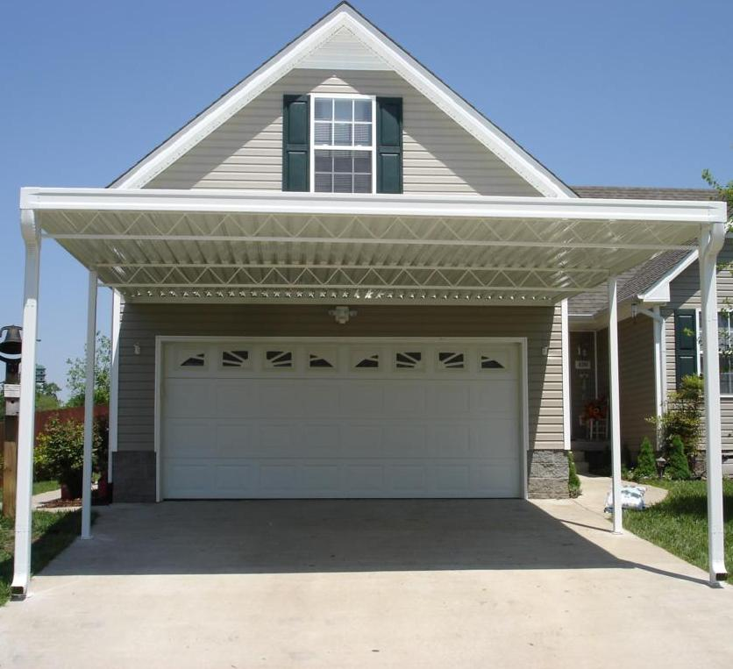

Slide 4
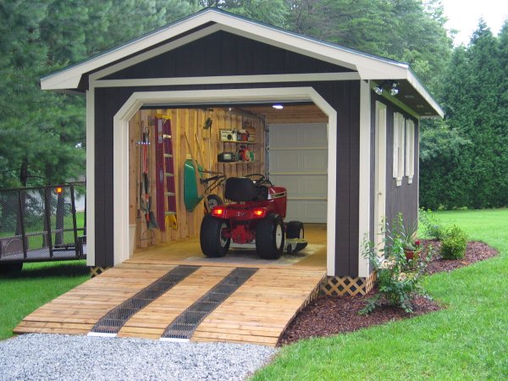

Slide 5
