Slide 1
Easements
The following pictures represent sections of a parcel of land your client would like to purchase. Assume that the entirety of the picture, unless explicitly stated otherwise, is part of the property in question. Identify any potential issues you see with regard to each picture. Explain why these may be a problem and how they can be avoided or fixed, if possible.

Slide 2
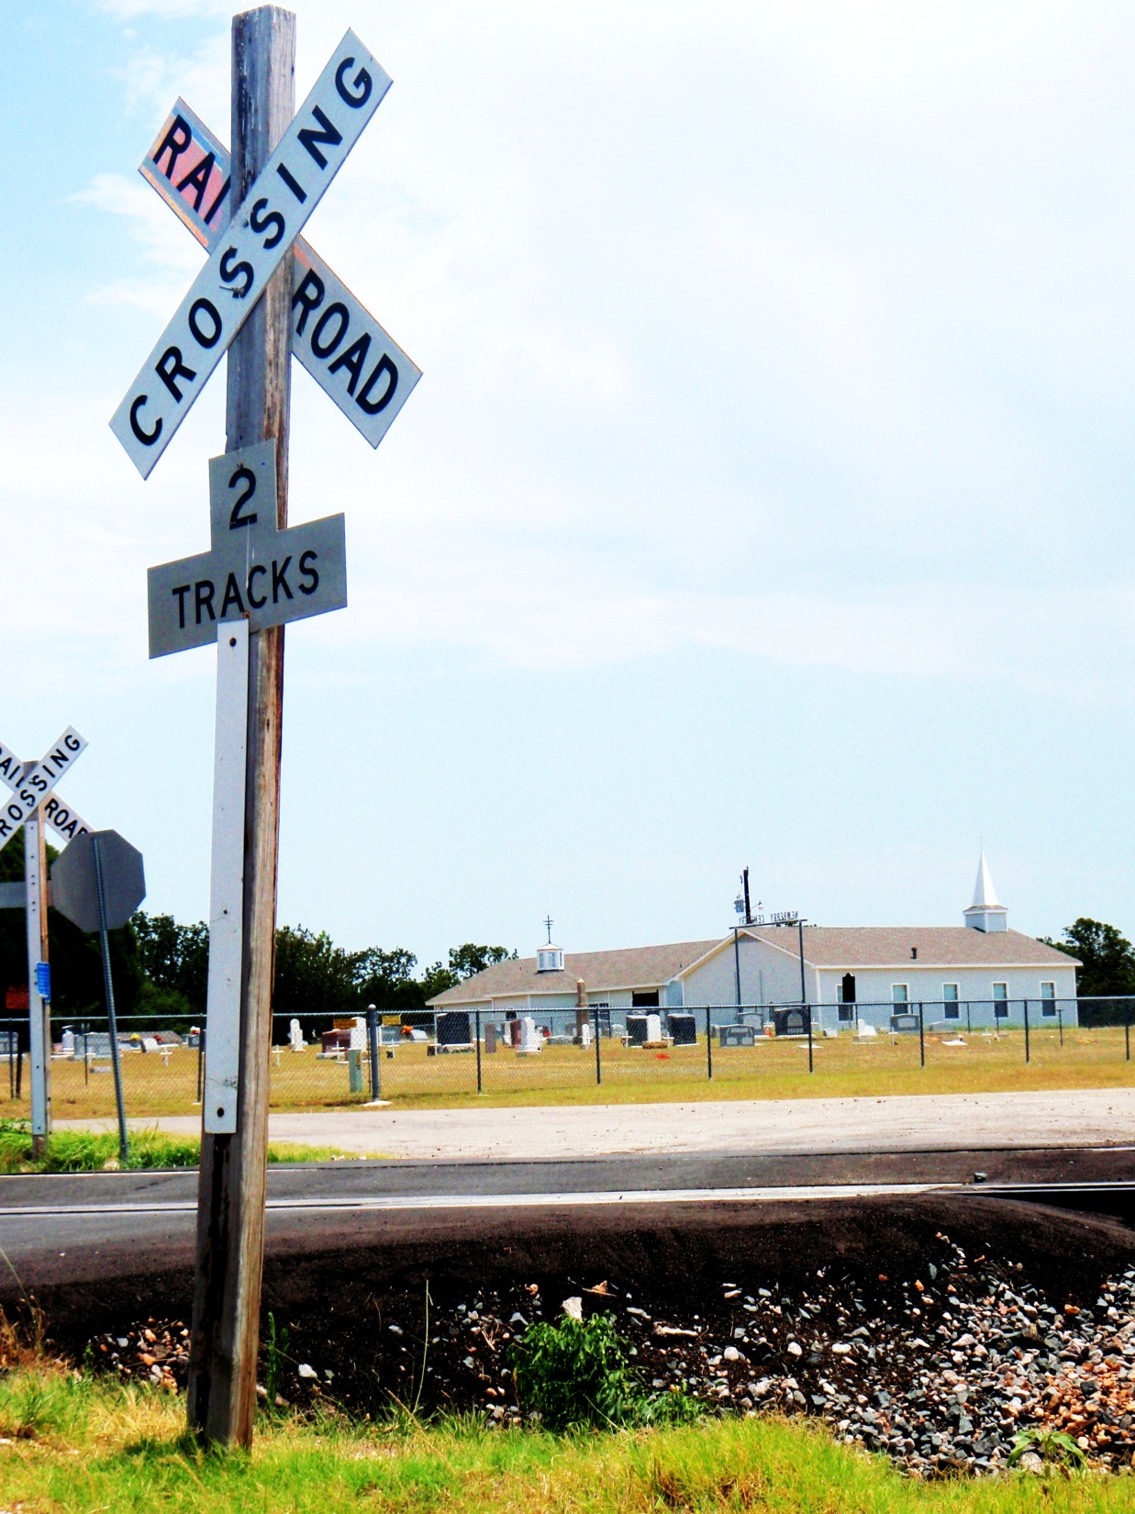
All property within the chain link fence is NOT part of the property in question.

Slide 3
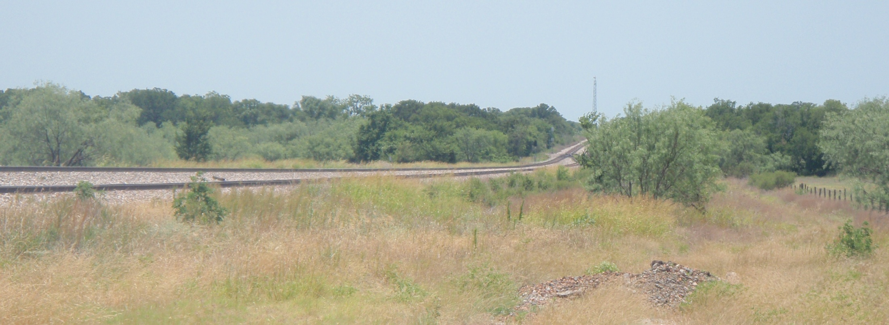
The land to the right of the fence is NOT part of the land in question.

Slide 4
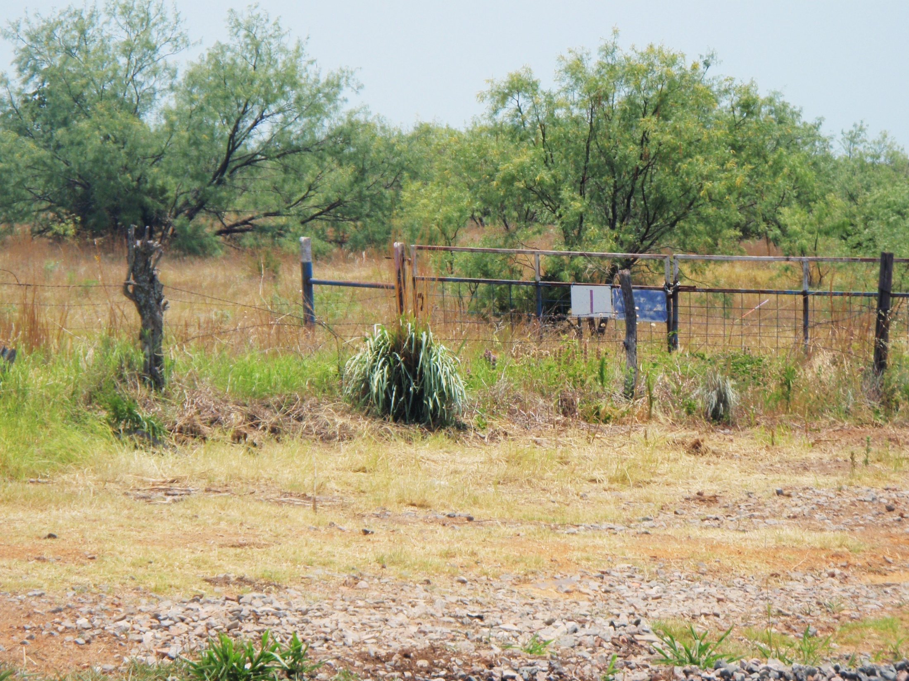

Slide 5
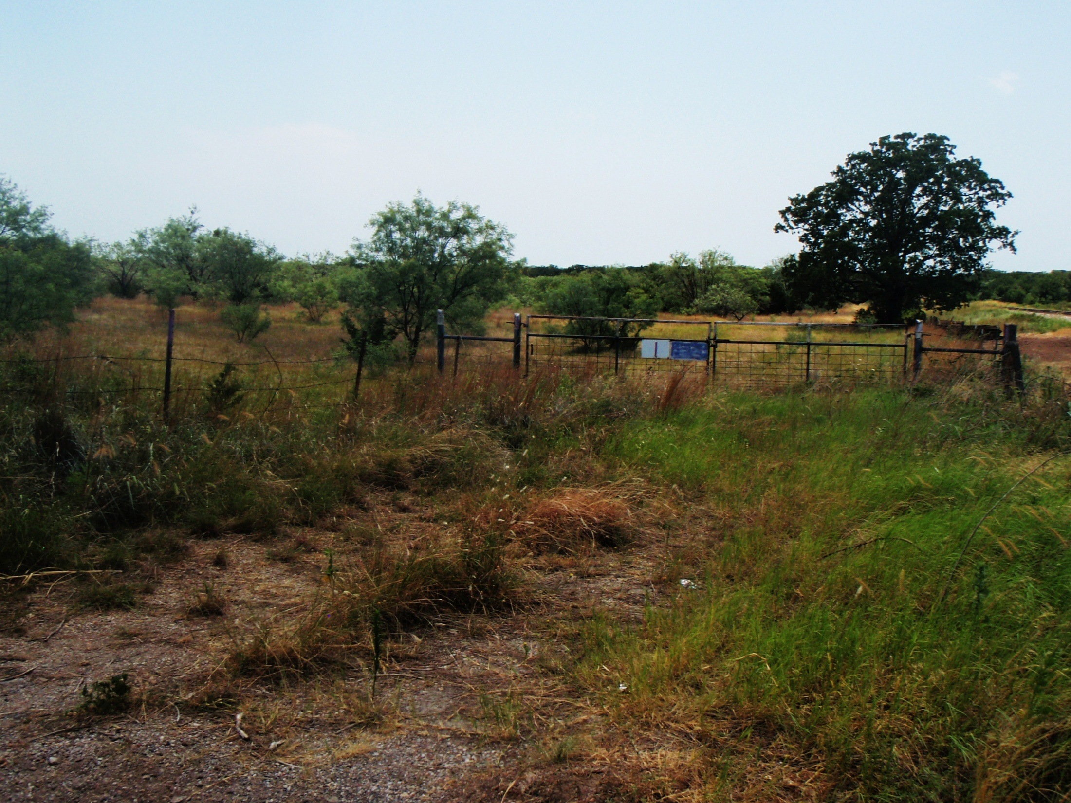

Slide 6
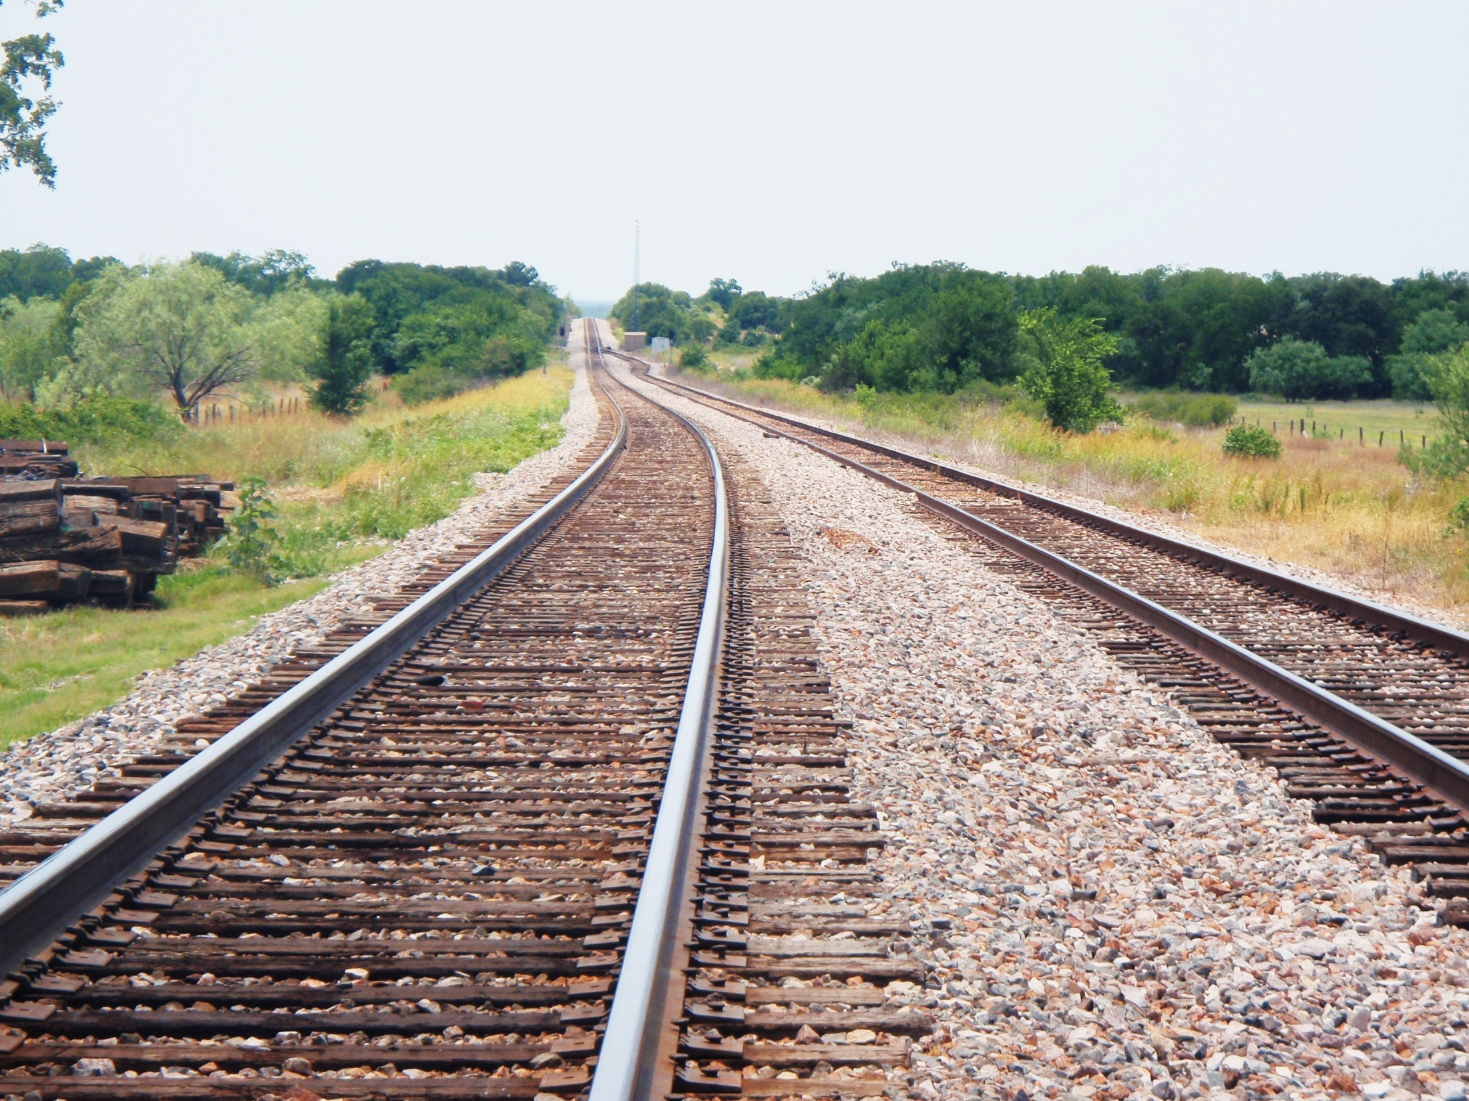
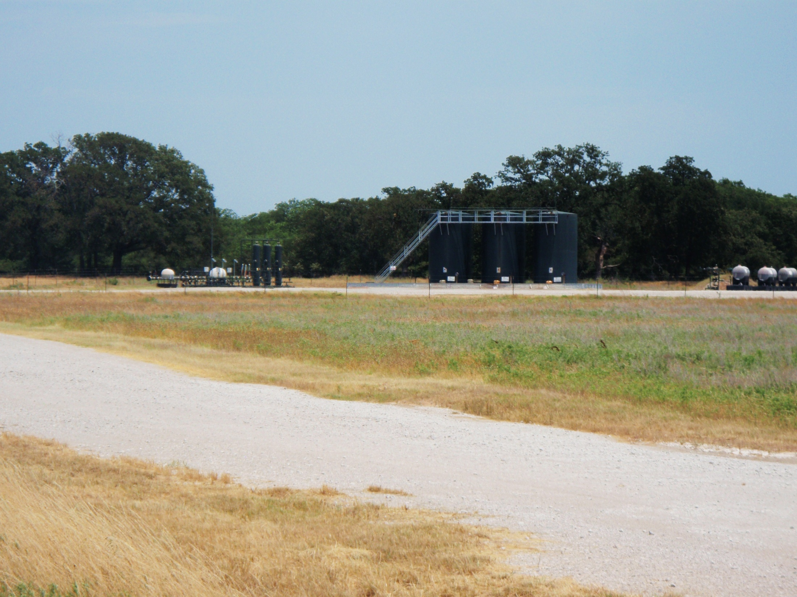

Slide 7
