Slide 1
Lost, Mislaid, or Abandoned?
The following slides depict various pieces of personal property in different locations and under varying circumstances. Based on the picture and accompanying description, determine whether the item(s) have been lost, mislaid, or abandoned and what should, or may, be done with each item(s). Explain your answer thoroughly.

Slide 2
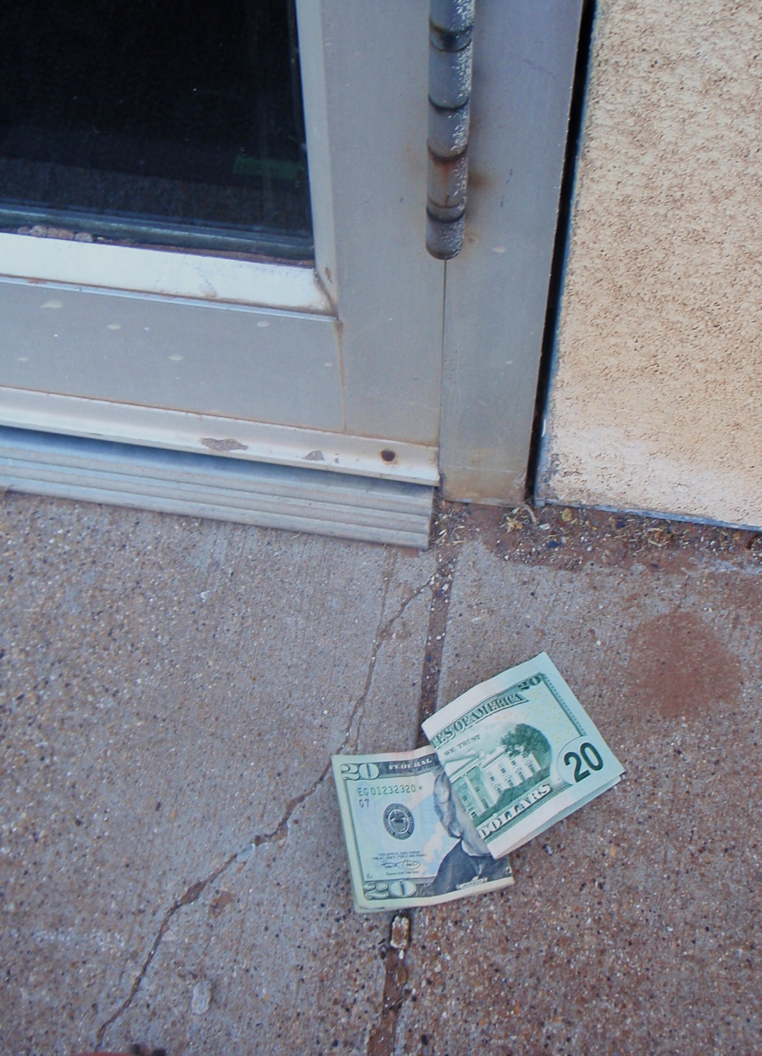
You see this lying outside the door of a local bookstore. You did not witness anyone walk in or out of the bookstore before you found the money: lost, mislaid or abandoned? What do you do with the money?

Slide 3
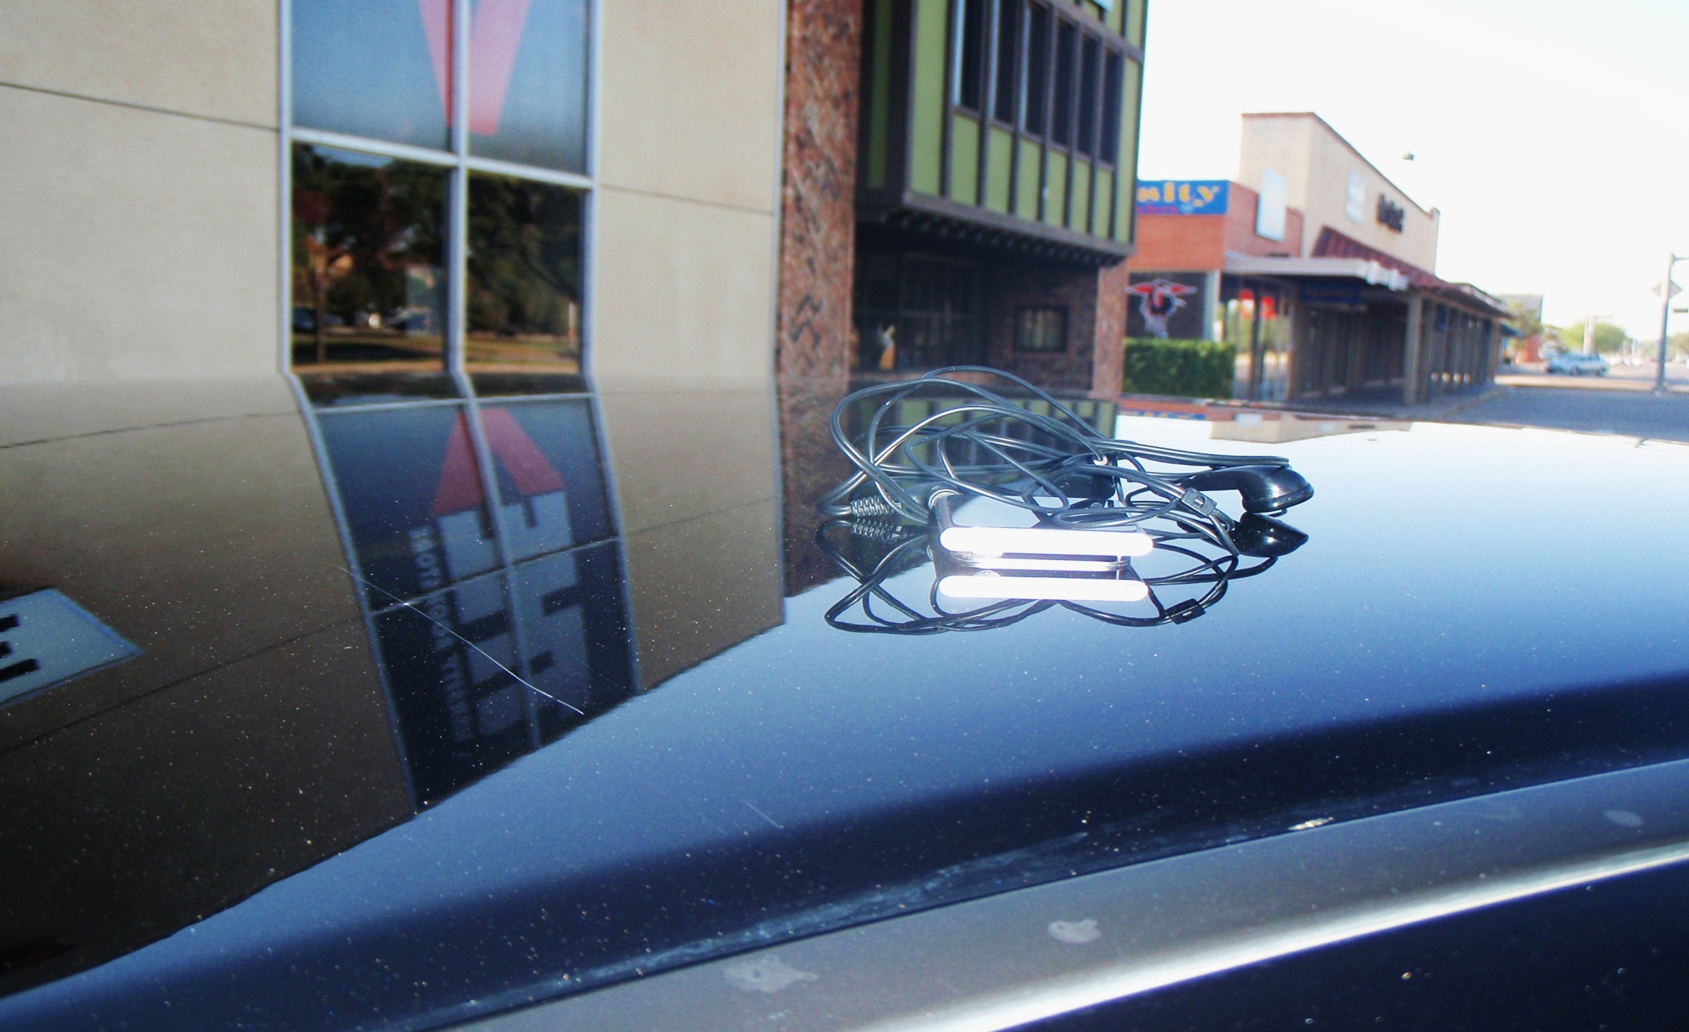
This is sitting on the car parked next to yours. The car is parked outside a shopping center, which contains numerous different stores and restaurants. You did not see how the item ended up on top of the car. Lost, mislaid or abandoned? What should you do with the item, if anything?

Slide 4
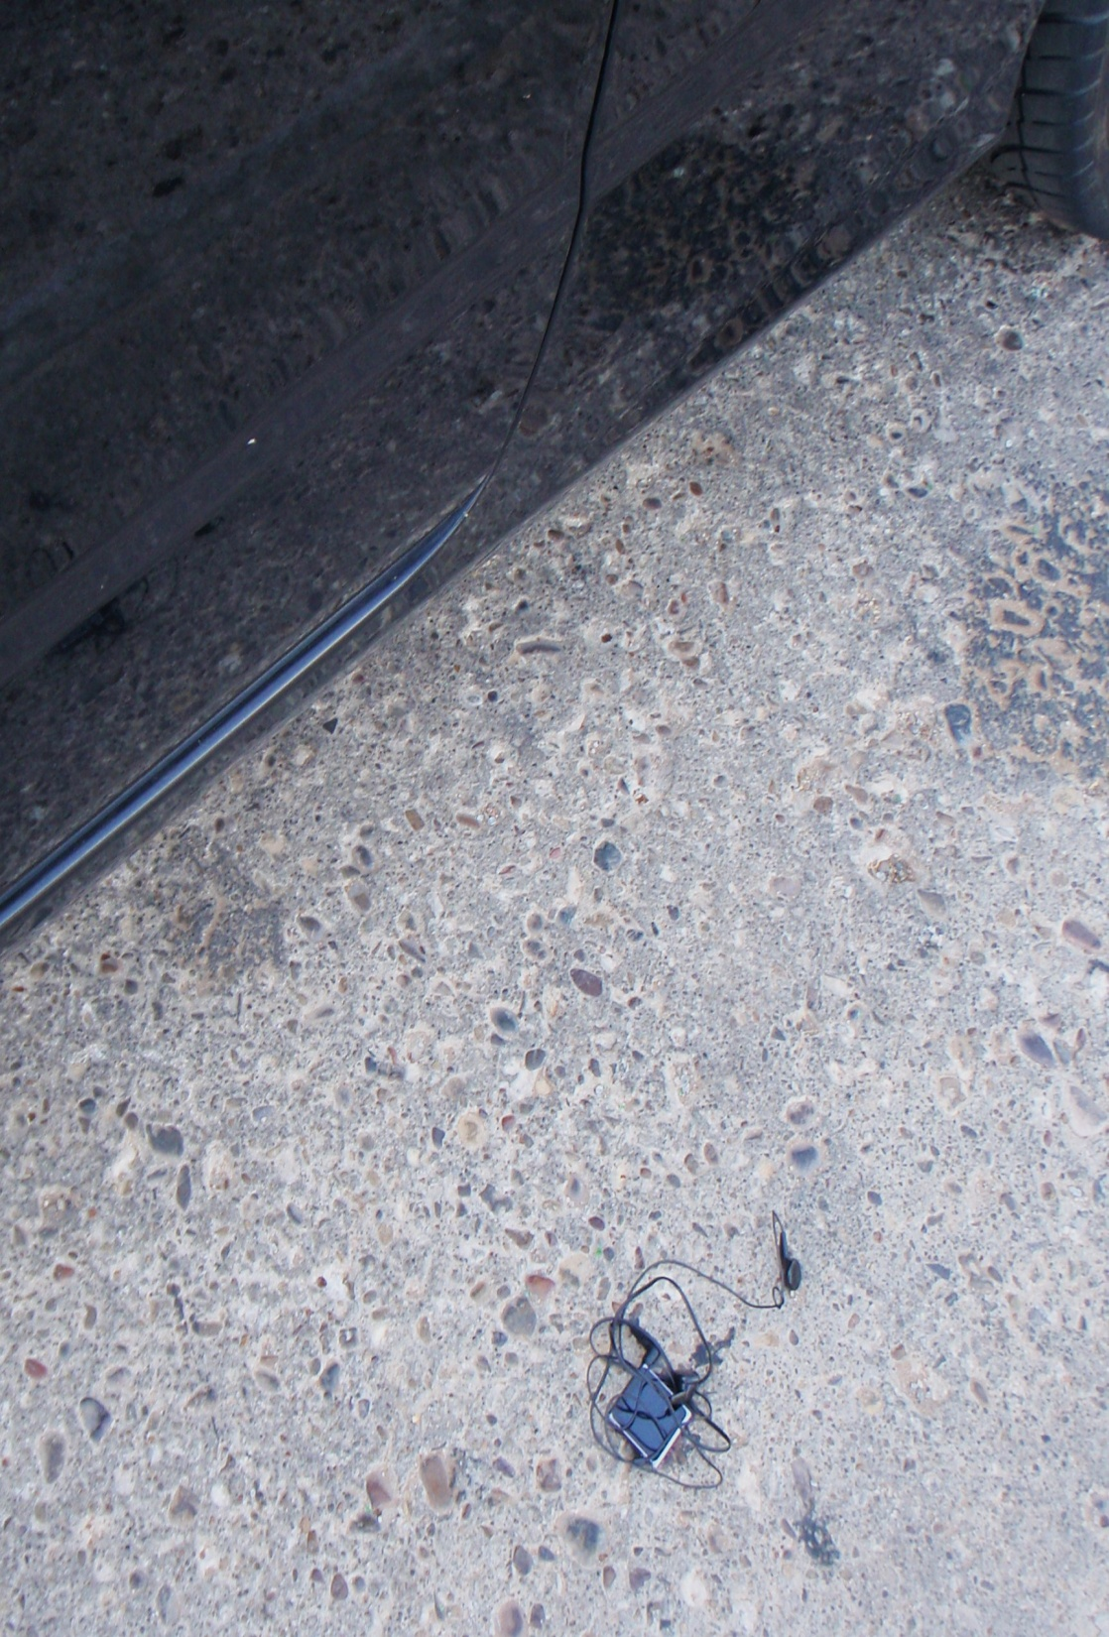
You return from lunch to get back into your car and find this item laying on the ground next to your driver’s side door. There is not a car parked next to you. You are in a high traffic area for pedestrians. Lost, mislaid, or abandoned? What should you do with the item?

Slide 5
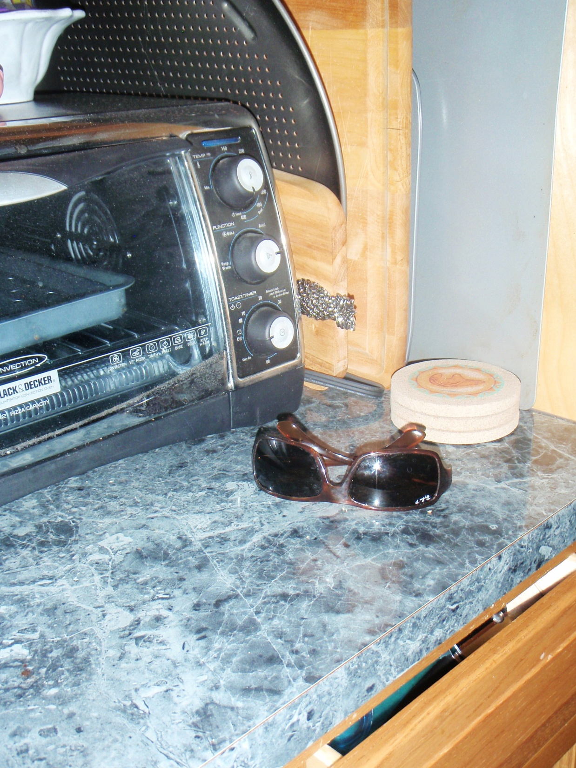
You had a big party the night before. While making breakfast, you see these sunglasses on your kitchen counter: they’re not yours or your roommate’s, and you don’t recognize them. They could be anyone’s. Lost, mislaid, or abandoned, and what do you do with them?

Slide 6
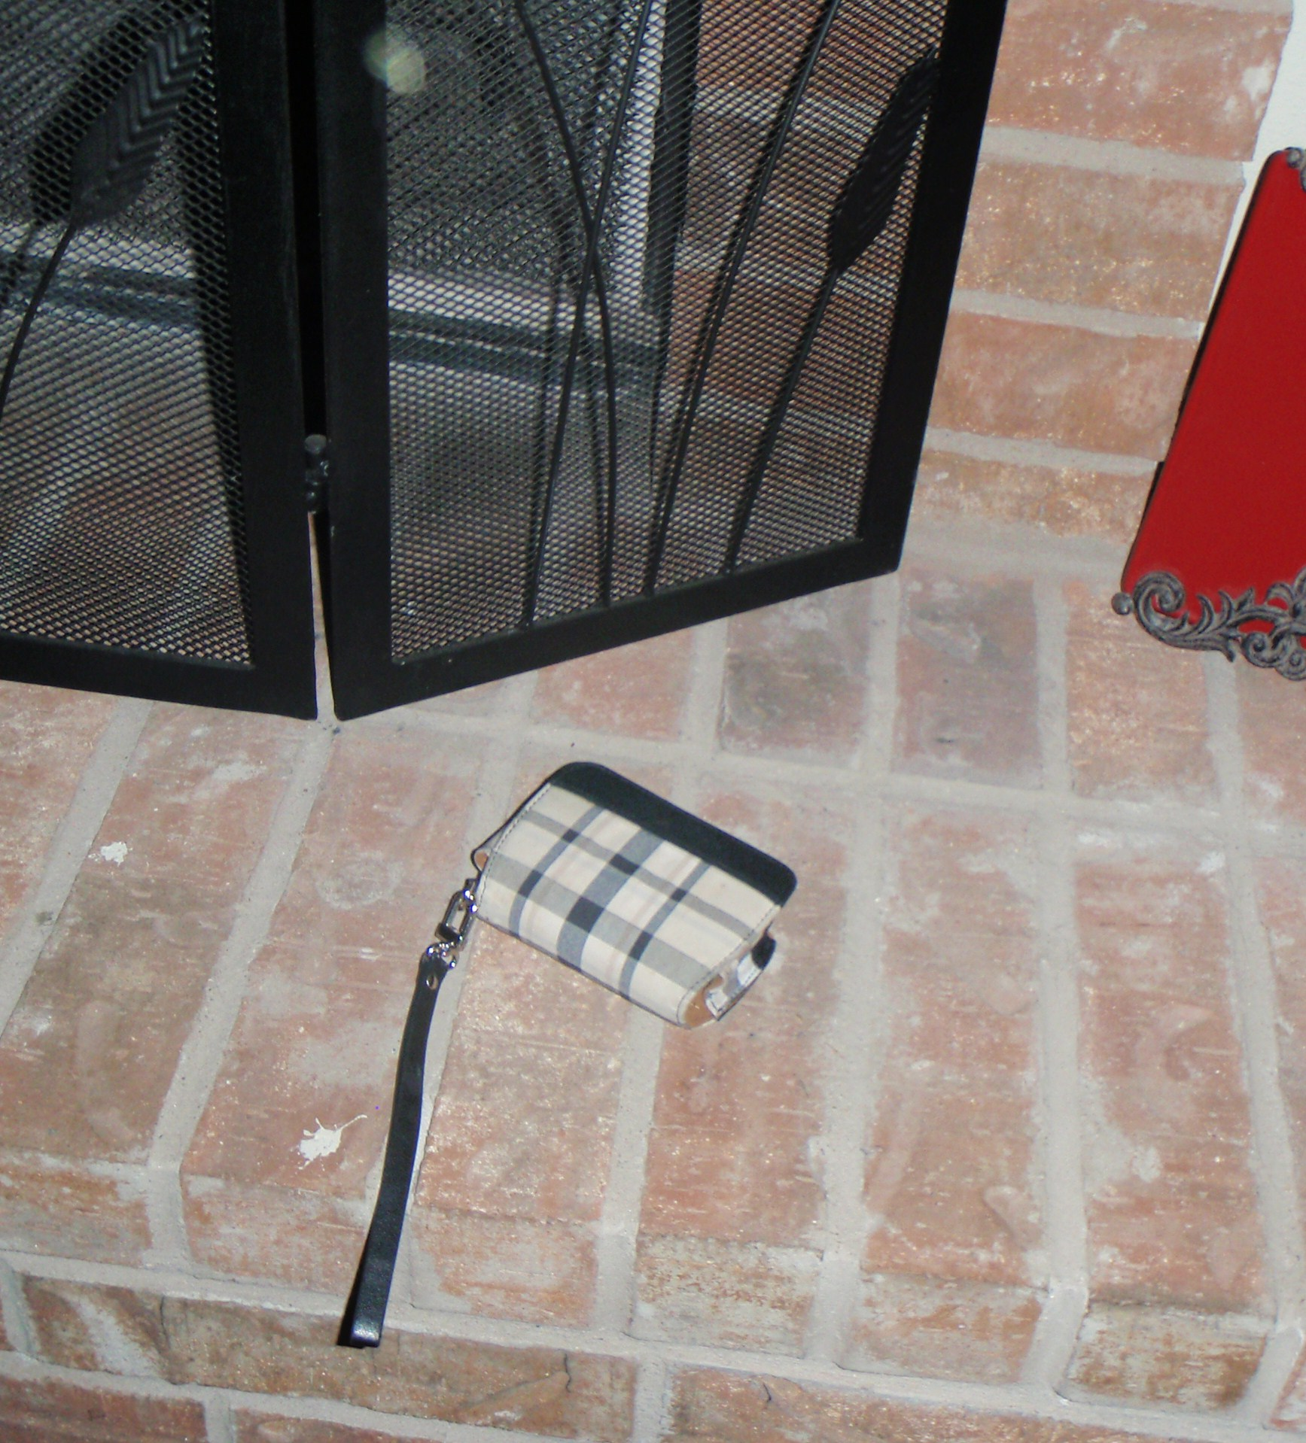
It’s been three days since the party and this camera and case are still sitting by your fireplace. Neither you or your roommate have any idea as to who the owner is. Lost, mislaid, or abandoned? What should you do with the camera?

Slide 7
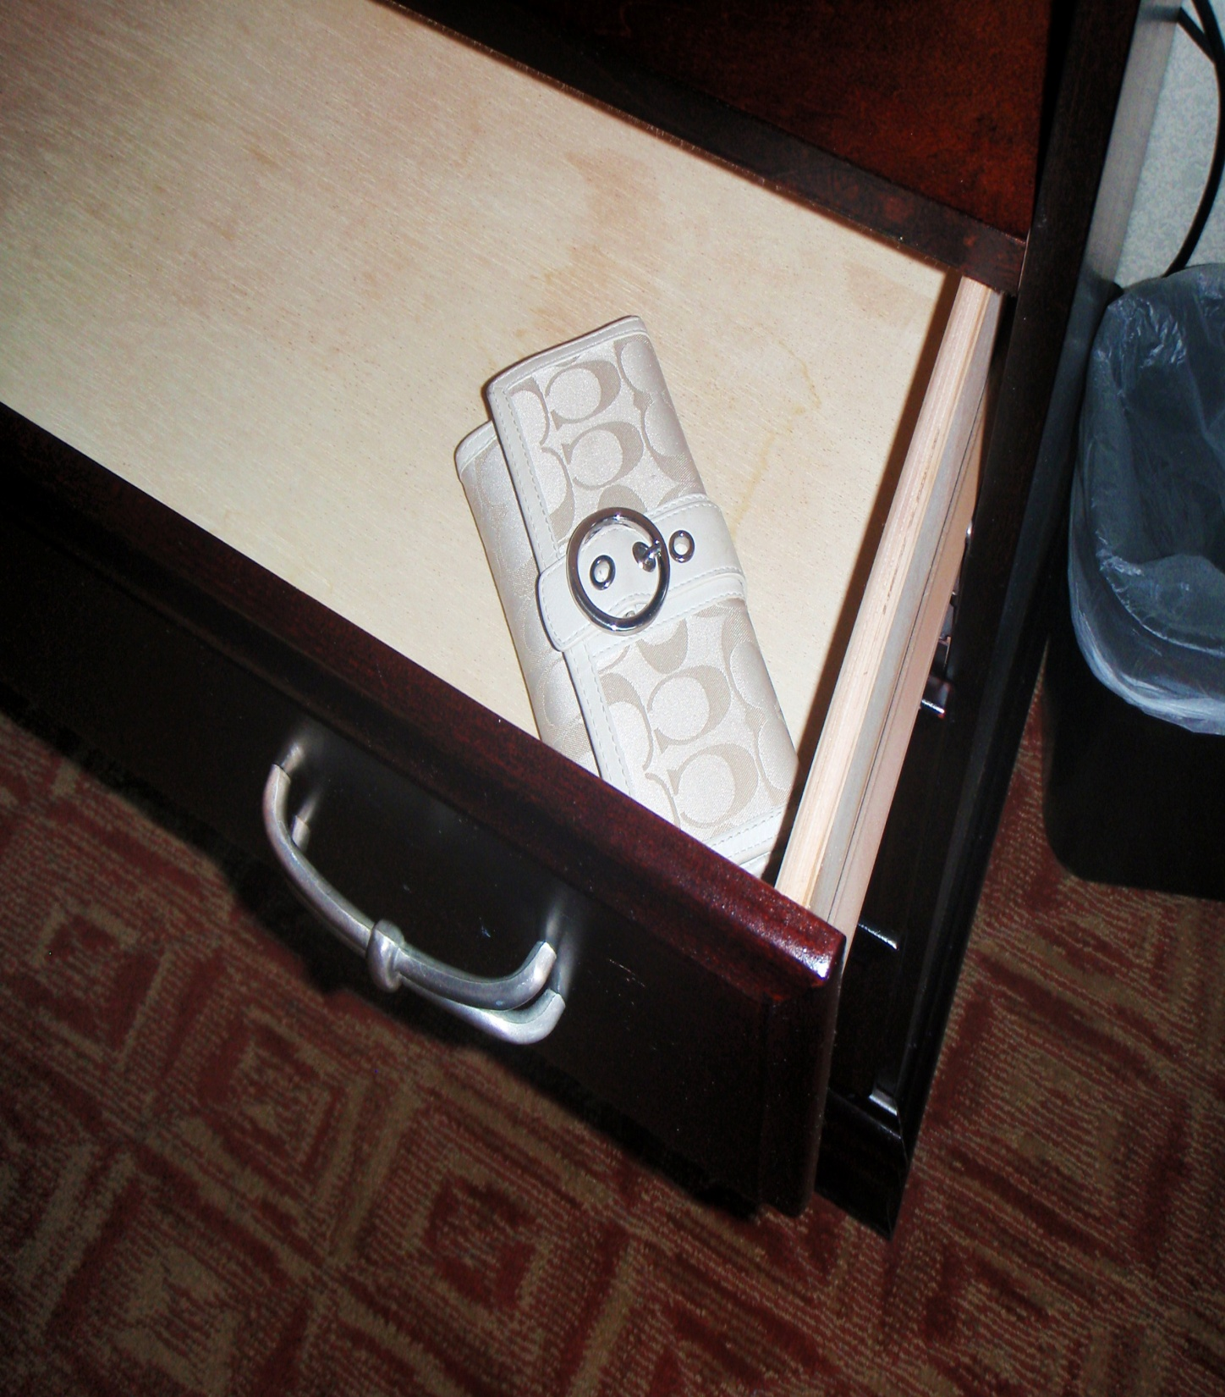
While on vacation, you open the dresser drawer in your hotel room to put up some of your belongings. You have not yet opened this wallet. Lost, mislaid, or abandoned, and what should you do with the wallet?

Slide 8
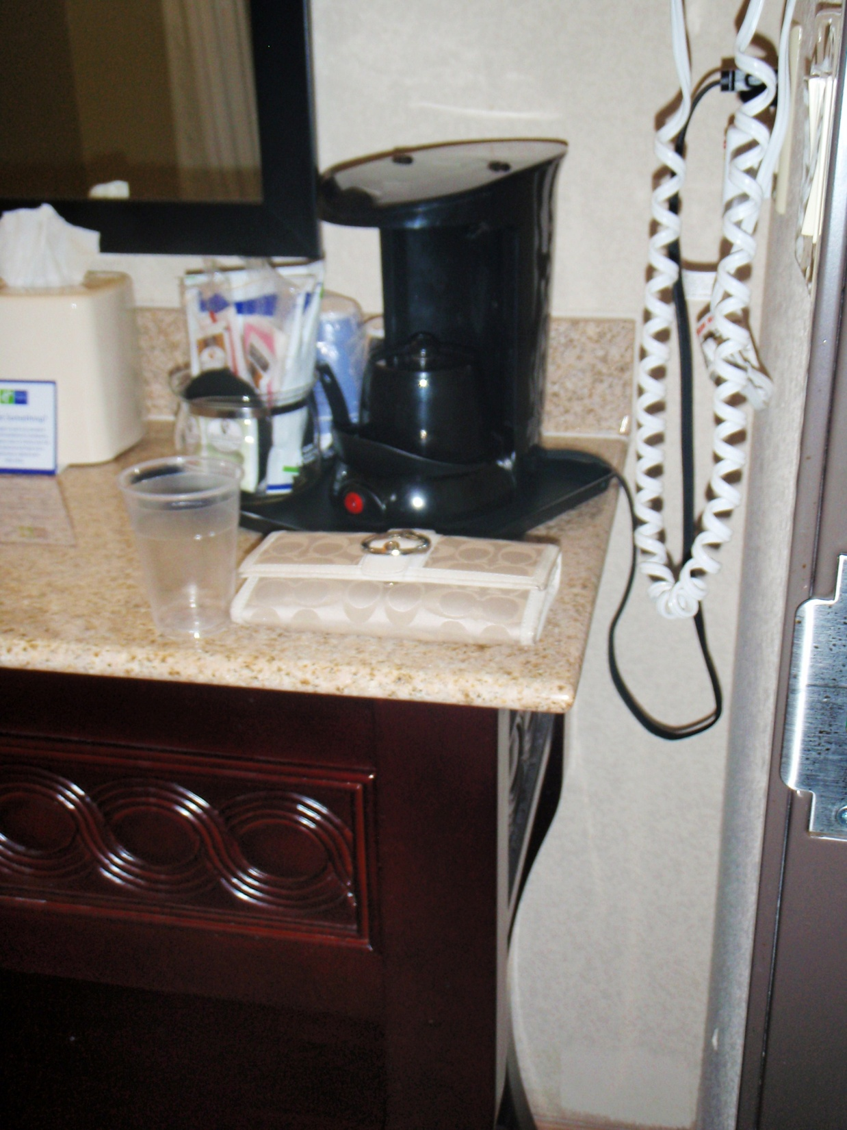
You are an employee with a local hotel’s housekeeping division. Upon entering a room to be cleaned, you find this sitting on the bathroom counter. The room has been designated as “clean after checkout,” and you are preparing it for new guests. Is the wallet lost, mislaid, or abandoned and what should you do with the item?

Slide 9
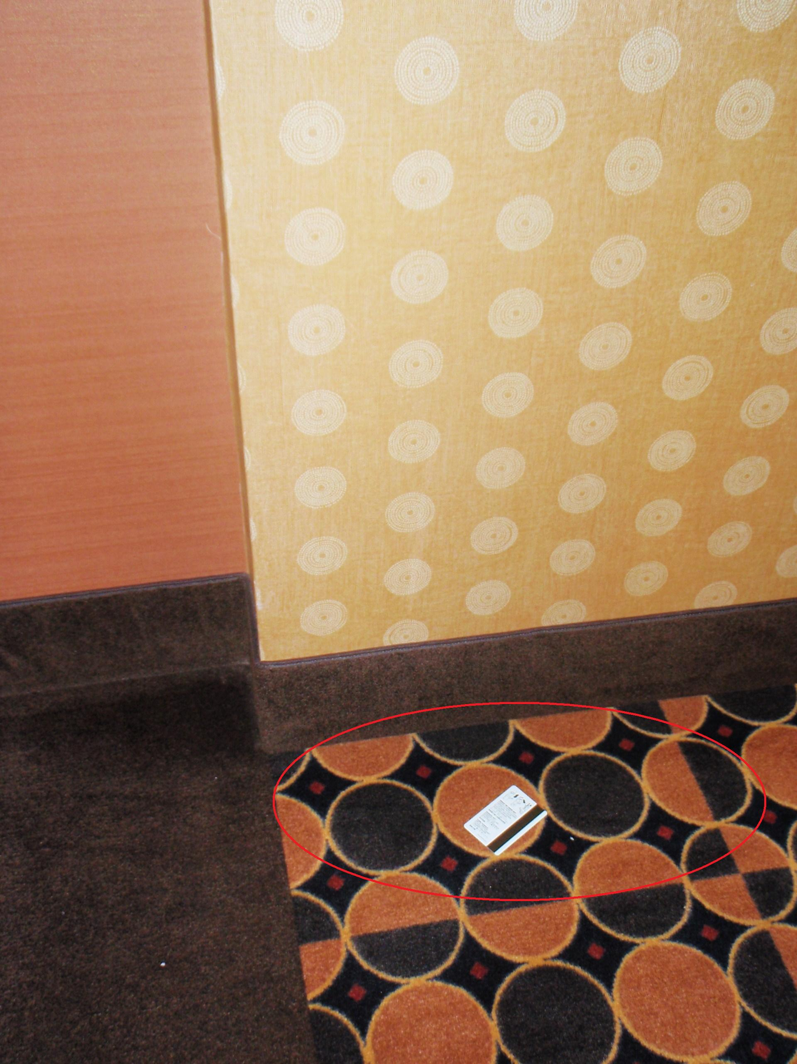
You are a guest at a hotel. While walking to the ice machine, you notice this key card laying on the floor. It is not near any specific room and you have not seen anyone else in the hallway. Is the card lost, mislaid, or abandoned and do you have any obligation to attempt to find the owner? What should be done with the item?

Slide 10
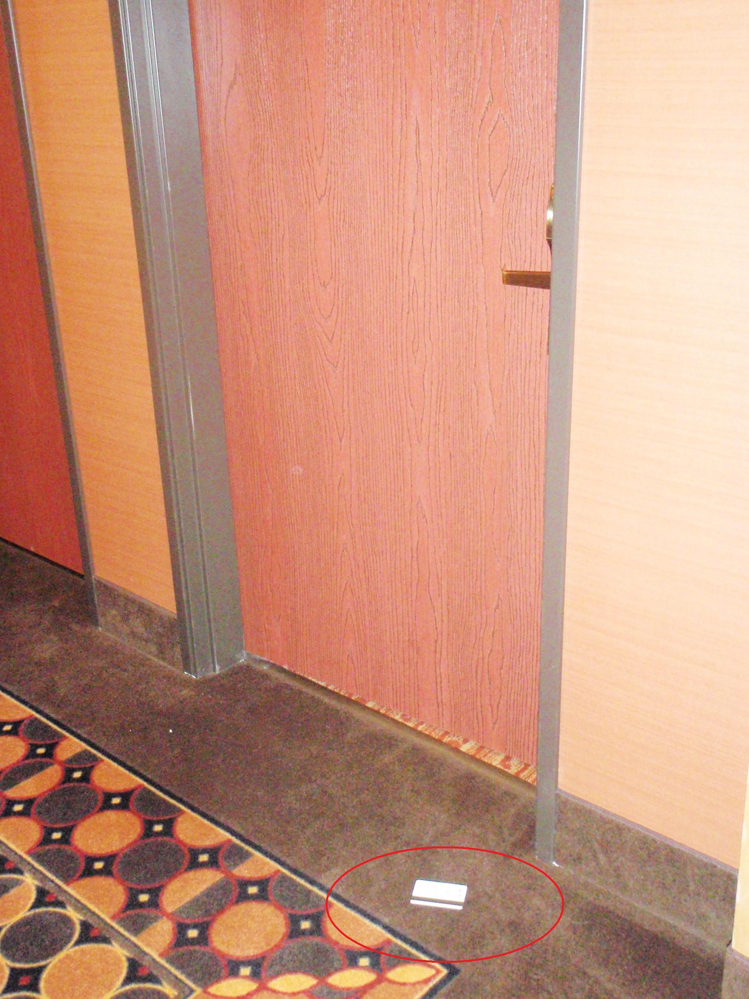
Same scenario, but this time you notice the card near a specific room: Room #123. You also notice the door to the room has been cracked open and you hear voices inside. Do you have any obligation to see if the card belongs to the occupants of the room? Does the status of the key card change from the previous scenario? Do your obligations change?

