Slide 1
Document Execution

Slide 2
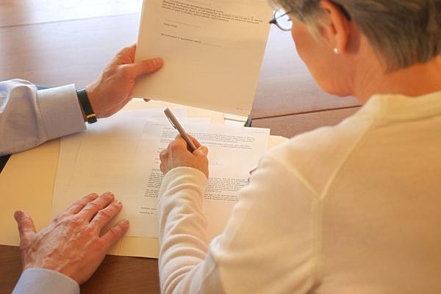
Selecting Witnesses

Slide 3
Selecting Witnesses
Normally, little thought is given other than to meet basic requirements:
  Age
  Competent
  Not a beneficiary
Less than 5% of wills are contested.
But, if anticipate a will contest, select witnesses with special care.

Slide 4

Selecting Witnesses
1. Witnesses familiar with testator

Slide 5

Selecting Witnesses
2. Supernumerary (extra) witnesses

Slide 6

Selecting Witnesses
3. Youthful and healthy witnesses

Slide 7

Selecting Witnesses
4. Traceable witnesses

Slide 8

Selecting Witnesses
5. Witnesses who would favorably impress judge and jury.

Slide 9

Will Execution Ceremony

Slide 10
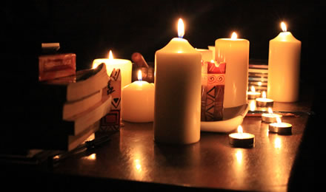
Will Execution Ceremony -- Purposes
1. Psychological benefits

Slide 11

Will Execution Ceremony -- Purposes
2. Effectuate client’s intent

Slide 12

Will Execution Ceremony -- Purposes
3. Limit exposure to malpractice claims

Slide 13
Will Execution Ceremony
Steps Before
1. Proofread will carefully
  “I leave $10.000 to Barry Allen.”
  “I enjoyed cooking my friends and my children.”
  The texting lookout:
    “The police are now here.”
    “The police are nowhere.”

Slide 14
Will Execution Ceremony
Steps Before
2. Assure internal integration to avoid fraudulent page insertion or removal.
  Same type, size color, etc. of paper.
  Same font styles.
  Same darkness of toner/ink.
  Ex toto pagination (page x of y).
  Avoid blank spaces.

Slide 15

Will Execution Ceremony
Steps Before
3. Review will with client
  Consider reward if client finds errors (either real ones or ones you inserted as a test) to confirm client actually reads the documents.

Slide 16
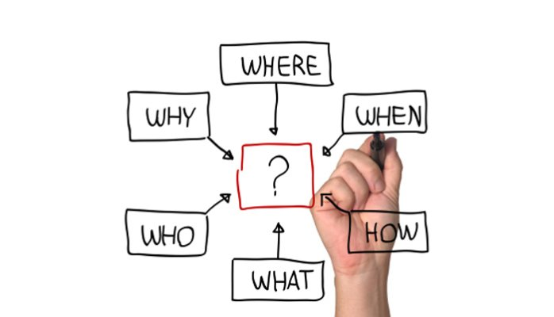
Will Execution Ceremony
Steps Before
4. Explain ceremony to client

Slide 17
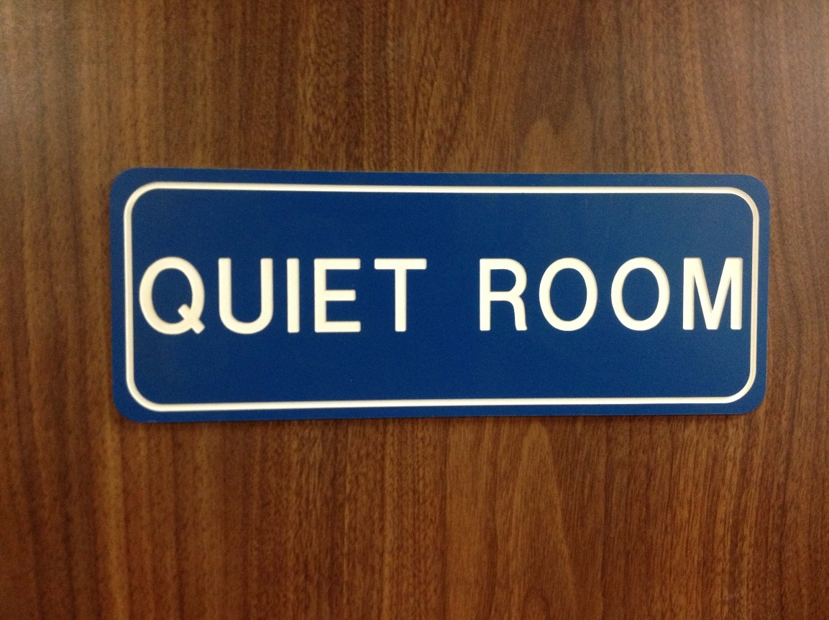
Will Execution Ceremony
The ceremony itself
1. Select proper location

Slide 18

Will Execution Ceremony
The ceremony itself
2. Seat participants strategically
Testator/Testatrix
Attorney
Notary
Witness One Witness Two

Slide 19
Will Execution Ceremony
The ceremony itself
3. Preliminary Matters
  Make general introductions
  Be sure everyone has a pen
  Sheet of paper with date on table
  Explain ceremony

Slide 20
Will Execution Ceremony
The ceremony itself
4. Establish Testamentary Capacity
  If you think the will may be contested on grounds of lack of capacity, ask questions to demonstrate capacity:
    Understanding that the will disposes of property upon death.
    General nature and extent of property.
    Identity of natural objects of bounty (family members—heirs).

Slide 21
Will Execution Ceremony
The ceremony itself
5. Establish Testamentary Intent
  [Testator’s name], is this your will?
  Have you carefully read this will and do you understand it?
  Do you wish to make any additions, deletions, corrections, or other changes to your will?
  Does this will dispose of your property at your death in accordance with your desires?
  Do you request [witnesses’ names] to witness the execution of your will?

Slide 22
Will Execution Ceremony
The ceremony itself
6. Will Execution – One-Step SPA
  Notary takes oath of testator and witnesses.
  Notary asks testator questions based on SPA.
  Testator initials each page and signs at end.
  Notary asks witnesses questions based on SPA.
  Witnesses initial each page and sign at the end.
  Notary signs the affidavit and affixes seal.

Slide 23
Will Execution Ceremony
The ceremony itself
7. Execute other estate planning documents:
  Trusts
  Beneficiary designations on non-probate assets
  Durable power of attorney
  Guardian self-designation
  Medical power of attorney
  HIPAA authorization
  Directive to physicians
  Mental health treatment declaration
  Body disposition document
  Anatomical gifts

Slide 24

Will Execution Ceremony
After ceremony
1. Confirm client’s intent.

Slide 25

Will Execution Ceremony
After ceremony
2. Make copies

Slide 26
Will Execution Ceremony
After ceremony
3. Discuss safekeeping of will
  Attorney?
  Client?
  Third party?
Regardless, give or obtain receipt.

Slide 27
Will Execution Ceremony
After ceremony
4. Discuss disposition of any prior will
  Destroy to prevent confusion, or
  Retain if fear new will contested and old will better than intestacy.

Slide 28
Will Execution Ceremony
After ceremony
5. Provide post-will instructions
  Avoid self-help changes.
  Update will when situation changes:
    Divorce
    Births
    Deaths
    Change in feelings about included and excluded relatives
    Change in composition or value of estate

Slide 29
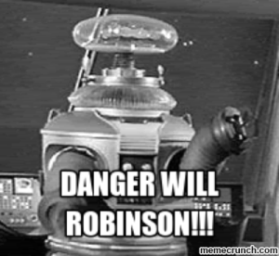
Warning – Do Not Delegate
Do not allow your staff to supervise the ceremony!
  May violate PR rules against non-lawyer to practice law.

Slide 30

Notary Instructions
Notary instructions (script) included in article.

Slide 31


