Slide 1
Reminders
Friday, April 15
  Submit documents drafts to Ashley and Rebekah.
Monday, April 18
  Complete on-line edits to will draft.

Slide 2
Co-ownership and
Multiple-Party Accounts

Slide 3
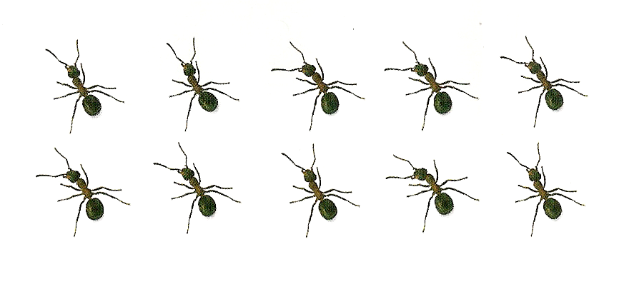
Tenants in Common

Slide 4
Tenants in Common
Default method under modern law
Sample grants:
  “To A and B”
  “To A and B as tenants in common”
  Passage to co-heirs by intestacy

Slide 5
Tenants in Common
No survivorship rights – No probate avoidance
  Upon death, deceased co-tenant’s share passes to successors in interest:
    Heirs, if intestacy
    Beneficiaries, if testate

Slide 6

Joint Tenants

Slide 7
Joint Tenants
Does the survivorship feature exist?
  Texas requires the survivorship feature to be expressly stated.
    “To A and B as joint tenants with right of survivorship.”
    Why?
    Texas Estates Code §§ 101.002 & 111.001
  Many states continue the common law rule that survivorship is automatic for joint tenancies.

Slide 8
Multiple-Party Accounts
Joint Accounts
Convenience Accounts
Pay on Death Accounts
Trust Accounts
Issues in common to all multiple-party accounts

Slide 9
Brief History
Before August 27, 1979
  Governed by scattered statutory and case law making operation uncertain.
On and after August 27, 1979
  Governed by extensive statutes in old Probate Code and new Estates Code.

Slide 10
Key Clarification
Transfers that occur upon death are NOT testamentary.
  Thus, the account contracts do not need to comply with the requirements of a will.

Slide 11

Joint Accounts

Slide 12
Format
“Payable to A or B”

Slide 13
Rights During Lifetime
Ownership is in proportion to net contributions:
  Add deposits
  Subtract withdrawals
  Add proportional share of interest
Practical problem!
  How compute this amount?

Slide 14

Rights During Lifetime
Any party may withdraw all, even in excess of net contributions.

Slide 15
Rights After Death of a Party
Presumption = no survivorship
  Deceased party’s net contributions pass through deceased party’s estate.

Slide 16
Rights After Death of a Party
To create the survivorship feature:
  Written account contract,
  Signed by deceased party, and
    If community property, both spouses must sign.
  Contain express survivorship language
Disputes arise as to whether language creates the survivorship feature.

Slide 17
Does this language create survivorship?
“On the death of a party, the party’s ownership of the account passes to the surviving parties.”

Slide 18
Does this language create survivorship?
“Upon the death of either of us, any balance in said account or any part thereof may be withdrawn by, or upon the order of the survivor.”
  Stauffer v. Henderson, 801 S.W.2d 858 (Tex. 1990).

Slide 19
Does this language create survivorship?
The signature card contained an “X” in a box labeled “MULTIPLE-PARTY ACCOUNT WITH RIGHT OF SURVIVORSHIP” and both the deceased and surviving joint parties initialed on the blank next the box.
  Hare v. Longstreet, 531 S.W.3d 922 (Tex. App.—Tyler 2017, no pet.).

Slide 20
Does this language create survivorship?
The account signature card has checkboxes next to paragraphs describing individual joint accounts and joint accounts with the right of survivorship.
  Neither box is checked.
  Check mark is between the two boxes.

Slide 21

Using Extrinsic Evidence
To show account invalid?
  Yes, e.g., fraud, lack of capacity or undue influence.

Slide 22
Using Extrinsic Evidence
To obtain account funds from other parties or estate of deceased depositor?
  No.
  Stauffer v. Henderson, 801 S.W.2d 858 (Tex. 1990).

Slide 23
Using Extrinsic Evidence
To recover damages from bank?
  Yes, based on breach of contract and/or negligence.
  A.G. Edwards & Sons, Inc. v. Beyer, 235 S.W.3d 704 (Tex. 2007).

Slide 24
Benefits
Convenient, especially for spouses.
Avoids probate if account has survivorship rights.

Slide 25
Disadvantages
Danger of unauthorized withdrawals.
Lack of understanding of effect.
Inability to show contrary intent.

Slide 26

Convenience Accounts

Slide 27
Format
“Payable to A for the convenience of B”
  A is a “co-signer.”

Slide 28
Rights During Lifetime
Ownership = only the party who funds the account
  Convenience signer has no ownership claim.
Withdrawal rights = any party can withdraw all.

Slide 29
Rights After Death of a Party
No survivorship rights in the co-signer.
All funds pass through depositing party’s estate.

Slide 30
Purpose
A simple type of agency making it easy for someone to make payments from another person’s account. For example, the person is:
  Traveling out of country (vacation or military)
  Residing in an iron hotel
  Has difficulty writing

Slide 31
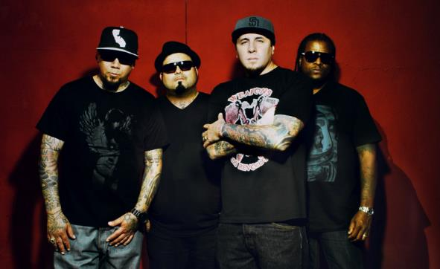
Pay on Death Accounts

Slide 32
Format
“A, pay on death to B.

Slide 33
Rights During Lifetime
Depositor has all rights.
Pay on death beneficiary has no rights
  Depositor can change POD beneficiary at any time for any or no reason.

Slide 34
Rights After Death
If Beneficiary survives all depositors, all to the Beneficiary.
If Beneficiary does not survive all depositors, all to depositor’s estate.

Slide 35
Common Usages
Parent, POD child.
Grandparent, POD grandchild.
Spouse or Spouse with rights of survivorship, POD children.
Friend, POD Friend.
Employer, POD Employee.

Slide 36
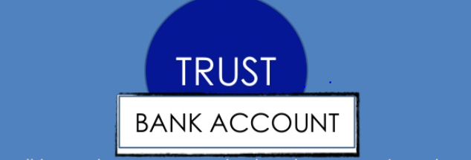
Trust Accounts
Also called Totten Trusts

Slide 37
Format
“A, trustee for B.”
Does NOT include:
  Account maintained to administer a real trust.
  Account held as a trust asset.
  Fiduciary account (e.g., an attorney’s client trust fund account).
A “trust account” is NOT a trust.

Slide 38
Rights During Life and at Death
Same as pay on death account.

Slide 39

Advice
Do not use!!
Confusion with a real trust.

Slide 40

Other Concerns

Slide 41
Effect of Divorce
Ex-spouse (and relative of ex-spouse who is not relative of the deceased party such as a step-child) removed as POD and trust account beneficiary.
Ex-spouse (and relative of ex-spouse who is not relative of the deceased party such as a step-child) will not benefit from the survivorship feature.
  Exception: Reaffirmation of survivorship agreement after divorce.

Slide 42

Conflict with Will Provision
Account contract prevails over will disposition.

Slide 43
Creditors
While depositor alive
  Creditors can reach to extent of depositor’s net contributions.
After depositor dies
  Funds available as a last resort to pay creditors.
    Two year statute of limitations from the depositor’s death.

