Slide 1


Slide 2
Reminders
Friday, April 15
  Submit documents drafts to Ashley and Rebekah.
Monday, April 18
  Complete on-line edits to will draft.

Slide 3
Overview
Reasons to use non-probate transfers.
Inter vivos gifts.
Powers of appointment.

Slide 4
Reasons to Use
Non-Probate Assets

Slide 5
Non-Probate Transfers Generally
Property that transfers before, at the time of, or after death but not via:
  Intestacy, or
  A will.
Non-probate assets are not administered as part of the decedent’s estate.

Slide 6
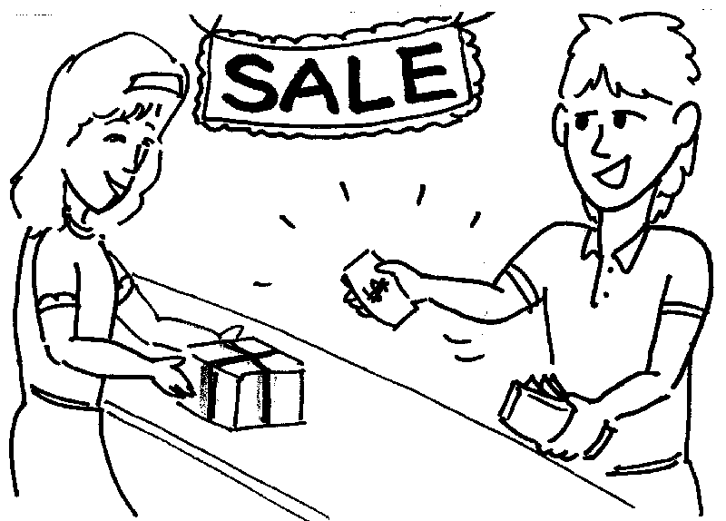

Reasons to use a non-probate transfer -- #1
1. Non-estate planning reasons
  Non-gratuitous transfers
  Gratuitous transfers

Slide 7
Reasons to use a non-probate transfer -- #2
2. Avoid delay in asset distribution
  Needs of beneficiaries
  Asset management
  Psychological effect

Slide 8

Reasons to use a non-probate transfer -- #3
3. Reduce expenses
  Estate planning fees
  Estate administration costs

Slide 9

Reasons to use a non-probate transfer -- #4
4. Enhance confidentiality

Slide 10

Reasons to use a non-probate transfer -- #5
5. Reduce taxes, if properly used

Slide 11

Reasons to use a non-probate transfer -- #6
6. Great flexibility

Slide 12

Reasons to use a non-probate transfer -- #7
7. Ease of change

Slide 13

Reasons to use a non-probate transfer -- #8
8. Creditor protection

Slide 14

Reasons to use a non-probate transfer -- #9
9. Resilient to contest

Slide 15

Reasons to use a non-probate transfer -- #10
10. Enhanced understandability

Slide 16
Outright Inter Vivos Gifts

Slide 17
Inter Vivos Gifts -- Generally
Give away during life so not in estate upon death.
  Present donative intent
  Delivery
  Acceptance

Slide 18
1. Present Donative Intent
Voluntary
No consideration or compensation
Presently effective
Irrevocable

Slide 19
2. Delivery
Physical delivery of property from donor to donee
Delivery of property to a third party, who is not under donor’s control, with irrevocable instructions to deliver to donee (escrow)
Constructive Delivery
  Donor transfers to donee the means of obtaining possession and control of the property.
Symbolic Delivery
  Deed of gift

Slide 20
3. Acceptance
Presumed if gift is beneficial to donee.

Slide 21
Potential benefits of inter vivos gifts
  Donee’s immediate enjoyment
  “The joy of giving”
  Donor no longer needs to manage the property
  Federal gift tax exclusions
    $16,000 annual exclusion
    Unlimited education and medical expense exclusion
  Beyond reach of donor’s creditors
    Unless transfer is deemed fraudulent

Slide 22
Potential disadvantage of inter vivos gifts
  Irrevocability
  Lack of control
  Leverage reduction
  Jealously of similarly related individuals
  Problematic if donee is a minor or incompetent

Slide 23
Powers of Appoinment

Slide 24
Powers of Appointment
Receives “stick” of right [not a duty] to name new owner
General = everyone (even donee)
Special or limited = as donor provided

Slide 25
Creation Methods
Inter Vivos Document
  Deed
  Trust
  Separate document
Will

Slide 26
Types
General
  Holder may designate anyone, even him/herself.
  Often treated by the law, especially tax law, as “ownership.”
Specific or Limited
  Exercise possible only in favor of certain individuals, classes, or upon conditions.

Slide 27
Basic Operation
Donee does not have title to underlying property; just the power to designate its new owner.
No duty on donee’s part to exercise power
  It is not a trust; donee is not a fiduciary.
If exercised, must follow its terms and conditions.

Slide 28
Time of Exercise
The power of appointment will specify when the donee may exercise it.
  Inter Vivos = only while donee is alive.
  Testamentary = only by donee’s will.
  Both inter vivos and testamentary
If not exercised, passes to:
  Default takers names in PoA, or
  If none, donor or donor’s estate.

Slide 29
Texas Estates Code § 255.351
A residuary clause or “all property clause” will not exercise a testamentary power of appointment.
The testator must:
  Make specific reference to the PoA in the will, or
  Indicate in writing that the testator intended to include the property subject to the power in the will.

