Slide 1
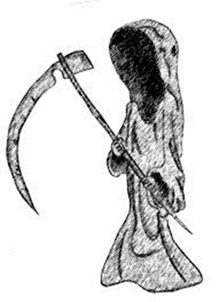
Planning for the
Death Event

Slide 2
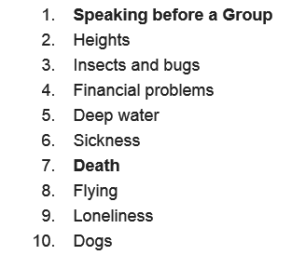
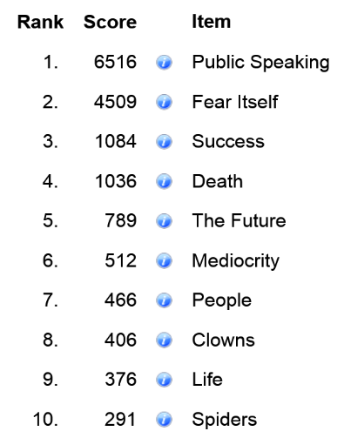
Fears

Slide 3
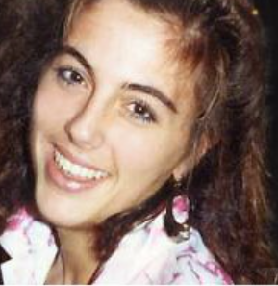

Famous cases
Nancy Cruzan
Terri Schiavo

Slide 4
Death Methods
1. “Normal” Death

Slide 5
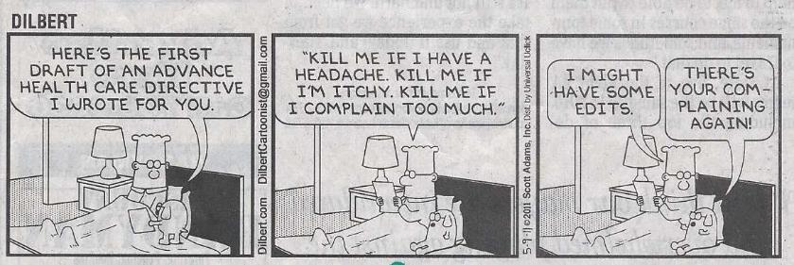
Death Methods
2. Advance Directives
  Agent under Medical Power of Attorney
  Directive to Physicians (living will)

Slide 6
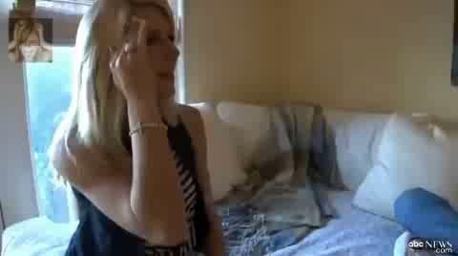
Death Methods
3. Voluntary Euthanasia (assisted suicide)

Slide 7
Death Methods
3. Voluntary Euthanasia (assisted suicide)
  By Statute
    California
    Colorado
    DC
    Hawaii
    Maine
    New Jersey
    New Mexico
    Oregon
    Vermont
    Washington
  By Judicial Decision
    Montana

Slide 8

Death Methods
4. Active (requested) Euthanasia

Slide 9
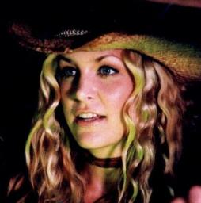
Death Methods
5. Involuntary Euthanasia
“Whatever you need to do, you do it. There is no wrong. If someone needs to be killed, you kill 'em. That's the way.”
Baby, House of 1000 Corpses

Slide 10
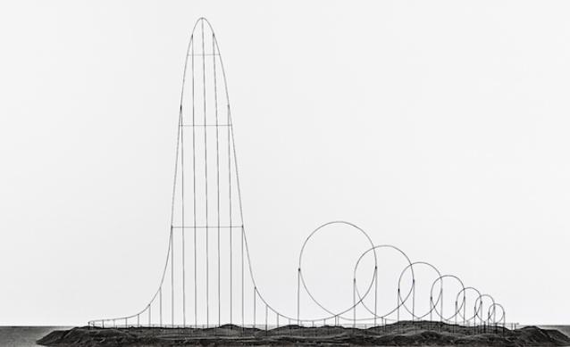
Euthanasia Coaster
1,670 feet tall

Slide 11
Living Wills

Slide 12
Formalities
Written
Oral or gesture in some states
  Question to avoid: “Blink once to pull the plug and twice to stay plugged in.”
Two witnesses or notarized
Review key parts of form

Slide 13
Opinion?
Benefits:
Problems:

Slide 14
Out-of-Hospital
Do-Not-Resuscitate Order

Slide 15
Physician Orders Regarding
Life Sustaining Treatment
(POLST)
Medical Orders for Scope of Treatment
(MOST)

Slide 16
Monday Reminders
Death Planning Interview
  Rebekah
  Ashley
Disability Planning for Health Care Assignment due.

Slide 17

Participation Scoring

Slide 18

Anatomical Gifts

Slide 19
Reasons In Favor
Extend length and quality of life for others.
Bring a “benefit” from an otherwise tragic situation of a loved one’s death.
Assist medical research and education.
  Note: ABA recommends all attorneys discuss organ donation with their clients.

Slide 20
Reasons Against
Fear that physicians will not work hard enough to save the life of a donor.
Cannibalism by technology.
Religious beliefs.

Slide 21
Transplant History
Bones first transplanted in 1878.
Cornea transplants started in the 1940s.
Kidney transplants started in the 1950s.
First lung transplant in 1963.
First heart transplant in 1967.

Slide 22
Legal Evolution
Uniform Anatomical Gift Act of 1968
Revised Uniform Anatomical Gift Act of 1987
Revised Uniform Anatomical Gift Act of 2006

Slide 23
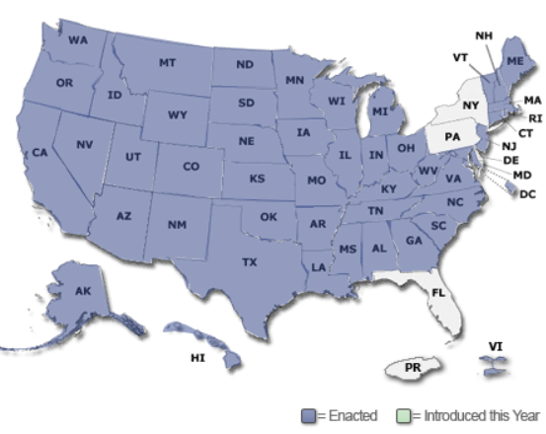
Revised Uniform Anatomical Gift Act of 2006

Slide 24

Who may be a donee of his/her own organs?
Adult (18 or older).
Emancipated minor.
Unemancipated minor 16
or older with parental
consent.
Medical agent.
Guardian.
Note: Living donations are not covered.

Slide 25
Who may donate another person’s organs?
Medical agent.
Spouse (even if divorce pending).
Any adult child.
Any parent.
Adult sibling.
Adult grandchildren.
Any grandparent.
Adult who exhibit special care and concern.
Guardian of the person.
Hospital administrator.
Anyone else with body disposition authority.

Slide 26
Who are proper recipients?
Designated individual for insertion (not just to keep in a jar).
Organ procurement organization.
Hospital f0r research.
Eye or tissue bank.
Forensic science program.
For training of human remains detection canines.
Anatomical Board of State of Texas

Slide 27
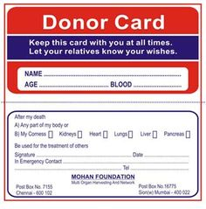
Donation methods
1. Donor Card
  Signed.
  No witnesses needed unless donor is signing by proxy in which case two witnesses are needed.
  Advice: carry in wallet near driver’s license.

Slide 28
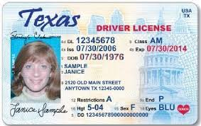
Donation methods
2. Driver’s license designation

Slide 29

Donation methods
3. Registration in a donor registry
https://www.donatelifetexas.org/

Slide 30

Donation methods
4. Will
  Effective without probate.
  But, BAD technique as will often not examined until too late to make anatomical gift.

Slide 31
Donation methods
5. Terminal illness or injury communication
  Oral, written, by gesture, etc.
  Two adult witnesses.
  One witness must be disinterested (not a spouse, child, parent, sibling, grandchild, grandparent, or another adult who exhibited special care and concern for the individual).
  Donor must be suffering from a terminal illness or injury.

Slide 32
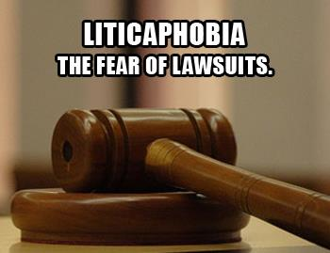
Warning!
Regardless of what the donor does, hospitals are unlikely to follow the donor’s wishes if the family members object.

Slide 33

Possible solution
Will provision denying family members property if they oppose organ donation.

Slide 34

Anti-donation methods
Signed record.
Will provision.
Any communication to two adults during terminal illness or injury.

Slide 35

Revocation methods
Destruction of donor card.
Donor card which revokes expressly or by inconsistency.
Will amendment or revocation.
Communication to two adults during terminal illness or injury.

Slide 36
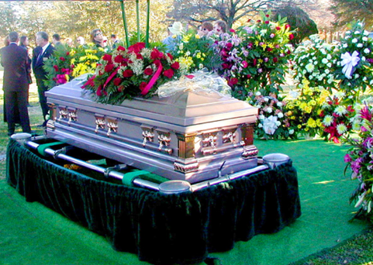
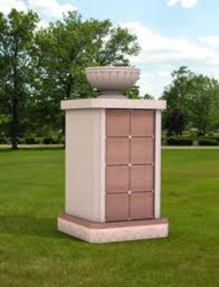
Body Disposition

Slide 37

1. Fact or Urban Legend
To be dressed in comfy clothes (not a suit) and allowed to stand in my home near my mom.

Slide 38
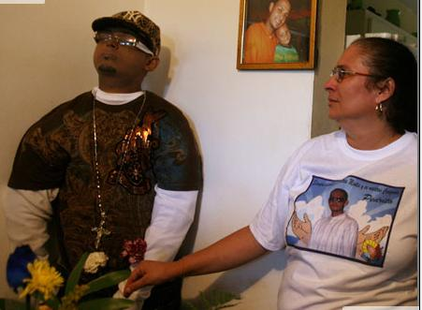
Enjoying the home life after death
Angel Pantoja

Slide 39

2. Fact or Urban Legend
To be impaled through the heart with a steel rod.

Slide 40
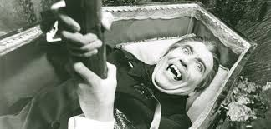
Doctor to impale with steel stake
Harold West?

Slide 41
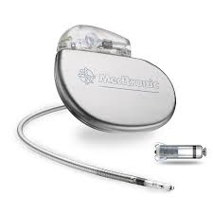
3. Fact or Urban Legend
Give my pacemaker to my dog.

Slide 42
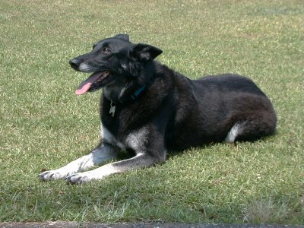
Pacemaker to dog
Sunshine

Slide 43
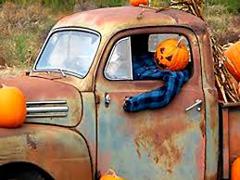
4. Fact or Urban Legend
Bury me in my car.

Slide 44
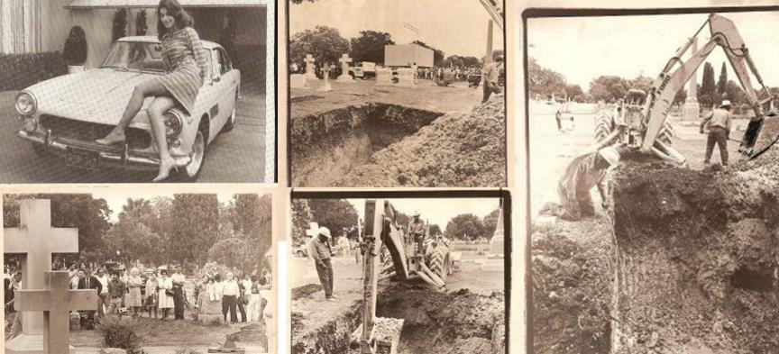
Buried in Ferrari
Sandra West

Slide 45
How do you wanted to be handled?
Burial
Cremation
Don’t care; whatever family wants
Something “exotic”

Slide 46
Religious considerations
Many religions have rules regarding body disposition that your client may want followed.
For example, in October 2016, Catholics were told that cremation is allowed if remains kept in a sacred place. Thus, the following not allowed:
    Scatter ashes
    Keep at home in an urn
    Divide among family members
    Preserve in mementos

Slide 47

Governing law
Health & Safety Code § 711.002.

Slide 48
Disposition if no planning
In priority order, the following people control your body disposition:
  Spouse, unless killed decedent.
  Any adult child.
  Any parent.
  Any adult sibling.
  Qualified personal representative.
  Adult heirs in intestacy order.

Slide 49
Disposition if no planning
If the person with priority does not make final arrangements before the earlier of
  (1) the 6th day after the person received notice of the decedent’s death or
  (2) the 10th day after the decedent died,
  the person is presumed to be unable or unwilling to control the disposition.
  This person’s right to control the disposition is terminated and the right passes to another person with the same priority or, if none, to the next person in priority order.

Slide 50

1. Written Directions
Requirements:
  In writing,
  Signed, and
  Acknowledged.

Slide 51
Typical items covered
Burial or cremation.
Name of desired funeral home.
Preferred location of services.
Celebrant (e.g., a clergy member, a relative, or friend).
Burial location.
Whether an obituary is desired and, if so, its contents.
Type of headstone and information desired thereon.
Whether the viewing is to be open or closed casket.
Desired burial clothes and jewelry.
Type of casket and vault desired.
Names of pallbearers.
Others directions, e.g., types of flowers, music selections, prayers, etc.

Slide 52
Duty to carry out instructions
The person who would otherwise be entitled to control body disposition must “faithfully carry out the directions of the decedent to the extent that the decedent’s estate or the person controlling the disposition are financially able to do so.”

Slide 53
Penalty for not following directions
No statutory penalty for failing to follow directions.
Use of conditional testamentary gift may be effective deterrent to ignoring client’s wishes.
  “I leave my spouse all my property but only if I am cremated. If I am buried, my spouse is to receive nothing and I leave all my property to the Cremation Society of America.”

Slide 54
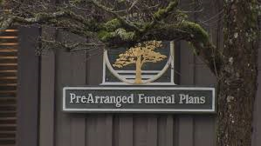
2. Prepaid funeral contract

Slide 55
Good idea?
Yes
  Relieves family of burden of planning and paying.
No
  Funeral home may go out of business.
  Client may move out of service area without reciprocal arrangement.
  Client “overspends.”

Slide 56
Liability for failure to follow
If the funeral home fails to honor the prepaid contract, the funeral home “is liable for the additional expenses incurred in the disposition of the decedent’s remains as a result of the breach of contract.”

Slide 57

3. Will provision
Will often not found until too late.
  Cannot bury if already cremated.
  Unlikely to get exhumation order to effectuate cremation.

Slide 58

4. Designated agent
Client may designate an agent to control disposition of remains.

Slide 59
Requirements
Designate agent.
Signed by principal.
Acknowledged.
Signed by agent before acting
  Agent does not sign when principal executes.
Statutory form is optional but highly recommended.

Slide 60

Effect of divorce
Divorce from agent automatically revokes the designation unless documents provides otherwise.

Slide 61

Unusual Dispositions

Slide 62
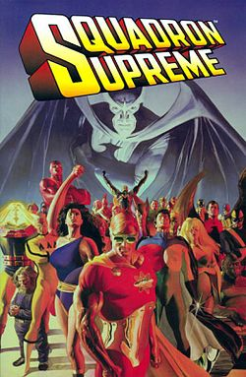
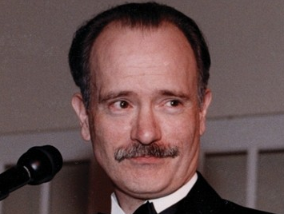
Ashes to ink
Mark Gruenwald

Slide 63
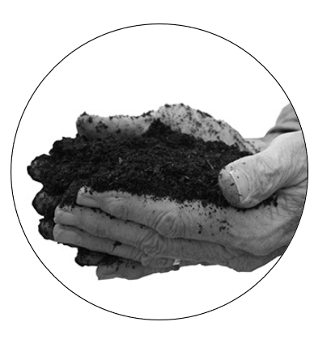
Compost
The Urban
Death Project

Slide 64
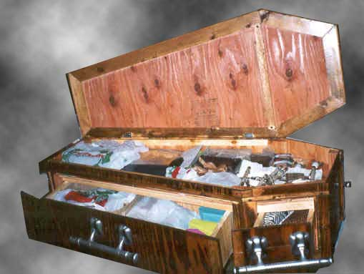
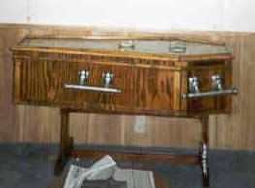
Dual use furniture
Designed and built by Bryan Schoening.

Slide 65
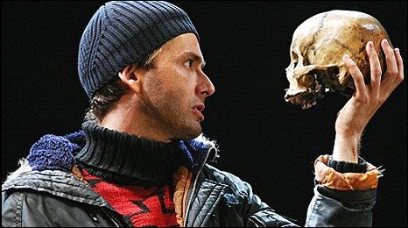
Use skull in Hamlet
Juan Potoachi?

Slide 66

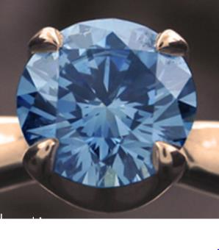
Cremains to Diamonds

Slide 67
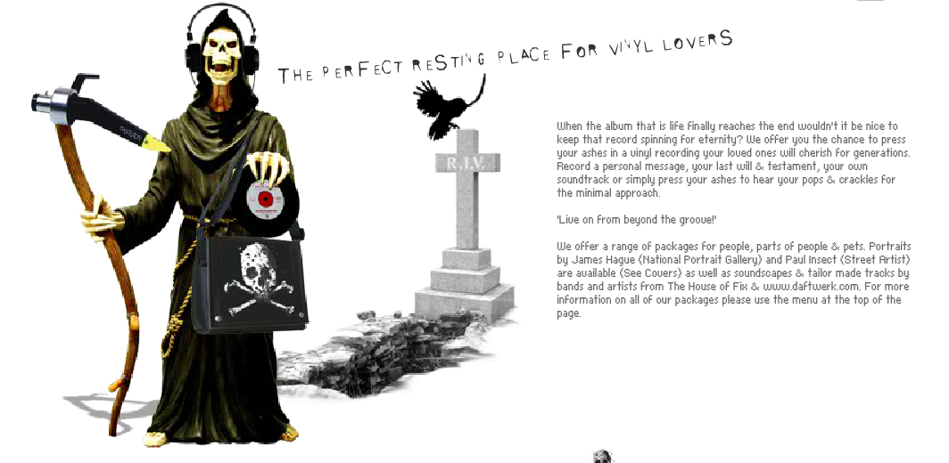
Cremains to Vinyl Records

Slide 68
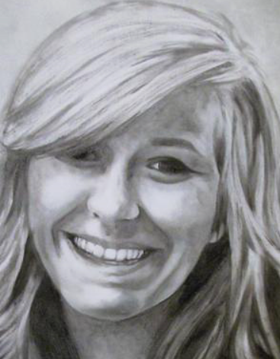

Cremains to Portraits

Slide 69


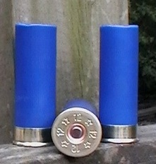
Bullets and shotgun shells

Slide 70


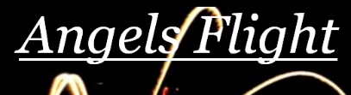
Fireworks

Slide 71
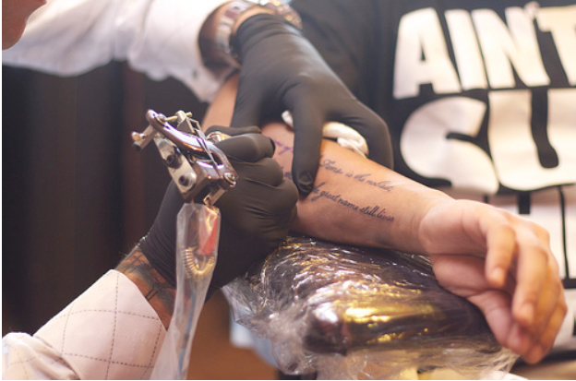
Add to Tattoo ink

Slide 72
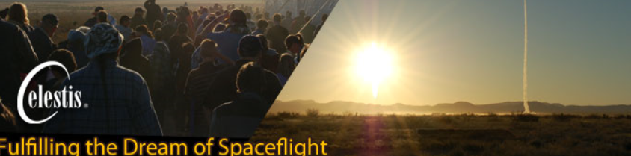



Launch into space
Timothy Leary
Gene Rodenberry
Joe and Jane Ingram

Slide 73

Questions?

