Slide 1
Disability Planning for Health Care

Slide 2
Introduction
More important than property matters as impacts client’s medical care and thus quality of life.
  Life and death decisions included.

Slide 3
Statutory
Surrogates

Slide 4
Statutory Surrogates
What happens if no planning done and no guardian has been appointed?
Health & Safety Code Chapter 313 provides list of decision-makers.

Slide 5
Priority List UPDATE NEWSTATUTE
Spouse
Adult children.
Parents.
Nearest living relative.
Physician not involved in patient’s medical treatment.
  Note: Statute does not resolve issue if children or parents disagree.

Slide 6
Prohibited Decisions
Remove life support
Authorize electroshock
Inpatient mental health services
Delegation of decision-making authority

Slide 7
Discussion Questions
Are family members the right people to be default decision-makers?
Are your family members according to the priority list the people you would want making decisions for you?

Slide 8
Medical Power of Attorney
[health care proxy]
[advance directive]

Slide 9
Historical Background
Common Law
  Medical decisions non-delegable
Modern Law
  Started with California in 1983
  Virtually all states now allow either with their own acts or adoption of Uniform laws

Slide 10
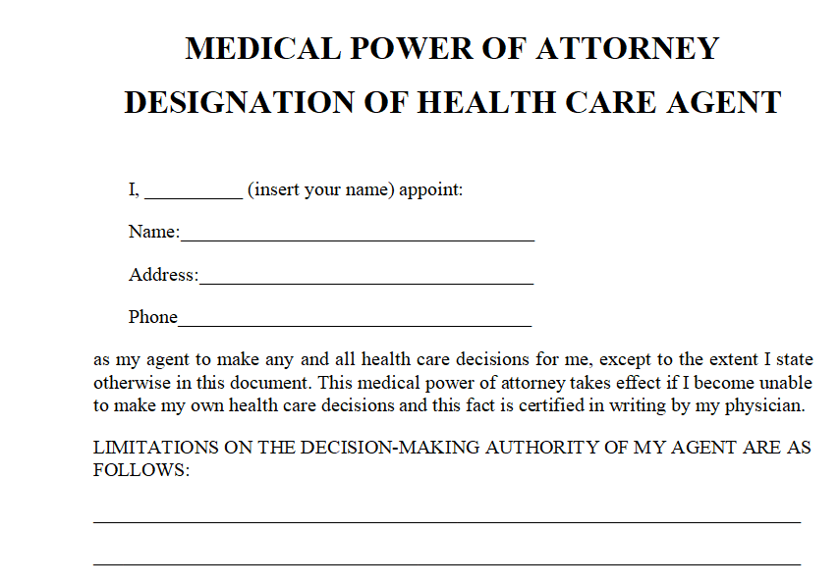
Texas Statutory Form

Slide 11
Texas Statutory Form Comments
Must be in substantially the statutory form.
  Only a few states have this requirement.
Name agent and alternates.
Opportunity to provide detailed instructions.
Mandatory disclosure statement.
Notarized or two witnesses.

Slide 12
Special Concerns
Select agent carefully
  Life-changing and life-ending decisions may be made.
  Discuss with agent your thoughts so agent can do a good job of making substitute decisions.
Consider special instructions for any particular desires you may have.

Slide 13


Slide 14

Will Drafts Due

Slide 15

What did you do?

Slide 16

Were you arrested?

Slide 17




Is there evidence you did something your mom and future employers should not see?

Slide 18

Did you get engaged or married?

Slide 19


Reminders
Disability Planning for Health Care Interview
  Audra Apke
  Pedro Gonzales-Cruz
Disability Plan for Property Due

Slide 20
Disability Planning for Health Care
[continued]

Slide 21
Review
Statutory Surrogates
  No planning decision-makers
Medical Power of Attorney
  Planned decision-makers

Slide 22
HIPAA Authorization
[Heath Insurance Portability and Accountability Act]

Slide 23
Basic Issues
Can medical agent get needed information?
Split of opinion
  MPA is sufficient to grant authority, or is
  Separate HIPAA authorization needed?
Recommendation – Separate document
Warning – Do not combine with MPA as federal law requires it to be separate.

Slide 24
Declaration for
Mental Health Treatment

Slide 25

Statutory Form

Slide 26
Texas Statutory Form Comments
Must be in substantially the statutory form
Decision items
  Psychoactive medications
  Convulsive treatment
  Preferences for emergency treatment
    Rank order: restraint, seclusion, and medication
    Gender of person to administer
Additional preferences or instructions
Notarized or two witnesses

Slide 27
Guardian
Self-Designation

Slide 28
General Comments
Same form as for guardian of the estate.
Normally, select same people in same order as health care agents.
Disqualification of individuals who would have statutory priority possible.

Slide 29
Review
Planning Documents
  Medical Power of Attorney
  HIPAA Authorization
  Self-Designation of Guardian
  Mental Health Treatment Declaration

Slide 30
Methods of Funding Care
[not discussing medical insurance]
Your own money.
Long-term care insurance.
Accelerated life insurance payments.
Viatical settlements.
Home care contracts.
Welfare (Medicaid).

Slide 31
Long-Term Care
Insurance

Slide 32
Cost and Need
Cost of LTC per month average:
  Lubbock = $6,500
  Dallas = $6,600
  Austin = $7,000
  Houston = $7,600
  New York City = $13,000
40% who need LTC are under age 65.

Slide 33
Insurance Concerns -- Cost
Expensive
  Probably not cost effective for someone earning less than $75,000 per year or net worth less than $250,000.

Slide 34
Insurance Concerns -- Benefits
Type of care covered
  In home?
  Non-health care professionals?
Cap on benefits?
Waiting period?
Is hospitalization a prerequisite
How “sick” must person be to receive benefits?
  Normal activities?
  Alzheimer’s?

Slide 35
Accelerated Life Insurance and
Viatical Settlements

Slide 36
Accelerated Life Insurance
Insurer prepays insured part of death benefit if insured in terminal condition.
Purposes:
    Medical care
    Non-medical assistance
    Bucket list
    Party

Slide 37
Decision Issues
Unlikely available on term policies.
Death benefit reduced.
    Original plans for use of proceeds (e.g., provide for spouse and children) impacted.
Not deemed taxable income to insured.
Potential of tax savings

Slide 38
Viatical Settlements
Separate company purchases policy
  Insured gets cash now
  Company pays premiums to insurer
Company collects proceeds upon death
[read advertisement]

Slide 39
Home Care Contracts

Slide 40
Basic Idea
In exchange for in-home care, person leaves caregiver property in caregiver’s will (home, cash, etc.).
    Person lacks funds to pay caregiver outright
    “Property rich but cash poor”

Slide 41

Problem
Subject to abuse, fraud, undue influence, duress, etc.

Slide 42
Solutions
Complete background check of caregiver.
Cameras to monitor conduct.
Random inspections.
Place property in trust and have trustee arrange and supervise care, etc.
  Best option!

Slide 43
Medicaid Planning

Slide 44
Basic Idea
Transfer property to have quick eligibility for Medicaid benefits.
  “Plan to be poor” to save assets for family members.
Very complex area.
  In law school:
    take Elder Law
  In practice:
    Attend CLEs
    Consult expert

Slide 45
Medicaid Recovery
After death, priority claim against estate for Medicaid amounts received by the decedent.
  If money in estate at death, really did not need Medicaid benefits.
    Exceptions, for example:
      Living spouse
      Child under 21
      Estate under $10,000
      Medicaid cost less than $3,000
      Cost of selling property more than it is worth

