Slide 1




Slide 2
Disability Planning
Introduction

Slide 3
Importance
One-half of population will be disabled for 90 days or more.
If you are under age 60, the odds of disability occurring in the next year is greater than dying.

Slide 4
Neglected area of estate planning
Attorneys more concerned about property disposition and taxes.
Clients think, “It won’t happen to me.”

Slide 5
What happens if no planning?
Person flounders and suffers until a family member, friend, or government official notices the problem
Court appoints guardian
  No control by person
  Embarrassing, costly, time-consuming
Loss of self-determination

Slide 6
Goals of disability planning
Property Management
Health Care Decisions
Prevent Financial Loss
  Lost income
  Increased expenses

Slide 7
Durable Power of Attorney for Property Management

Slide 8
Basic Idea
Formal method of creating an agency relationship
  Principal = person granting authority (your client)
  Agent = person who obtains authority to act
    Often called “attorney-in-fact” but is not a reference to a lawyer.
  Durable = authority continues even after principal is incompetent.

Slide 9
Historical Background
Powers of attorney traditionally ended when principal became incompetent and unable to monitor agent.
  Thus, not a disability planning technique.
Virginia in 1954 was first state to authorize a durable power of attorney.
All states now authorize this technique.

Slide 10
Basic Requirements
Principal with capacity
Written
Signed by principal
Witnessed (not Texas)
Acknowledged
Filed (not in Texas currently; was required in the past)
Express statement of durability feature
Statutory form (optional in Texas)

Slide 11
Key Benefits
Reduces gap in property management
Avoids need for guardianship
Principal controls person who manages property

Slide 12
Selection of Agent
Review Fiduciary Selection lecture
Especially important concerns
  Person has the skills needed to manage the principal’s property.
  Likelihood to be available in emergency.

Slide 13
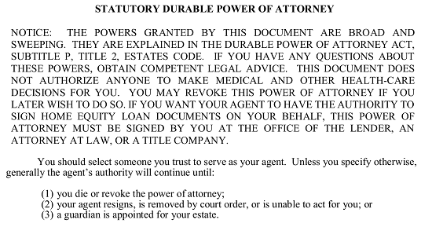
Review of Texas Statutory Form

Slide 14
Key Decisions
Grant all powers
  Special concern about electronic communication contents
Compensation
Co-agents
Special instructions
  Not sell specifically gifted items
  Pet care
When effective – immediately or springing
Hot powers

Slide 15
Disability Planning for Property
[continued]

Slide 16

Technique already covered
Durable Power of Attorney for Property

Slide 17
Self-Designation of
Guardian of Estate

Slide 18
Overview
Avoid statutory order by naming your own preferences.
Correlate with durable power of attorney
  Same person deals with property
  Reduce circumvention of DPA
Disqualification

Slide 19
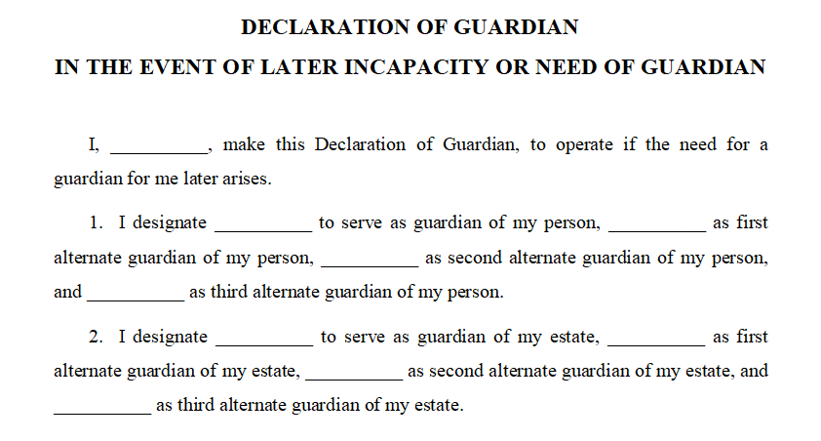
Review of Texas Statutory Form

Slide 20
Key Decisions
Persons to appoint
Persons to disqualify
Same or different person than guardian of the person

Slide 21
Custodial Trusts
Uniform Custodial Trust Act
    15 states
    Not Texas
Modeled after Uniform Transfers to Minors Act for adults

Slide 22
Basic Operation
Donor transfers property to trustee for beneficiary
  Donor cannot revoke but a competent beneficiary may.
  Beneficiary and Donor may be the same person.
If beneficiary competent, trustee must follow beneficiary’s instructions.
  Thus, trustee is actually acting like beneficiary’s agent.
If beneficiary incompetent, trustee uses property in a reasonably prudent manner for beneficiary and beneficiary’s dependents.

Slide 23
Disability Income Insurance
Disability reduces income and increases expenses.
This insurance provides payments upon disability to compensate for lost income.

Slide 24
Compared to Social Security
Social Security definition of disabled is stricter.
  Unable to work in any gainful employment
Insurance may define disability as being unable to work at your prior job.
Social Security benefits are low compared to insurance.

Slide 25
Sources
Employer
Organizations
  Bar associations, alumni groups, civic groups, fraternities/sororities, etc.
Insurance agent

Slide 26
Key Provisions
Premiums
Definition of disability
Waiting period
  Short term
  Long term
Benefit amount
Adjustment for inflation
Total time or payout limits
Renewability
Reliability of insurer
Coverage if preexisting condition

Slide 27
Income Tax Warning
Pay premiums yourself
  Do not let employer pay as a fringe benefit.
If insured pays the premiums, proceeds are income tax free.

